Slide 1
Introduction & Purpose
Iowa SMR Task Force
Workforce & Readiness Status Update
Presenters
Anne M. Lucietto, PhD – Workforce Development Section Lead
William Boyer – Research & Analysis Support Workforce Development
Purpose of Today’s Update
Summary of Findings
Initial Recommendations
Notes:
The purpose of this workforce development assessment is to provide ESN and the State of Iowa with a detailed, evidence-based understanding of how Iowa’s existing workforce assets could support future nuclear deployment, and to identify areas where proactive planning and targeted investment will be required.
A central objective of this effort is to move beyond conventional workforce analyses that focus primarily on aggregate labor availability.
Accordingly, this assessment is designed to help decision-makers understand not only whether Iowa has sufficient workforce capacity, but how that workforce could be mobilized, trained, credentialed, and sustained to meet the unique demands of nuclear construction, operations, and oversight.

Slide 2
Scope of work completed
Scope
Alignment Priorities
Integrates multiple dimensions of Workforce Readiness
Occupational demand and skills transferability
Perspectives from industry, labor, and education stakeholders
Cultural and organizational workforce dynamics
Near-term actions and longer-term structural requirements
Decision-relevant insight
Institutional coordination
Credibility with external partners
Notes:
Rather than conducting a high-level scan, this assessment intentionally integrates multiple dimensions of workforce readiness.
Occupational demand and skills transferability
The analysis considers how skills from Iowa’s existing sectors such as energy generation, advanced manufacturing, construction, engineering, and operations could translate into nuclear workforce roles. Interviewees frequently noted that many core competencies already exist in Iowa but would require formal alignment with nuclear standards, certifications, and regulatory expectations.
Perspectives from industry, labor, and education stakeholders
Stakeholder interviews revealed differing but complementary priorities. Employers emphasized reliability, safety culture, and procedural rigor; labor representatives focused on apprenticeship pathways, flexible availability, and long-term career stability; and educational institutions highlighted the need for early curricular alignment and instructor readiness. This assessment incorporates these perspectives to reflect the full workforce ecosystem.
Cultural and organizational workforce dynamics
Interviews highlighted that nuclear work environments demand strong procedural discipline, cross-functional coordination, and an ingrained safety culture. Several participants observed that Iowa’s workforce culture—characterized by low turnover, strong institutional loyalty, and experience operating in regulated environments—could represent a comparative advantage if properly leveraged.
Near-term actions and longer-term structural requirements
Stakeholders consistently stressed the importance of sequencing. Near-term actions include awareness-building, curriculum mapping, and identifying transferable credentials, while longer-term needs include sustained training pipelines, faculty development, and institutional partnerships capable of supporting nuclear deployment over multiple decades.
Decision-relevant insight – Participants emphasized that state leaders and project developers need clarity on where Iowa is well-positioned today versus where early investments would materially reduce risk.
Institutional coordination – Interviews revealed strong interest in clearer linkages among employers, unions, community colleges, universities, and state agencies, which this assessment is structured to inform.
Credibility with external partners – Several stakeholders noted that demonstrating a thoughtful, integrated workforce strategy will be essential for engaging reactor developers, federal partners, and regulators.

Slide 3
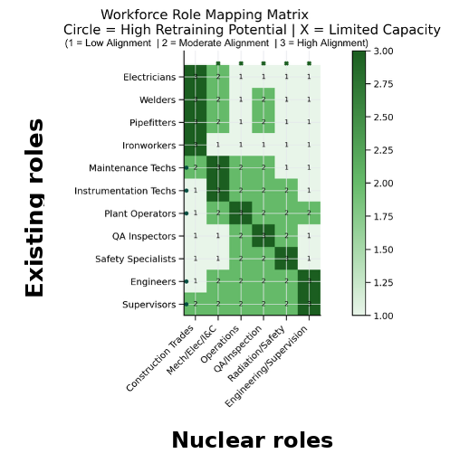
Nuclear-Relevant Workforce Identified in iowa
X
X
X
X
X
Workforce Role Mapping
Maps existing jobs → nuclear roles
Highlights retraining potential
Identifies gaps
Key Takeaways: The nuclear-relevant workforce landscape is assessed not as an abstract labor-market exercise but as a practical planning challenge tied to how Iowa’s workforce operates today and how it could evolve to support nuclear deployment in the future.
Notes:
Interviewees repeatedly emphasized, however, that skill transferability should not be assumed to be automatic. Nuclear work introduces additional regulatory requirements, documentation rigor, and cultural expectations that exceed those of most non-nuclear industries.
Stakeholders emphasized that such a tool would be particularly valuable in early planning stages, when uncertainty remains high but strategic signaling and preparatory investments can meaningfully reduce future risk.
This perspective underscores the importance of structured transition pathways—such as bridge training, credential alignment, and supervised experience—rather than relying on informal or ad hoc worker movement.

Slide 4
Skill Area | Existing Iowa Skill Sources | Relevant Credentials (Current) | Additional Nuclear‑Specific Additions
Electrical Installation & Maintenance | Electricians, industrial maintenance | Journeyman Electrician, NCCER, IEC | Nuclear safety culture, procedural compliance
Welding & Fabrication | Welders, pipefitters | AWS welding certs, union credentials | Nuclear QA documentation, code compliance
Mechanical Systems | Millwrights, maintenance techs | Industrial maintenance certs | Configuration control, work package execution
Instrumentation & Controls | I&C technicians, automation techs | Control systems certificates | Nuclear I&C standards, system testing
Operations & Process Control | Power plant operators | NERC, process ops credentials | Reactor operations fundamentals
Radiation Protection | Health physics techs | Radiation safety training | Nuclear radiation protection standards
Safety & Quality | EHS, QA/QC professionals | OSHA, ISO, QA certs | Nuclear QA (10 CFR Appendix B concepts)
Engineering Analysis | Mechanical / Electrical Engineers | ABET engineering degrees | Nuclear design basis, configuration management
Planning & Scheduling | Industrial planners | PMP, scheduling certs | Outage planning, nuclear work sequencing
Training & Instruction | Technical instructors | Instructor certifications | Nuclear training accreditation standards
Key Takeaways: Most nuclear skills already exist in Iowa
Notes:
This table shows how existing Iowa workforce skills align with nuclear‑relevant credentials, and where additional “nuclear lens” training is needed. It is designed to guide education partners, unions, and policymakers, not reactor vendors
The gap is context, regulation, and culture, not core ability
Many credentials are adaptable, not replaceable

Slide 5
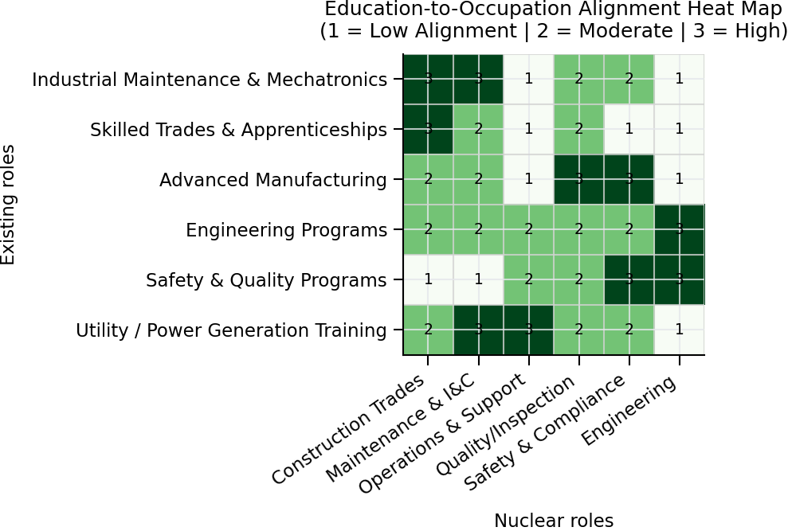
Education & Workforce partner capacity
Existing Capabilities
Industrial maintenance and mechanical systems
Welding, fabrication, and materials handling
Engineering and applied technology programs
Safety, quality assurance, and procedural compliance training
Nuclear workforce development is less about inventing new educational pathways and more about strategically enhancing and contextualizing existing ones.
Notes:
Interviews consistently emphasized that Iowa is not starting from zero: many foundational technical competencies required for nuclear roles are already embedded within existing programs.
Stakeholders noted that graduates from these programs already possess many of the technical and behavioral competencies required in nuclear environments, such as adherence to procedures, attention to detail, and familiarity with regulated work settings.
Interviewees also highlighted the advantage of Iowa’s established relationships between educators, employers, and labor organizations, which can facilitate rapid adaptation if nuclear deployment becomes a defined priority.
Industrial maintenance and mechatronics credentials - AAS in Automation/Mechatronics/Robotics
Kirkwood Industrial Maintenance Technology AAS
DMACC Industrial Technician (Focus of maintenance technician)
ALPLA Mechatronics Apprenticeship – Kirkwood + ICATT
Industry Consortium for Advanced Technical Training (ICATT)

Slide 6
Education & Workforce partner capacity
Faculty, Facilities, and Credentialing Considerations
Interview Findings
Faculty readiness and availability
Facilities and equipment
  IBEW 405 (Cedar Rapids) – Currently has ~240 apprentices with a growth of between 10 and 25% over the last 5 years
  Pipefitters (Des Moines) – Currently has ~200-300 apprentices with a growth of between 15 and 30% over the last 5 years
Credentialing and alignment
  10 CFR 50.120
  Systematic Approach to Training (SAT)
Leverage before building
Sustainability over speed
Credibility with industry and regulators
Nuclear workforce development requires institutional commitment and planning, not one-time curriculum updates.
Iowa is positioned to make informed decisions about when incremental adjustments are sufficient and when more substantial institutional investments will be required to support nuclear deployment.
Notes:
Faculty readiness and availability – Instructors must be trained not only in nuclear concepts but also in nuclear regulatory culture, documentation standards, and safety philosophy. Several respondents stressed that faculty development timelines are often underestimated.
Facilities and equipment – Access to specialized labs, mock-ups, or simulation tools—particularly for instrumentation, control systems, and radiation protection—was cited as a limiting factor for some institutions.
Credentialing and alignment – Stakeholders emphasized the importance of aligning educational credentials with industry-recognized standards, regulatory expectations, and, where applicable, union apprenticeship requirements to ensure portability and credibility.
Leverage before building – Stakeholders encouraged the state to build upon existing programs and partnerships rather than creating parallel nuclear-specific systems.
Sustainability over speed – Education leaders consistently warned against short-term solutions that do not account for faculty pipelines, accreditation, and long-term funding stability.
Credibility with industry and regulators – Participants noted that workforce programs must be viewed as credible by reactor developers and regulators alike, which requires more than technical competence—it requires cultural alignment with nuclear norms.

Slide 7
Identified Workforce Development gaps & Strategy
Near‑Term Actions
Longer‑Term Actions
Align existing curricula with nuclear‑relevant competencies
Upskill faculty
Conduct outreach to adjacent sectors
Introduce cross‑disciplinary training
Develop faculty pipeline
Define nuclear‑specific credential pathways
  10 CFR 50.120
  ASME NQA-1
Build training infrastructure
Coordinate multi‑year workforce pipeline
Key Takeaways: By grounding both near‑ and long‑term strategies in interview insights, this framework positions Iowa to advance workforce readiness in a manner that is credible, flexible, and responsive while preserving the ability to scale if nuclear deployment proceeds.
Notes:
Translating the findings from prior workforce, education, and collaboration analyses into a practical strategy framework that distinguishes between actions Iowa can initiate in the near term and structural investments that will require longer‑term planning and coordination.
While Iowa possesses many underlying workforce strengths, readiness for nuclear deployment will depend on intentional sequencing rather than reactive or piecemeal action.
Absence of a clear strategy even in the presence of strong baseline capacity—could create delays, inefficiencies, or credibility challenges if nuclear deployment opportunities advance quickly.
Near‑term actions that can be initiated with existing institutions, programs, and partnerships
Longer‑term structural needs that require sustained investment, coordination, and policy alignment
Align existing curricula with nuclear‑relevant competencies
Education partners emphasized that modest curriculum adjustments—such as embedding nuclear context, documentation rigor, and safety culture examples—could significantly enhance relevance without redesigning entire programs.
Upskill faculty and instructors
Interviewees consistently noted that early investment in faculty awareness and professional development would improve program credibility and shorten future ramp‑up timelines.
Conduct outreach to workers in adjacent sectors
Stakeholders encouraged proactive engagement with workers in advanced manufacturing, utilities, and industrial construction to raise awareness of nuclear opportunities and requirements, countering inaccurate assumptions about accessibility.
Introduce cross‑disciplinary orientation training
Even short, introductory training experiences that bring multiple roles together were viewed as effective in reinforcing shared expectations and preparing workers for nuclear environments.
Stakeholders also identified a set of structural workforce development needs that cannot be addressed through short‑term adjustments alone.
Faculty pipeline development
Interviewees emphasized the importance of developing a durable pipeline of instructors with nuclear familiarity, noting that reliance on a small number of subject‑matter experts creates fragility.
Nuclear‑specific credential pathways
Stakeholders identified the need for clearly defined credentials—stackable where possible—that align education, industry expectations, regulatory requirements, and labor structures.
Training infrastructure and facilities
Over time, access to specialized laboratories, simulators, and mock‑ups was viewed as increasingly important for credibility and experiential learning, particularly for operations, instrumentation, and safety roles.
Multi‑year workforce pipeline coordination
Participants stressed that nuclear workforce development requires coordination across education, labor, employers, and state agencies to align enrollment, graduation timing, hiring needs, and regulatory milestones.
Distinguishing what can be done now from what must be built deliberately
Reducing risk associated with premature or misaligned investment
Creating a common planning framework that can be updated as deployment scenarios become clearer

Slide 8
Conclusion
Key Themes
The importance of functional, capability‑based workforce analysis
The presence of strong baseline workforce and education assets in Iowa
The need for intentional skill transfer pathways and integrated training
The value of sequencing actions to align with evolving deployment timelines
Closing message: By combining evidence‑based analysis with stakeholder perspectives, Iowa is positioned to move forward with nuclear workforce planning in a way that is credible, flexible, and strategically grounded.
Notes:
Across all objectives, interview insights were intentionally integrated to ensure that findings reflect not only theoretical workforce capacity, but the practical realities of implementation within regulated, safety‑critical environments.
By combining evidence‑based analysis with stakeholder perspectives, this report positions Iowa to move forward with nuclear workforce planning in a way that is credible, flexible, and strategically grounded.

Slide 9
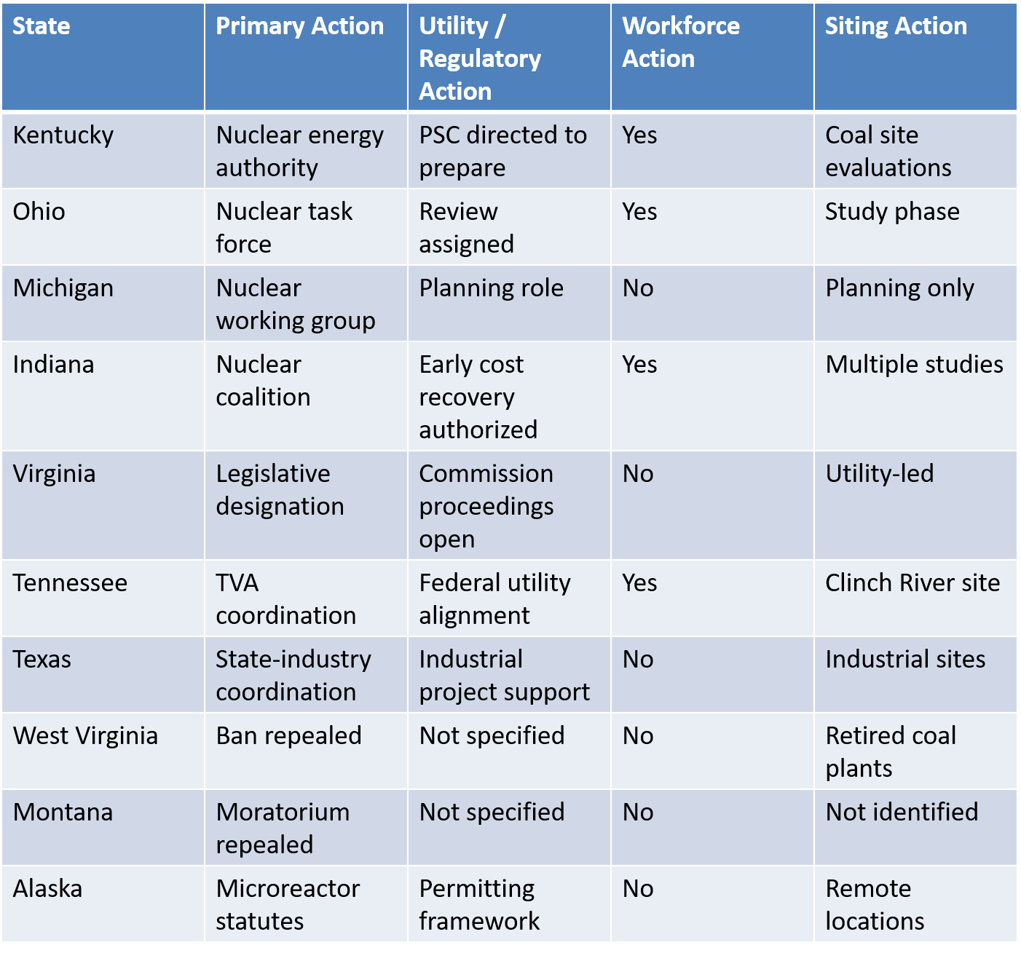

Slide 10
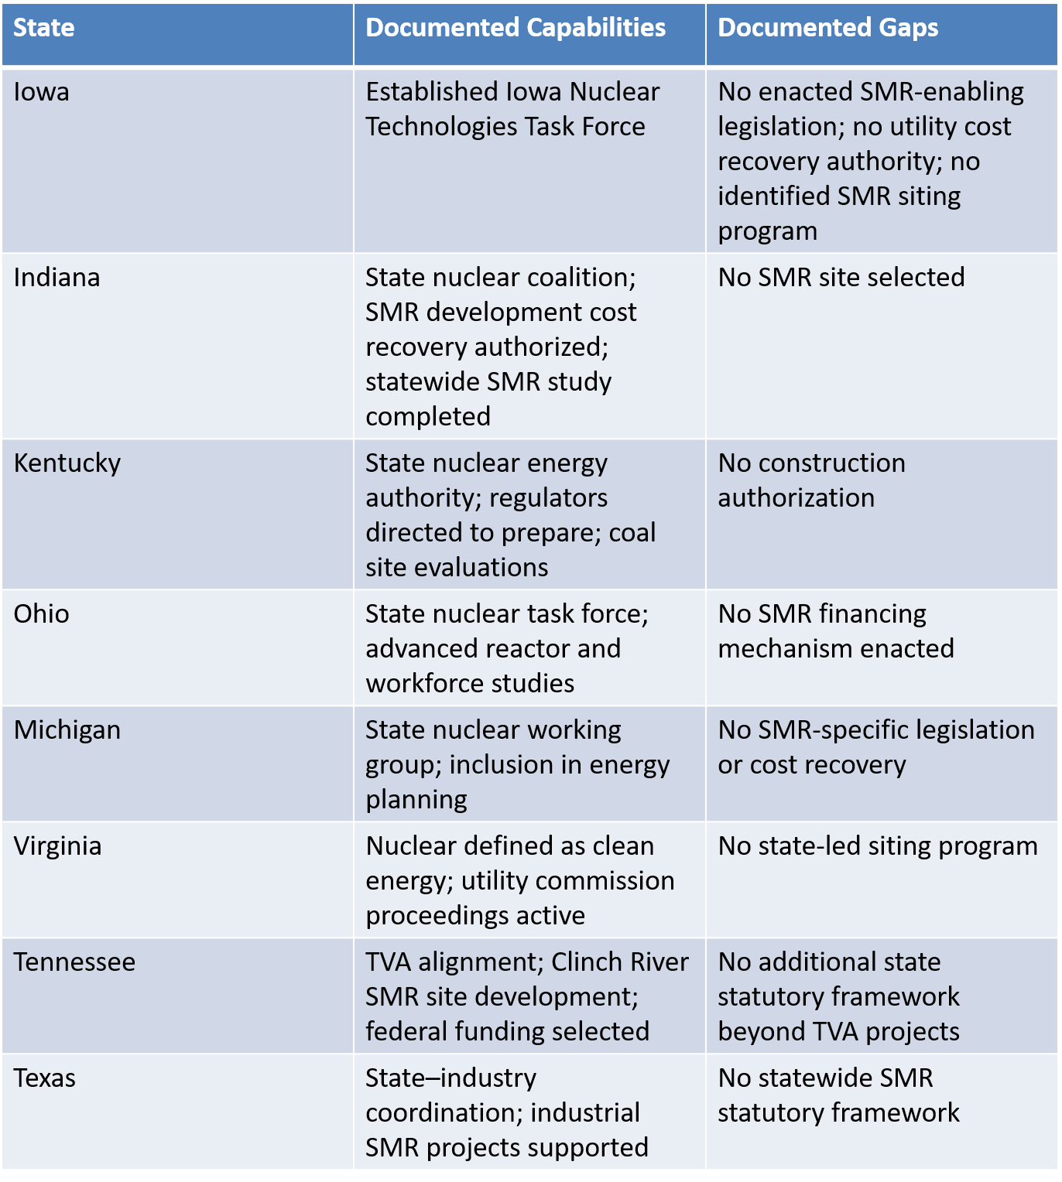

Slide 11
Thank you!

Slide 12
Extra Slides

Slide 13
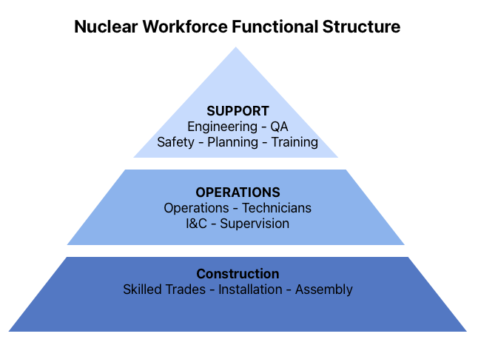
Nuclear-Relevant Workforce Identified in Iowa
Role Categories and Functional Groupings
Skilled construction trades (e.g., electricians, welders, pipefitters, ironworkers)
Mechanical, electrical, and instrumentation technicians
Operations and control room support roles
Quality assurance, inspection, and documentation specialists
Radiation protection and industrial safety roles
Engineering, planning, and supervisory positions
Key Takeaways: Strong potential for lateral workforce movement into nuclear-relevant roles from adjacent sectors where procedural discipline, safety culture, and technical rigor are already embedded.
Notes:
Objective is to establish a clear, functionally grounded understanding of the workforce roles required to support nuclear construction, operations, and maintenance in Iowa, and to assess the degree to which those roles align with the state’s existing labor base. Interviews conducted for this assessment consistently indicated that early-stage nuclear workforce planning is most effective when it focuses on capabilities and functions rather than narrowly defined nuclear job titles.
“If you strip away the label ‘nuclear,’ a lot of these roles already exist across Iowa industry.”
Rather than focusing narrowly on nuclear-specific job titles, this assessment examined functional role categories required across the nuclear project lifecycle, including construction, operations, and maintenance.
Stakeholders across sectors affirmed that many of these roles are already present in Iowa’s economy, particularly in construction, utilities, manufacturing, and regulated industrial environments.

Slide 14
Functional Category | Description (What the Function Does) | Representative Roles | Primary Iowa Talent Sources
Skilled Construction Trades | Execute physical construction, installation, and assembly under strict specifications and QA requirements | Electricians, welders, pipefitters, ironworkers, carpenters | Union trades, industrial construction, infrastructure projects
Mechanical & Electrical Technicians | Maintain and operate plant systems, equipment, and machinery | Maintenance technicians, millwrights, electrical techs | Manufacturing, utilities, industrial maintenance
Instrumentation & Controls (I&C) | Install, calibrate, and maintain control systems and instrumentation | I&C technicians, automation specialists, control system techs | Advanced manufacturing, process industries, automation sectors
Operations & Control Room Support | Monitor plant systems, execute procedures, and maintain operational safety | Plant operators, system operators, control room staff | Power generation, ethanol plants, industrial operations
Quality Assurance & Inspection | Ensure all activities meet regulatory, safety, and documentation standards | QA/QC inspectors, auditors, document control specialists | Manufacturing QA, construction QA/QC, regulated industries
Radiation Protection & Industrial Safety | Protect workers and environment from hazards; ensure regulatory compliance | Radiation protection technicians, safety officers, EHS professionals | Health physics, safety programs, industrial EHS roles
Engineering & Technical Analysis | Design systems, analyze performance, and ensure compliance with safety and regulatory requirements | Mechanical engineers, electrical engineers, nuclear engineers, system analysts | Universities, engineering firms, utilities
Planning & Scheduling | Coordinate work activities, outages, and construction timelines | Project planners, schedulers, outage coordinators | Construction management, industrial project planning
Supervision & Work Management | Oversee teams, enforce procedures, coordinate across disciplines | Supervisors, foremen, work control managers | Trades leadership, plant supervision roles
Training & Workforce Development | Deliver technical training, ensure qualification and requalification of workforce | Technical instructors, training coordinators | Community colleges, union training centers, corporate training
Notes:
Objective is to establish a clear, functionally grounded understanding of the workforce roles required to support nuclear construction, operations, and maintenance in Iowa, and to assess the degree to which those roles align with the state’s existing labor base. Interviews conducted for this assessment consistently indicated that early-stage nuclear workforce planning is most effective when it focuses on capabilities and functions rather than narrowly defined nuclear job titles.
“If you strip away the label ‘nuclear,’ a lot of these roles already exist across Iowa industry.”
Rather than focusing narrowly on nuclear-specific job titles, this assessment examined functional role categories required across the nuclear project lifecycle, including construction, operations, and maintenance.
Stakeholders across sectors affirmed that many of these roles are already present in Iowa’s economy, particularly in construction, utilities, manufacturing, and regulated industrial environments.

Slide 15
Cross-disciplinary collaboration and integrated training
Identified Opportunities
Integrated Training Opportunities
Expand joint training experiences across roles
Implement scenario‑based simulations involving multiple roles
Enhance opportunities for shared safety and system‑level learning
Introduce shared safety and quality instruction
Provide common introductions to nuclear regulatory frameworks
Establish clear protocols for communication and decision‑making
Improve clarity regarding responsibilities and constraints
Key Takeaways: Workforce readiness for nuclear deployment is not solely a matter of occupational supply or educational capacity, but also of system integration and organizational behavior.
Notes:
Unlike many conventional industrial settings, nuclear operations depend on tightly coupled interactions among engineers, operators, technicians, and skilled trades, all working within a shared framework of safety expectations, procedural discipline, and decision authority.
While Iowa’s workforce was generally viewed as technically capable and safety‑minded, interviewees noted that existing training and education models often reinforce role‑specific expertise at the expense of shared understanding.
Limited joint training experiences across roles
Training pathways are typically siloed by occupation, with few opportunities for engineers, technicians, operators, and trades to train together or understand each other’s constraints and decision frameworks.
Improve clarity regarding responsibilities and constraints
Interviewees described situations in other industries where incomplete understanding of role boundaries or regulatory obligations led to friction, inefficiency, or elevated risk—conditions viewed as particularly problematic in nuclear environments.
Enhance opportunities for shared safety and system‑level learning
Stakeholders noted that safety culture is strongest when it is reinforced collectively, not individually. Separate training tracks can dilute shared ownership of system performance and safety outcomes.
Gaps were not framed as failures but as structural limitations of conventional workforce preparation models that may be insufficient for nuclear deployment without intentional modification.
Introduce shared safety and quality instruction
Joint training on nuclear safety culture, quality assurance principles, and procedural compliance was viewed as foundational to building trust and mutual accountability.
Provide common introductions to nuclear regulatory frameworks
Stakeholders emphasized the value of ensuring all roles—not just engineers or compliance personnel—understand the regulatory environment shaping nuclear work, including documentation requirements and conservative decision‑making expectations.
Implement scenario‑based simulations involving multiple roles
Interviewees highlighted the effectiveness of simulations that require coordination among engineers, operators, and trades, allowing participants to see how their actions affect system‑level outcomes.
Establish clear protocols for communication and decision‑making
Integrated training was seen as an opportunity to practice escalation pathways, peer checks, and cross‑role communication under controlled conditions.
Interview findings reinforce that nuclear performance emerges from interactions across roles, not isolated excellence within them.

Slide 16
Alignment with plausible Deployment timelines
Early preparation without irreversible commitment
Scalable growth as timelines clarify
Flexibility in the face of uncertainty
Key Takeaways: The proposed workforce strategy reflects these principles by sequencing actions in phases that correspond to increasing levels of deployment certainty, ensuring alignment between preparation and demand.
Notes:
Early preparation without irreversible commitment - Interviewees supported low‑regret actions—such as curriculum alignment, faculty upskilling, and cross‑disciplinary orientation training—that build readiness while preserving optionality.
Scalable growth as timelines clarify - Participants emphasized the importance of designing training pathways and institutional partnerships that can expand incrementally as project milestones are reached, rather than relying on sudden, large‑scale workforce mobilization.
Flexibility in the face of uncertainty - Given uncertainty related to siting decisions, reactor technology selection, and federal licensing timelines, stakeholders stressed that workforce strategies must be adaptable, not tied rigidly to a single deployment assumption.
How Iowa’s nuclear workforce development strategy aligns with plausible deployment timelines and to ensure that preparation activities are neither prematurely accelerated nor delayed in ways that could increase implementation risk.
Stakeholders consistently emphasized that workforce readiness must be deliberately sequenced to match evolving project timelines, regulatory milestones, and technology decisions.
Drawing on interview feedback, the analysis considers how preparation efforts can be structured to support early readiness signals, scalable ramp‑up, and flexibility as timelines evolve. Misalignment—either by acting too late or committing too early—poses real risks to cost, schedule, and credibility.
By grounding timing considerations in stakeholder experience, this provides the State of Iowa with a framework for pacing workforce investments in ways that:
Reduce the risk of workforce shortages or delays
Avoid stranded or underutilized training capacity
Demonstrate maturity and realism to developers, regulators, and federal partners

