Slide 1
Iowa Nuclear Energy Task Force Meeting 5
May 18, 2026

Slide 2
Ad-hoc Fact-Based Questions
Description
  Questions that were asked by the Task Force as relevant to the policy recommendation decision-making that have a fact-based answer
Questions
  The nature and timing of Iowa’s projected load growth
  Reactors’ ability to meet Iowa’s grid needs
  Benefits of load growth
  Tax implications of a new reactor
  Other states’ waste policies
  What are the environmental impacts and benefits of nuclear power
  What are other states’ approaches to education (public, K-12, AHJs, higher ed)

Slide 3
The Nature and Timing of the impending Load Growth

Slide 4
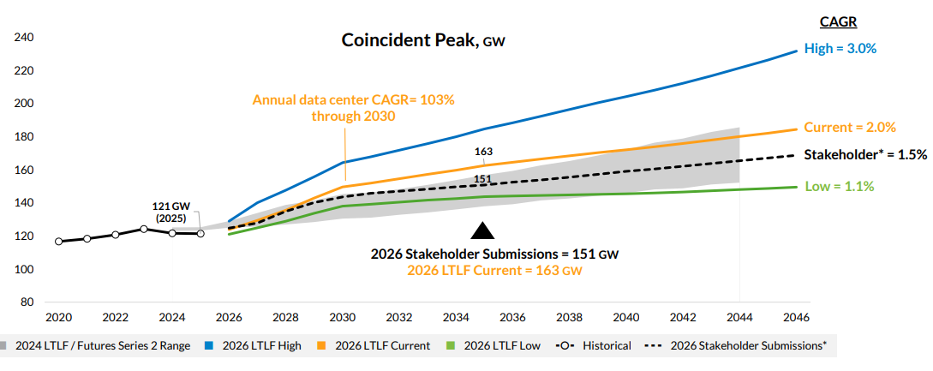
MISO Predicts Load Growth footprint-wide (2026)
In Report Draft
2026 LTLF increased to 2% CAGR through 2046, up from 1.6% in 2024
3% CAGR in first 4 years
Change in forecast was driven by datacenter expansion
Source: Presentation. MISO Long-Term Load Forecast. April 2026

Slide 5
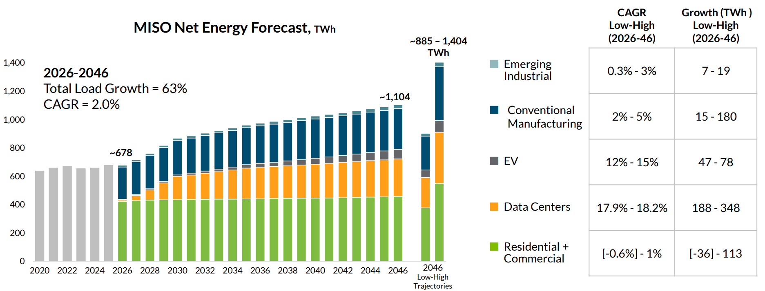
MISO’s predicted load growth driven by data centers (2026)
In Report Draft
Source: Presentation. MISO Long-Term Load Forecast. April 2026

Slide 6
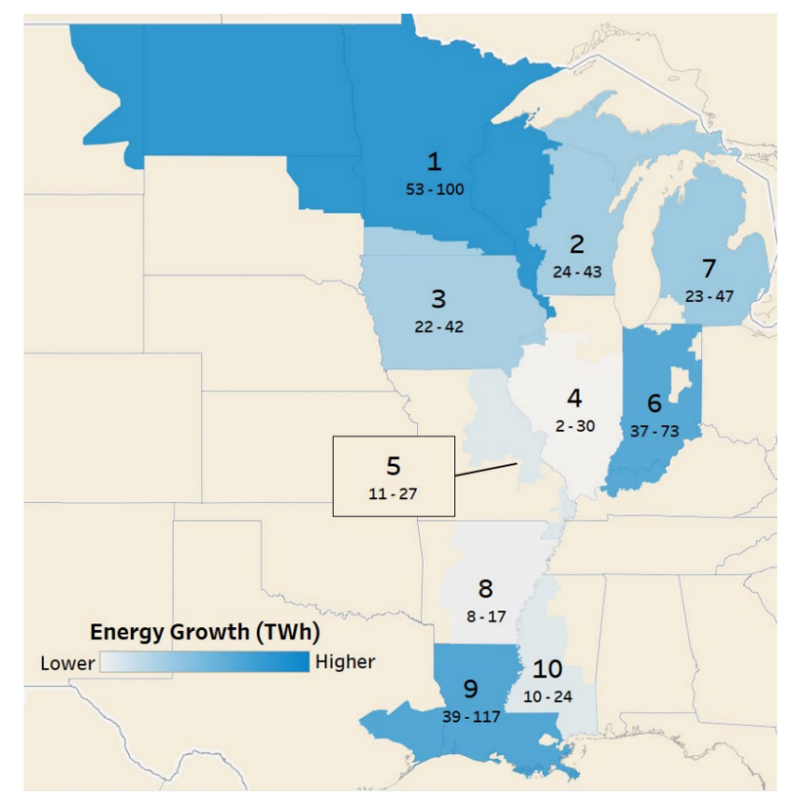
MISO Predicts Average Load Growth in Iowa (2024)
In Report Draft - Partly
“LRZs 3 (Iowa and Southern Minnesota) and 5 also exhibit data centers as the primary source of incremental demand”
LRZ 3 has a 2.8% 20-yr CAGR
“Within the next 18–24 months, MISO is tracking 31 publicly announced data center projects, which are expected to contribute roughly 8–14 GW of potential data center additions, with many of these projects more than 250 MW per phase. Some notable data center projects include QTS Big Cedar in LRZ 3, Google Project Louie in LRZ 6, and AWS Madison County in LRZ 10.”
2024-2044 Forecast Incremental Load Growth
Source: Informational Document. Existing Large Load and New Additions. Updated December 2024.
Source: Whitepaper. MISO Long-Term Load Forecast. December 2024.

Slide 7
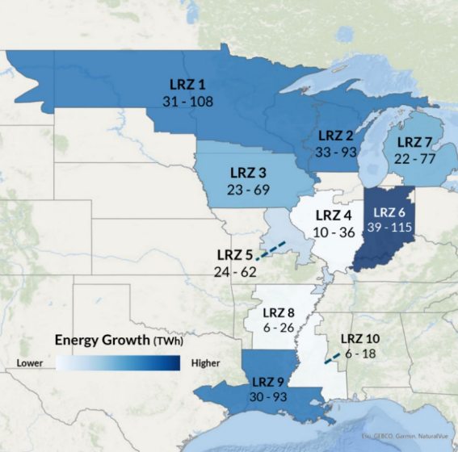
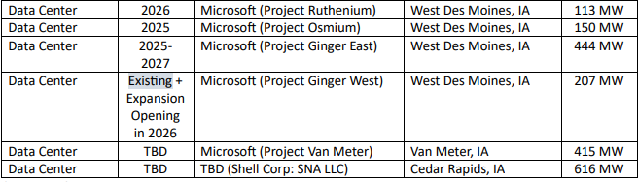
MISO Predicts Average Load Growth in Iowa (2026)
2026-2046 Forecast Incremental Load Growth
“Similarly, LRZ 3 (Iowa) will continue to attract data centers in the Des Moines area due to low construction costs, ample wind energy, and strong telecommunications infrastructure, with additional demand coming from ethanol refineries that benefit from fuel-blending requirements.”
Source: Informational Document. Existing Large Load and New Additions. Updated December 2024.
Source: Whitepaper. MISO Long-Term Load Forecast. May 2026.

Slide 8
This is continuing a trend of Industrial Load Growth in Iowa
In Report Draft
Electricity Sales Growth in Iowa over the Past Decade, by End-Use Sector
Industrial sector load has grown by 41% over the past decade
Residential and commercial load have each grown by 10% over the decade
Source: EIA Electricity Data Browser

Slide 9
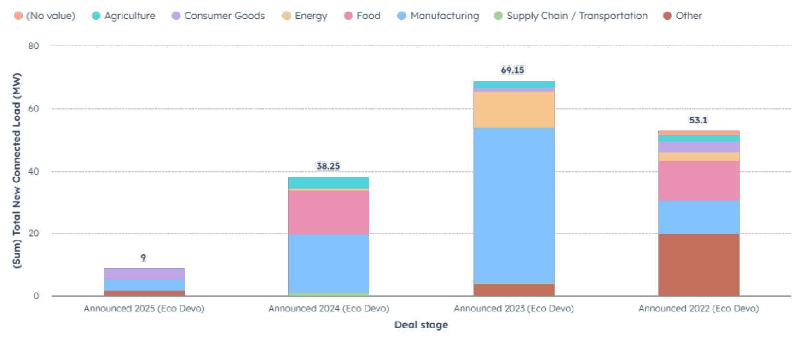
Large IOU’s in Iowa recent industrial growth
MidAmerican has already experienced significant growth from data centers
Alliant attributes most of its growth to manufacturing (see 2022-2025 announced projects)

Slide 10
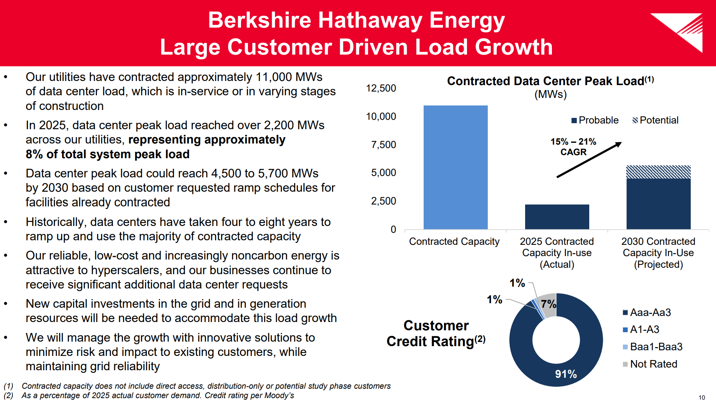
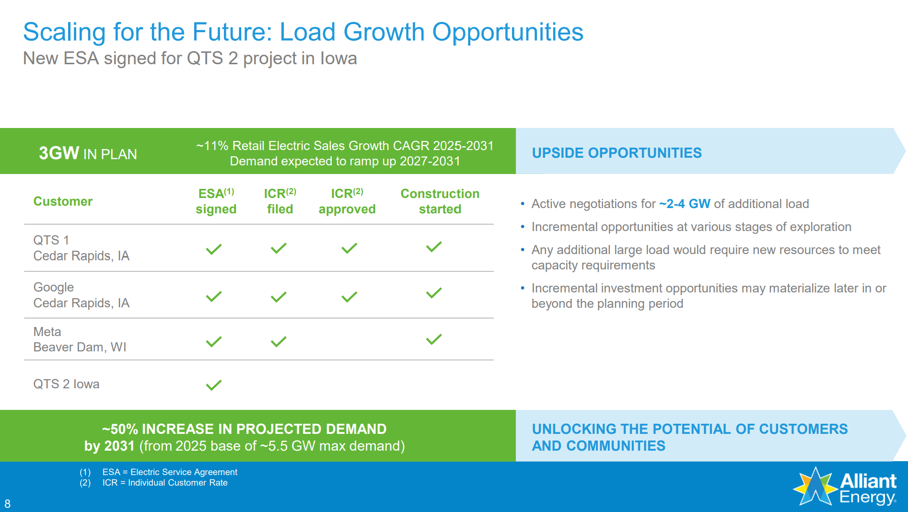
Large IOU’s in Iowa poised for future growth
Large IOU’s (together 75% of Iowa’s load) report expectations for data center load growth throughout their territories, which span multiple states.
2026 Investor Conference Presentation. Berkshire Hathaway. Accessed online.
Alliant Energy Corporation. Q1 2026 Investor Presentation. March 2026.
Notes:
In 2025, data center peak load reached over 2,200 MWs across our utilities, representing approximately 8% of total system peak load

Slide 11
Ability to meet the grid’s needs

Slide 12
Reactor’s Abilities to Meet Iowa’s Grids Needs:
Load Following
  Question: Iowa has a high penetration of wind and so often the utilities need generators that can follow the moving net load curve. TerraPower has a load-following capability, but what about the other nuclear generators?
  Further expanded this question: What about nuclear’s ability to provide capacity, another need of Iowa’s grid.

Slide 13
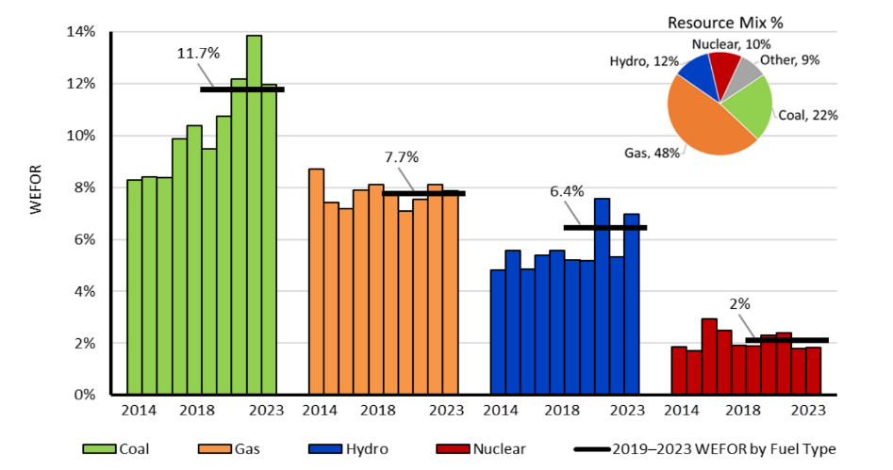
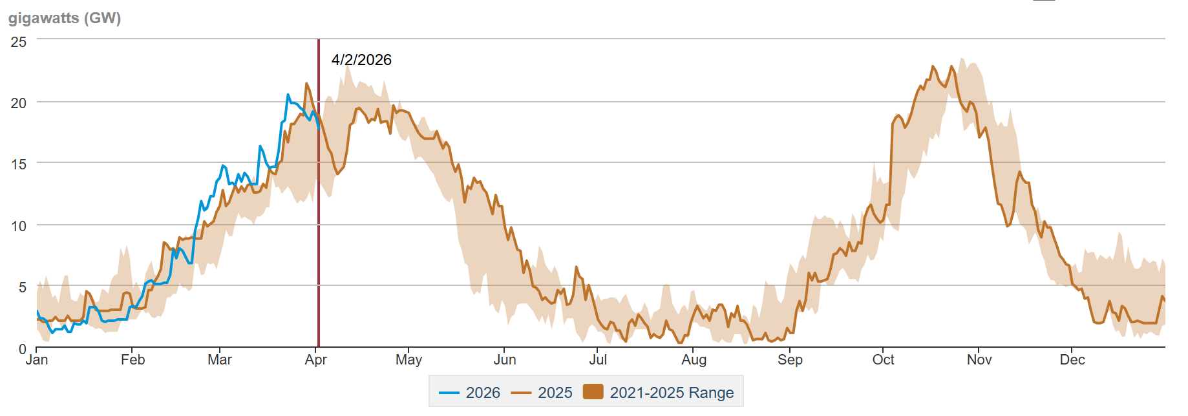
Capacity
In Report Draft
Nuclear Power Plants are reliable
  Overall annual uptime 91-93% over past 5 years
  Forced outages only 2% over 5 years 2019-2023
Forces Outage Rate in the USA 2014-2023 by fuel type
Nuclear Power Plant Outages by day of year

Slide 14
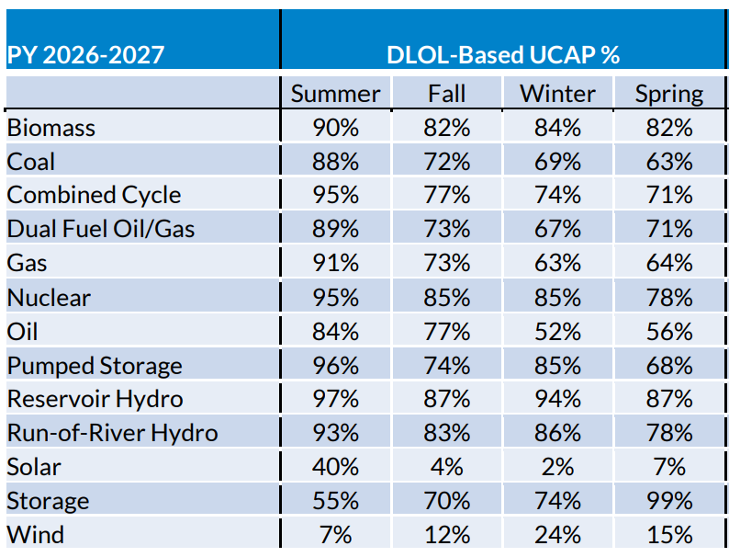
Capacity
Accordingly, MISO gives nuclear power plants a high accreditation for its capacity construct
  Higher accreditation than gas and coal in all four seasons
  Higher than combined cycle in 3 seasons and tied in summer
  Lower than reservoir hydro

Slide 15
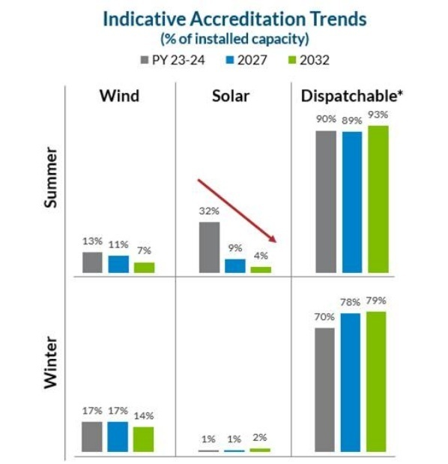
Lowering capacity accreditation leads to higher need
In Report Draft
Accreditation will continue to fall for solar and wind
Storage will have increased accreditation and then begin to fall
This will continue to create demand for capacity throughout the region
Additionally retirements will tighten capacity supply.
Figure 8: MISO Accreditation Changes

Slide 16
Loaf Following: Economics
Most of the costs are fixed
  Op ex is 22-41% of the LCOE
  Of the OpEx, most or all are fixed
Fixed Costs include
  Salaried employees
  Scheduled maintenance
  To large degree, fuel
Plant Operational Cost Breakdown, 2024
A lower power rate does not translate into a significant fuel saving. Due to the complexity of the neutron dynamics within the core (fission, absorption by all reactor materials, reactions, leaks, poisoning etc.), the proportionality between power produced and fuel consumed is not linear [5], [6]. Consequently running a power plant at 50% of its power does not save more than 4–5% of its cost, while the loss of revenue extends the recovery of the capital investment.
G. Locatelli, "Load following with Small Modular Reactors (SMR): A real options analysis," ScienceDirect, 27 December 2014. [Online]. Available: https://www.sciencedirect.com/science/article/abs/pii/S036054421401295X. [Accessed April 2024]

Slide 17
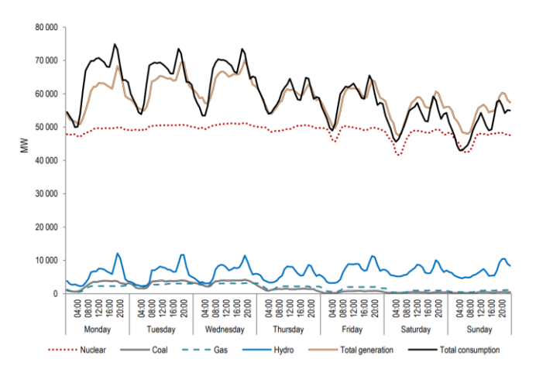
Load Following: Technical Capability
In Report Draft
Existing large LWR’s are capable of load following
It is rare, though in France, where 75% of generation is Nuclear, it does occur (See Figure)
“Still, this type of flexible operation can pose new operation and maintenance (O&M) challenges, Kpler acknowledges. Thermal cycling can lead to significant wear on reactor components, and temperature fluctuations could affect materials like steel and zirconium alloys used in the reactor pressure vessel, fuel cladding, steam generators, and piping. It also causes steam turbine erosion due to condensation, and it demands intricate control of reactor kinetics, particularly in adjusting neutron flux and reaction rates, with degradation impacts to control rods. It may even affect the uniformity of fuel burnup, leading to “suboptimal fuel use.”
https://www.powermag.com/how-nuclear-om-is-evolving-for-the-emerging-power-paradigm/ and Nuclear Energy Agency, "Technical and Economic Aspects of Load Following with Nuclear Power Plants." OECD. 2011

Slide 18
Reactor’s Abilities to Meet Iowa’s Grids Needs
In Report Draft
Westinghouse AP1000
15-100% range at 5%/minute
Nu Scale:
20-100% at 0.67%/minute, 10%/min (thermal)
Westinghouse, 26 9 2024. [Online]. Available: https://westinghousenuclear.com/energysystems/ap1000-pwr/overview/.
Rolls Royce SMR-300:
50-100% at 3-5%/minute
“The air-cooled condensers (wet cooled option shown below) are designed to accommodate 100% steam bypass of the turbine. The NPM is designed for load following using control rod motion and/or steam bypass.”
https://www.nrc.gov/docs/ML2521/ML25212A115.pdf
https://www.nuscalepower.com/hubfs/Website/Files/Technical%20Publications/nuscale-small-modular-reactor-integration-for-hydrogen-and-ammonia-production.pdf
https://www.nuscalepower.com/hubfs/Website/Files/Technical%20Publications/nuscale-smr-technology-an-ideal-solution-for-coal-plant-replacement.pdf
Holtec SMR 300
“No need to load-follow: SMR-300 can be configured to load follow which is inherently wasteful of energy. Instead, Holtec’s energy storage technology called the Green Boiler may be used to store the SMR plant’s surplus power and use it when needed to produce electricity or steam. “
https://holtecinternational.com/wp-content/uploads/2024/05/HTB-085-SMR-300-Rev-2.pdf

Slide 19
Reactor’s Abilities to Meet Iowa’s Grids Needs
In Report Draft
GE Vernova Hitachi’s BWRX-300:
50-100% at 0.5%/minute
Fuel use is tied to power production
X-Energy’s XE-100:
40-100% at 3%/minute
Some fuel saved when load following
“BWR core loadings are designed such that power maneuvering via control rod movement is performed within the BWR Fuel Operating Guidelines. The BWRX-300 core nuclear design can be improved for daily load following, using control rods only, while maintaining conformance with these guidelines. The BWRX-300 can maneuver from 100% and 50% power, with a ramp rate of +0.5%/minute, and return to full power with the same ramp rate, daily. The plant can reduce electric power at a faster rate by dumping steam to the condenser instead of using the main turbine/generator control valves. If dumping steam is expected to occur regularly for a particular plant, then an optional, higher capacity condenser is implemented.”
“Other Benefits: Ability to load follow (from 100% to 40% power within 20 minutes), making the plant complementary to maintaining a stable load on a grid that includes renewables.”
The technology load follows by limiting the helium flow rate. There are little to no fuel savings as the nuclear reaction will continue at the same rate
https://www.gevernova.com/content/dam/gevernova-nuclear/global/en_us/documents/carbon-free-power/005N9751-BWRX-300-General-Description.pdf
https://www.energy.gov/ne/articles/x-energy-developing-pebble-bed-reactor-they-say-cant-melt-down
5/5/2026 Discussion with Ron Marinzel

Slide 20
Reactor’s Abilities to Meet Iowa’s Grids Needs:
Load Following
In Report Draft
Kairos :
PENDING
TerraPower:
20% to 100% at 10%/minute
Stores up to 5.5 hours of energy
“Control elements adjust the reactor's power output.”
“The Natrium reactor and energy system architecture, recently introduced by TerraPower and GE Hitachi Nuclear Energy (GEH), offers baseload electricity output from a 345-MWe sodium fast reactor with the load-following flexibility of molten salt thermal storage. Stored heat can be used to boost the system’s output to 500 MWe for more than five and a half hours when needed, according to TerraPower.”
https://www.kairospower.com/technology
https https://www.ans.org/news/article-490/terrapowers-natrium-pairs-a-sodium-fast-reactor-with-heat-storage/

Slide 21
Benefits of Load Growth

Slide 22
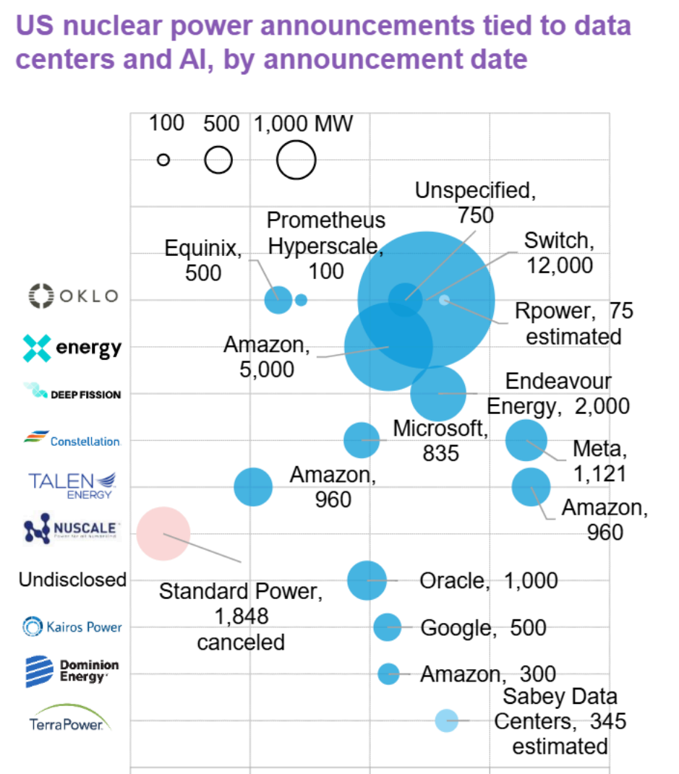
Data center alignment with nuclear
US datacenters will consume 60 TWh by 2026, or 6% of US total load), per IEA
Data centers’ needs align with new nuclear, and datacenters value nuclear at a premium
  Decarbonization requirements
  Large point-source loads (60 MW to GW scale)
  Difficulty interconnecting
  Access to capital
Technology companies are the major off-takers of all PPA’s. 43% of clean PPAs in 2024 from Google, Amazon, Meta, Microsoft.
New nuclear project announcements and restarts/relicensing projects are overwhelmingly tied to data center off-takers
Source: Diaz, Stephanie et. al. Developments in US Advanced Reactor Industry. Bloomberg New Energy Finance. June 23, 2025

Slide 23
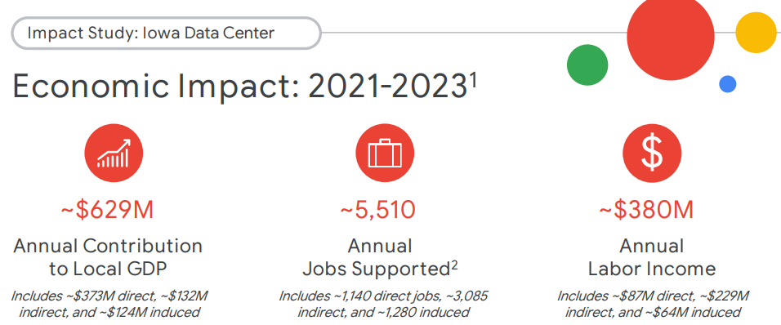
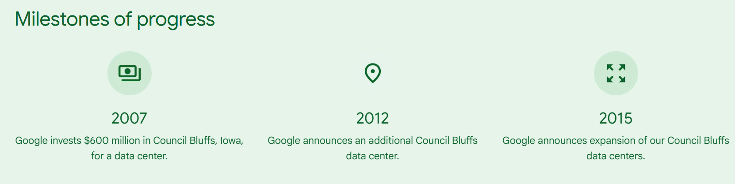
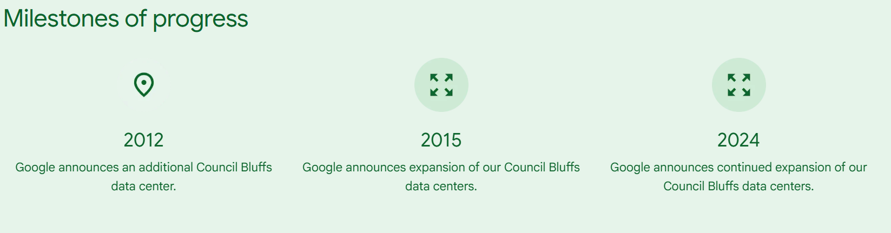
Data Center Impacts: Example Council Bluffs
Google has invested $5.5 Billion and announced $1 B more in 2024
Economic impact study was paid for by Google and does not break out construction versus operations jobs
Source: Google Economic Impact Report. https://www.gstatic.com/marketing-cms/3b/64/f40b9fe249dcb82912724229c834/2024-impact-study-iowa.pdf

Slide 24
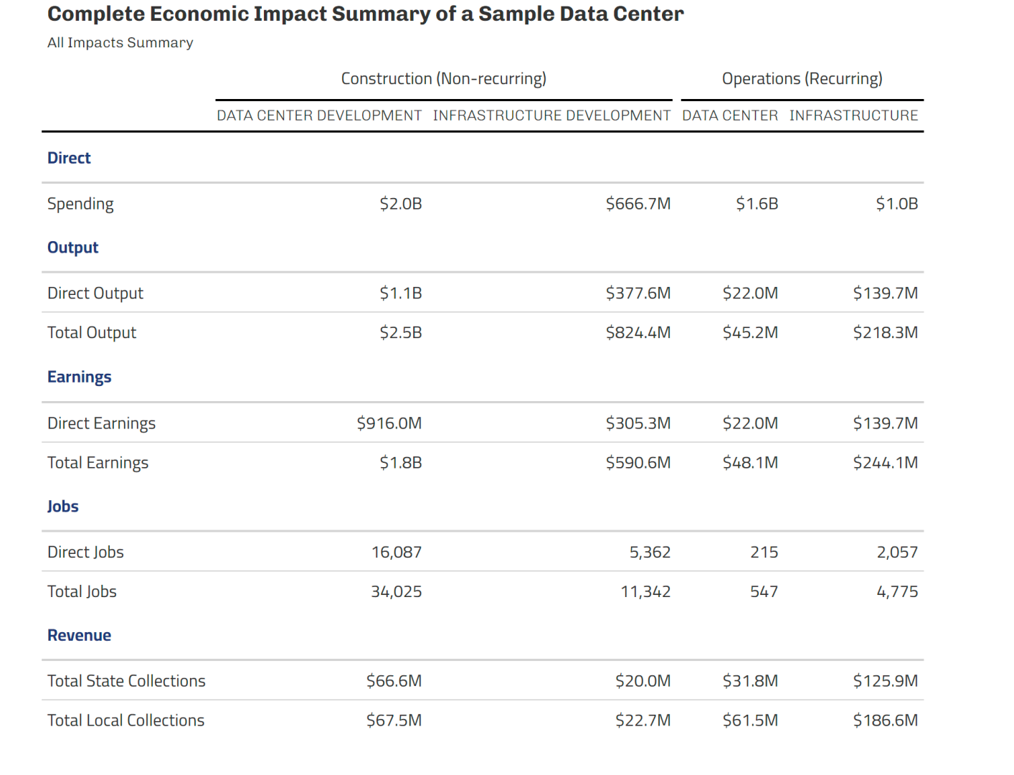
Data center benefits
Consumer Energy Alliance published estimates for a 1 GW-scale data center
Caution: the “double counting” might go both ways.
  Shown analysis includes “infrastructure investment”, such as power plants
https://consumerenergyalliance.org/cms/wp-content/uploads/2025/12/Economic-Impact-of-Data-Centers.pdf

Slide 25
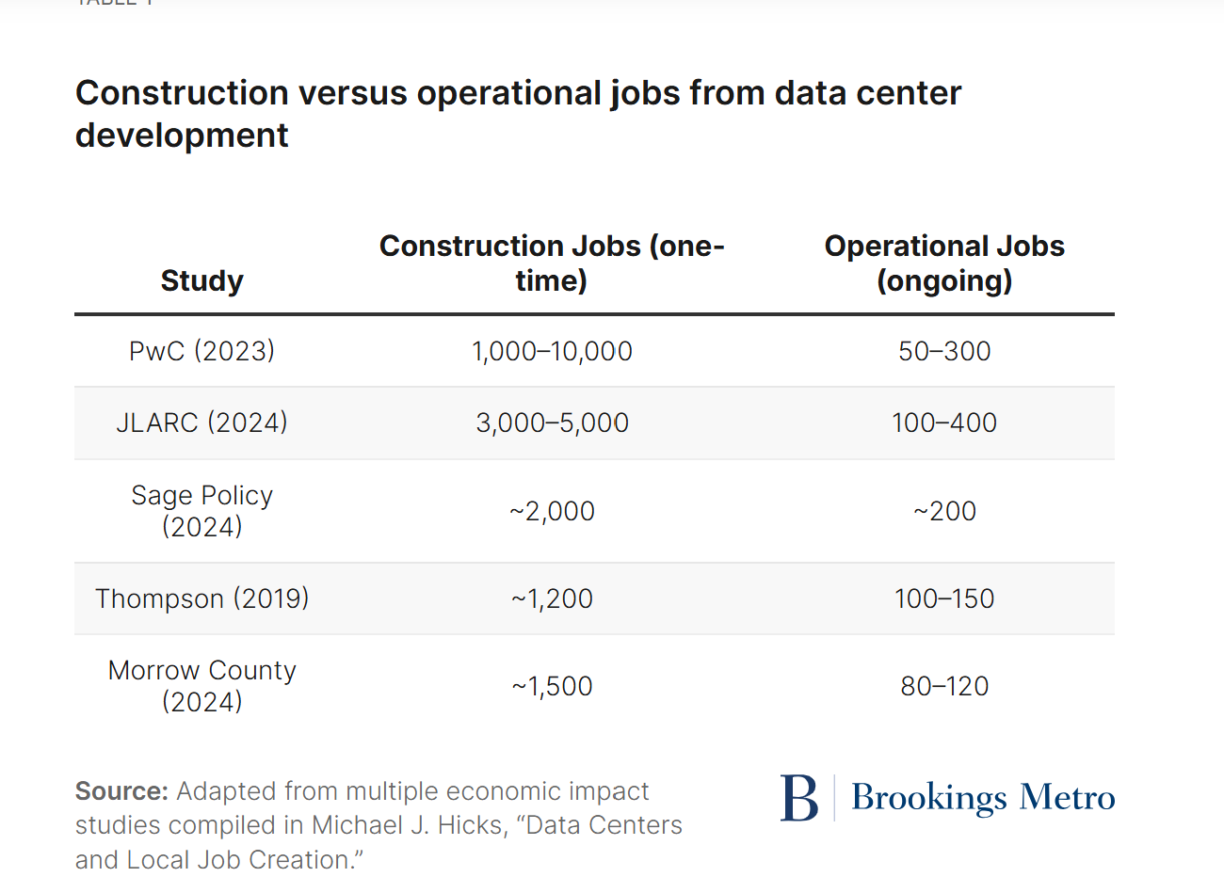
Data center benefits
No single resource, as with the INL study for nuclear power plant impact.
Varied by size, but also the particular use of the data center.
May require further research and specific studies on case-by-case basis for final refining

Slide 26
Tax implications of a new reactor

Slide 27
Construction: Income Tax
In Report Draft
TerraPower direct wages
  $409 million in direct wages
  Wyoming has no income tax
  At 3.8%, would be ~$15 million for Iowa
TerraPower indirect jobs
  3,000 job-years indirect
  Pay rate, wages not estimated
X-Energy
  $150 million earnings/year over 44 months
  Texas also doesn’t have income tax
  Fewer jobs/shorter construction time
  At 3.8% would be $5.7 million for Iowa

Slide 28
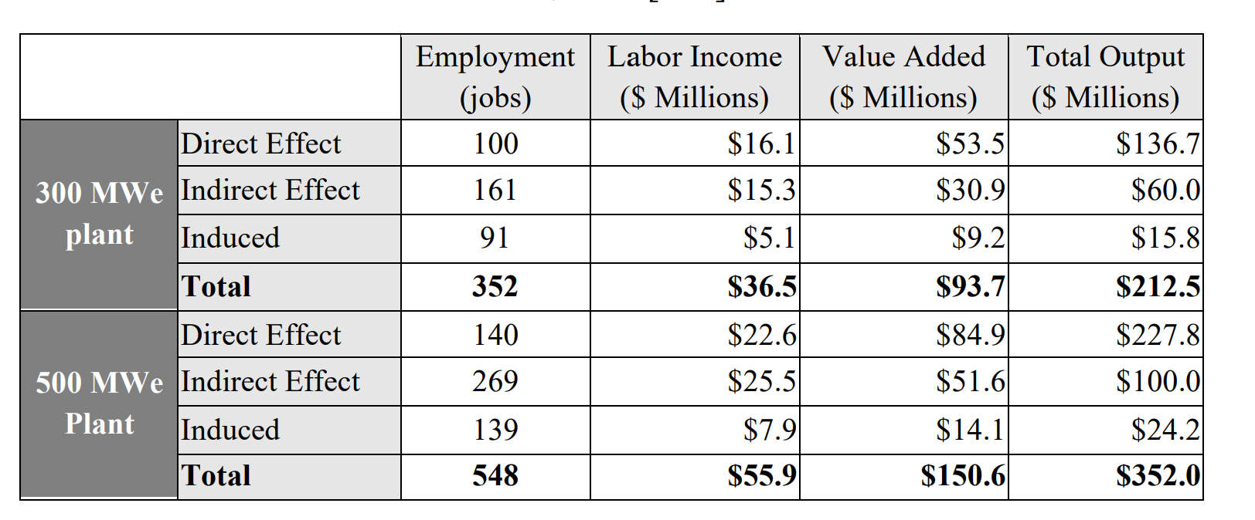
Operations: Income Tax
In Report Draft
For a hypothetical 300 MW SMR
  Labor income tax estimated to be 3.8% of wages
  $612 k/yr from direct
  $581 k/yr indirect
  $1.4 m/yr total (incl induced)

Slide 29
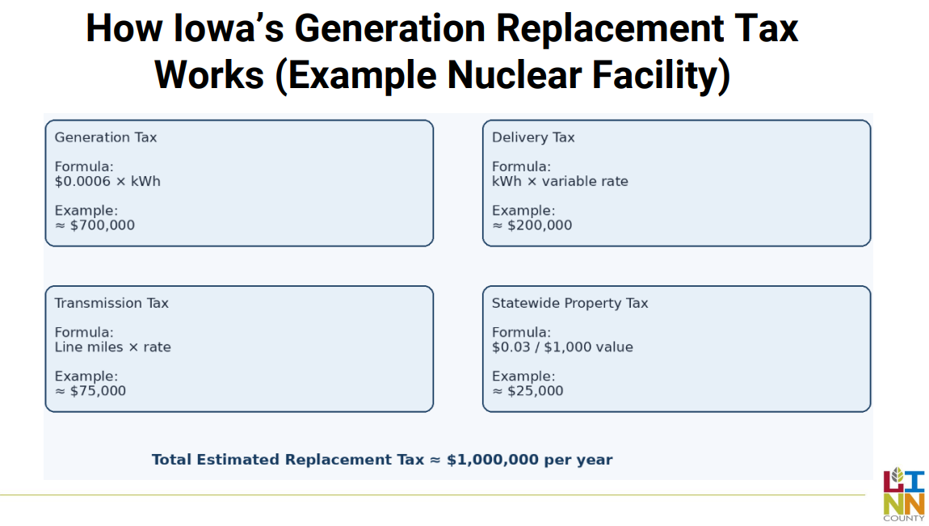
Operations: Local Utility Replacement Taxes
(in lieu of property taxes)
Generation Tax
  Most will pay $0.0006/kWh
  Paid to state, allocated to counties
  Counties may see less of the tax revenue when:
    They have multiple generators in multiple counties (allocated by value & tax rate)
    Assets value is above $44.4 million
Transmission, depends on transmission line length
Delivery Tax, depends on location and price of sold electricity
Tax Revenue for Nuclear Plant with 92% Capacity Factor
Nameplate Capacity | Generation (MWh/yr) | Generator Tax Revenue ($/yr)
300 MW | 2,417,760 | $1,450,656
600 MW | 4,835,520 | $2,901,312
1100 MW | 8,865,120 | $5,319,072
Note: Less than $3 million
https://revenue.iowa.gov/taxes/tax-guidance/property-tax/utility-replacement-tax-basics And https://www.legis.iowa.gov/docs/code/437A.6.pdf

Slide 30
Generation Tax: Detailed
Chapter 437A limits the amount of revenue that a local county can receive from the generation tax.
  437A.3(14) defines $44.44 million as the “local amount”
  437A.15 Allocates the tax, with local county only receiving a portion
Assumption for local capture: $44,444,445 local amount × $18/$1,000 consolidated levy = ~$800,000 local revenue capacity.
Project size | Capacity factor | Total annual generation tax | Approx. local amount revenue | Estimated local capture %
100 MW | 91% | $478,296 | $478,296 | effectively 100%
250 MW | 91% | $1,195,740 | $800,000 | 67%
500 MW | 91% | $2,391,480 | $800,000 | 33%
615 MW | 91% | $2,941,520 | $800,000 | 27%
750 MW | 91% | $3,587,220 | $800,000 | 22%
1,000 MW | 91% | $4,782,960 | $800,000 | 17%

Slide 31
Operations: State Tax
Statewide Property Tax
  $0.03/$1000 goes to the state and is not allocated locally
  Intention is to recover costs of administering the utility tax
  Typically, depreciated assets are 20% of original value
  $2 Billion SMR
    May start around $60 k
    May end around $12 k
  $6 Billion GW-scale reactor
    May start around $180 k
    May end around $36 k
As previously mentioned, state may receive part of the generation tax too
https://revenue.iowa.gov/taxes/tax-guidance/property-tax/utility-replacement-tax-basics

Slide 32
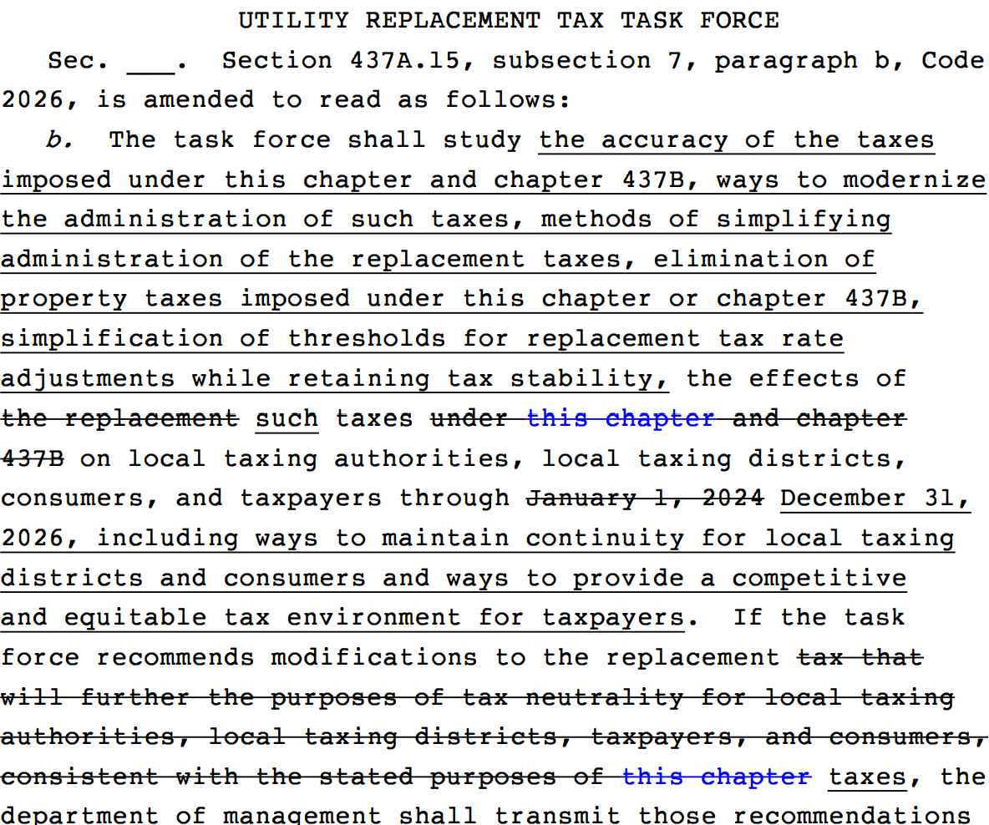
New Task Force: Utility Replacement Tax
HB 8495 Amendment
New task force will re-evaluate the Utility replacement taxes including
  Generation Tax
  Transmission Tax
  Delivery Tax
  (Statewide property tax) – possibly a separate task force
https://www.legis.iowa.gov/docs/publications/AMDI/91/H8495.pdf

Slide 33
Other states’ waste policies

Slide 34
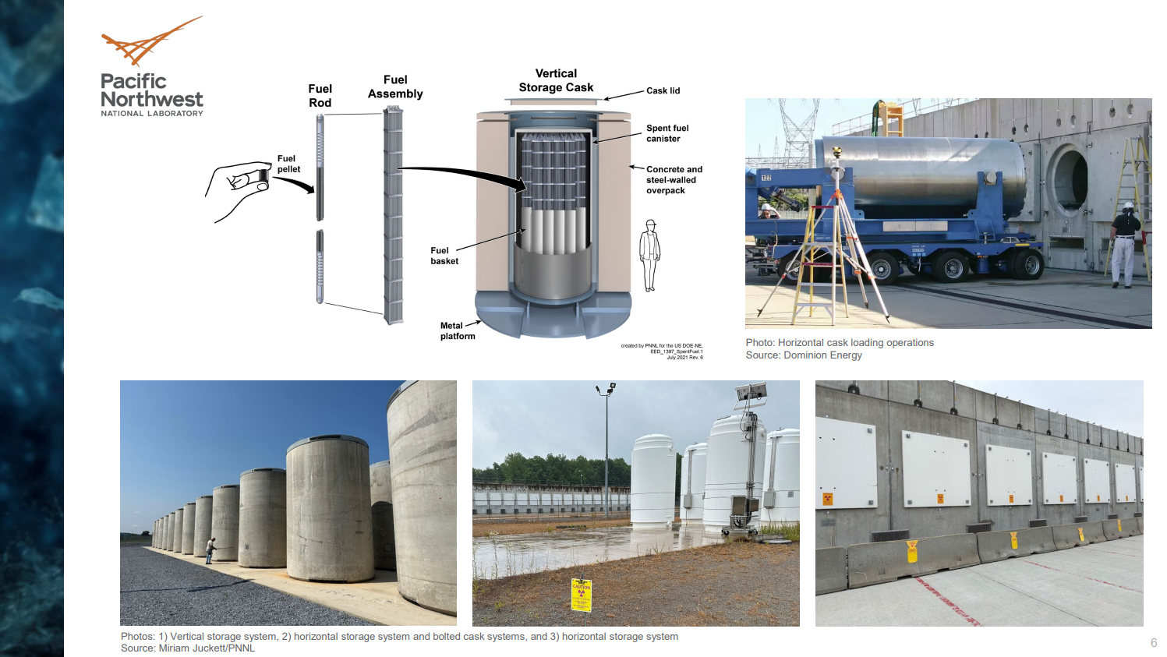
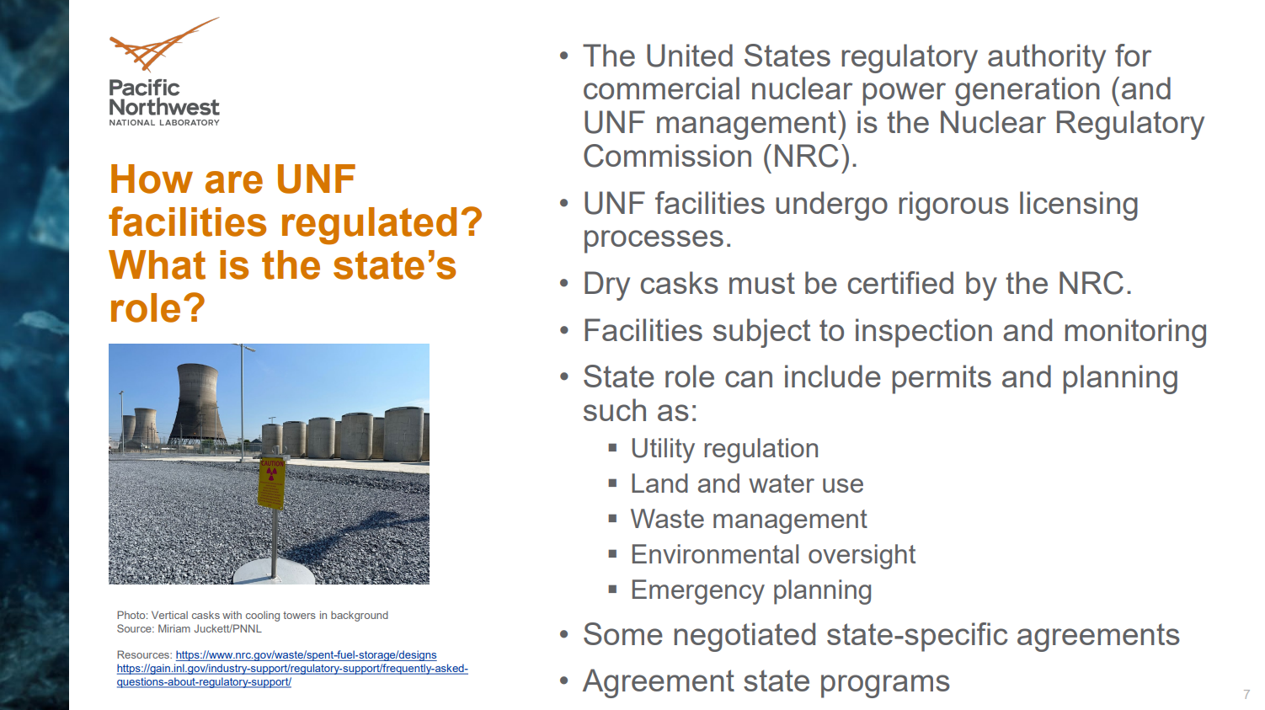
Question
  Source: B. Meisheid and J. McCalley
  Question:
    How do we make sure communities aren’t left with nuclear waste if DOE doesn’t come through on their contract to manage the waste
    What is Iowa’s role in all of this?
  Background: Presentation @ Task Force meeting #3 from M Juckett

Slide 35
State Policies
Pennsylvania 35 P.S. § 7110.402
  $650,000 per Nuclear power plant
  Requires DEP to:
    Radiation protection through the registration, licensing and regulation of radiation sources (e.g., X-ray equipment and radioactive materials);
    Environmental radiation monitoring in the proximity of the NPP sites and other locations throughout the commonwealth;
    Independent monitoring and evaluation of NPP sites;
    Establishing and maintaining a technical emergency radiation response capability to respond to accidents at NPP sites or at any other location throughout the commonwealth.
  2017 review showed that expenses are equal to revenues for these activities.
  Statute requires regular Reviews
https://wyoleg.gov/InterimCommittee/2023/09-2023071715-01NuclearRegulatoryOverviewforStateLegislatures-2023.pdf, https://files.dep.state.pa.us/PublicParticipation/Citizens%20Advisory%20Council/CACPortalFiles/Meetings/2018_02/Nuclear%20Fee%20Report%20to%20General%20Assembly%202017.pdf

Slide 36
State Policies
Many states tax low-level radioactive waste to recover costs
  Utah, Illinois, e.g.
Minnesota (Minn. Rev. Stat. 116C.779)
  Prairie Island
    $500,000 per spent fuel cask per year while in operation
    $7.5 million per year while not in operation (if no good faith effort was made to remove spent fuel)
  Monticello
    $350,000 per spent fuel cask per year while in operation
    $5.25 million per year while not in operation (if no good faith effort was made to remove spent fuel)
  Fund will be used for: Renewable R&D, grid modernization efforts, innovative energy projects
https://wyoleg.gov/InterimCommittee/2023/09-2023071715-01NuclearRegulatoryOverviewforStateLegislatures-2023.pdf, https://www.revisor.mn.gov/statutes/cite/116C.779

Slide 37
State Policies
Maine (Chapter 159-A: STATE NUCLEAR SAFETY PROGRAM §668. Interim Spent Fuel Storage Facility Oversight Fund)
  Fee collected to cover costs of:
    safety, radiation, and environmental monitoring
    security or other oversight-related activities related to the decommissioning of a nuclear power plant
    costs incurred by agencies with respect to federal or state proceedings
  $220,000 per year for each interim nuclear waste storage facility
  Goals:
    Protect the public
    Timely removal by the Department of Energy
Illinois
  Various fees based on license date;
  Local govts apply to cover costs related to planning/preparing for nuc. accident.
https://legislature.maine.gov/statutes/22/title22sec668.html, https://legislature.maine.gov/statutes/22/title22sec669.html , https://codes.findlaw.com/il/chapter-420-nuclear-safety/il-st-sect-420-5-4/

Slide 38
What are environmental impacts and benefits of nuclear power

Slide 39
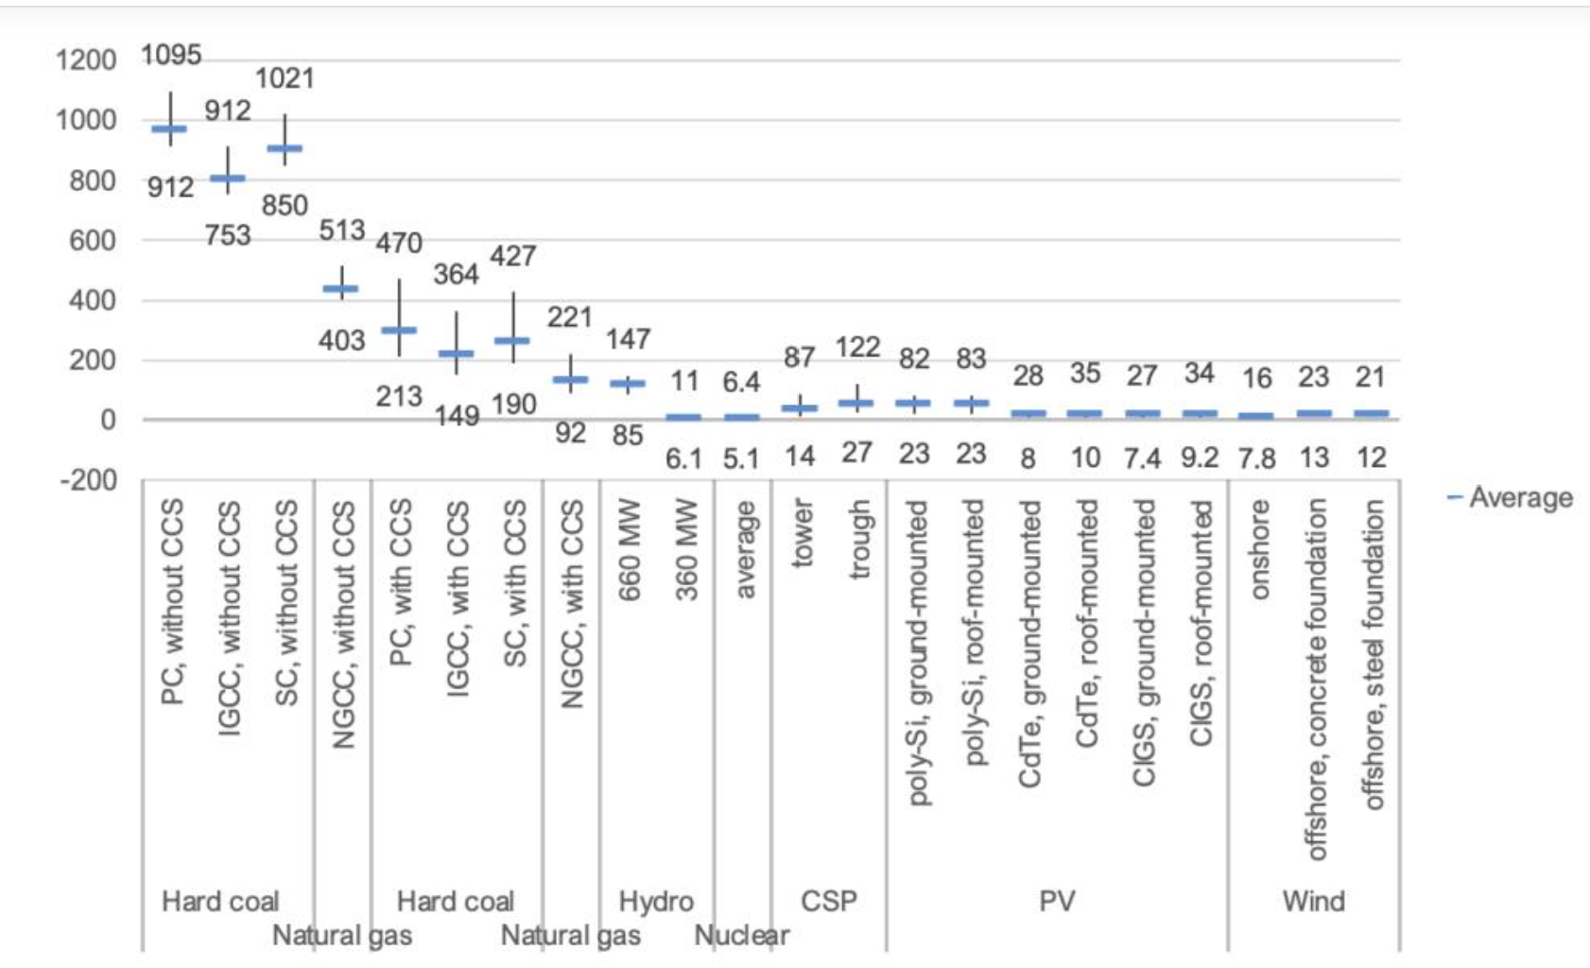
Benefit: Reduced Emissions
In Report Draft
Fewer Greenhouse gas emissions
  Lowest according to the UNECE data
Fewer harmful local emissions like
  SOx
  NOx
  Particulate matter
  Mercury
Lifecycle CO₂ emissions by technology
grams of CO₂ equivalent per kWh
https://world-nuclear.org/information-library/energy-and-the-environment/carbon-dioxide-emissions-from-electricity

Slide 40
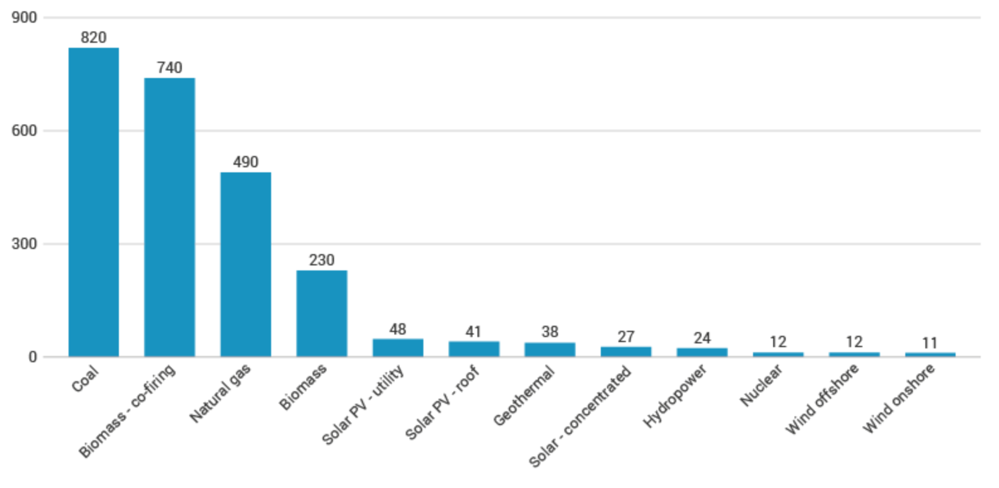
Benefit: Reduced Emissions
Lifecycle CO₂ emissions by technology
Fewer Greenhouse gas emissions
  Among the lowest according to the IPCC data
grams of CO₂ equivalent per kWh
https://world-nuclear.org/information-library/energy-and-the-environment/carbon-dioxide-emissions-from-electricity

Slide 41
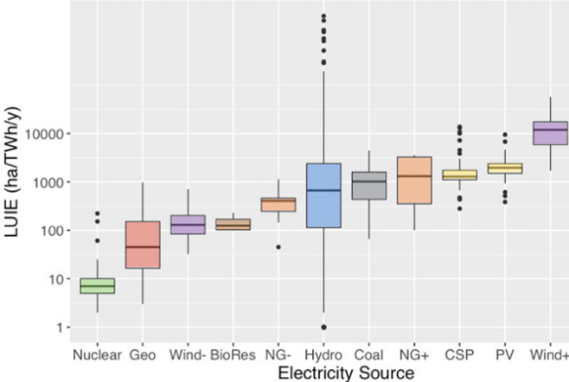
Lower Land Use Requirements
In Report Draft
Meta study of acreage required for various energy types normalized by TWh of production annually
Figure 54: Land use for Energy technologies (note: + indicates including spacing)

Slide 42
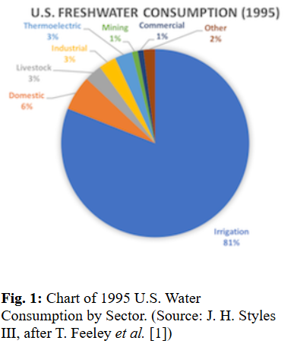
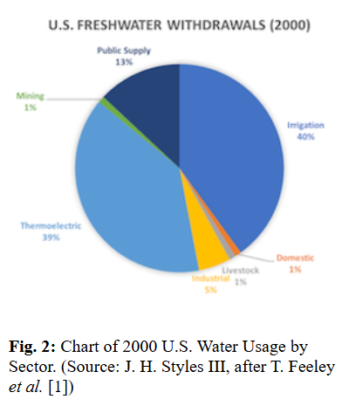
Negative Environmental Impacts: Operations
In Report Draft
Emergency Planning
Water usage, varies by design
  400 gallons/MWh
Socioeconomic impacts
  Housing shortages and/or price increases
  School spacing issues as new workers arrive/towns adjust
  Regular influx of workers during outages
Visual impacts, vary by type
Continual road usage

Slide 43
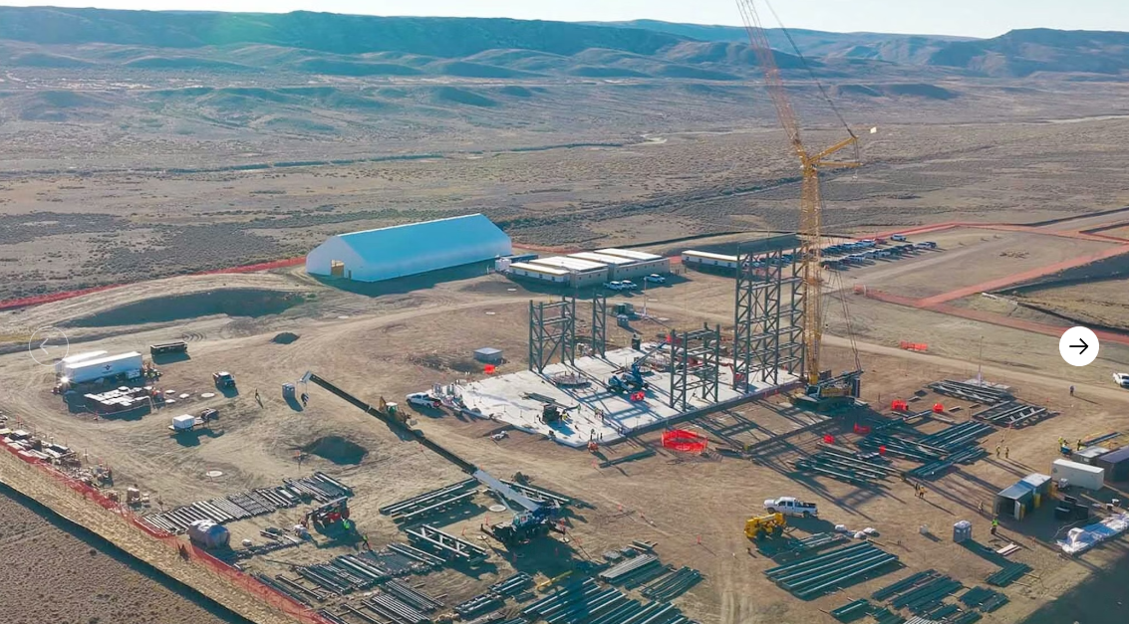
Negative Environmental Impacts: Construction
In Report Draft
Heavy Road usage
Noise/dust
Socioeconomic impacts
  Housing and hotel shortages and/or price increases
  School spacing issues as new workers arrive/towns adjust
TerraPower Project in Kemmerer, WY Feb, 2026
Source: https://cowboystatedaily.com/2026/02/15/inside-terrapowers-world-first-nuclear-project-being-built-just-outside-kemmerer/

Slide 44
What are other states’ approach to education public, k-12, AHJs, higher ed

Slide 45
Sample State Education Activities
Tennessee
  Public: Educate children in K-12 setting
    UT launched a K-2 education program in 2025
    Teacher Training (280 teachers) and hands-on learning kits
  Trades: Gov. Investment in vocational Education (GIVE) fund is $10 mm/year
  Higher-Ed:
    UT-Knoxville oldest nuclear engineering dept in the country, 150 incoming freshmen
    Tennessee Tech University: Started a Nuclear Engineering Program 2024-2025
    Community College certificate program
  “Freebies”: Oak Ridge National Laboratory is a major employer in the state (~7000 people) as are the two NPP’s
https://ne.utk.edu/ut-launch-k-2-nuclear-education-initiative/

Slide 46
Sample State Education Activities
Kentucky
  Public:
    Community Education: “Nuclear-Ready Communities” program participation mandates 2 public education meetings
    K-12: West Kentucky Educational Cooperative (WKEC) implementing a stem-focused K-12 educational program funded by KNEDA grant
  Trades:
    SOAR program in eastern Kentucky conducts workshops, hosts hiring events and helps with training/opportunity matchmaking
  Higher-Ed:
    West Kentucky Community and Technical College: To establish a regional hub for nuclear industry education, including a control room simulator.
  “Freebies”: Paducah has history of fuel manufacturing
https://research.uky.edu/news/uk-administered-kneda-awards-8-million-inaugural-grants https://caer.uky.edu/sites/default/files/2025-10/nuclear-ready-community.pdf
https://apps.legislature.ky.gov/AgencyReports/IJC/AR/KNEA/Kentucky%20Nuclear%20Energy%20Development%20Authority%20Workforce%20Development%20Report.pdf

Slide 47
Other Education Opportunities, not states
As previously noted, unions have their own training programs
American Nuclear Society
  Chapter-by-chapter activities often include public outreach
  New Credentialling Program: Nuclear Professional
Nuclear Power Plant Operators (and developers) often do public education for workforce development and community support purposes.
  High school programming, including job fairs and shadowing
  K-12 outreach near their plants including tours and education
  Integration with trades to co-strategize around recruitment
https://www.ans.org/certification/

Slide 48
Other Education Opportunities, not states
Local Governments
  INL’s GAIN program
  ANS and Energy Communities Alliance (past program)
  NRC (limited to community emergency preparedness)
  NEI has “Nuclear Matters” outreach for members
https://www.energyca.org/eca-updates/2022/12/9/doe-selects-eca-partnership-to-engage-communities-on-nuclear-energy/
https://www.nrc.gov/about-nrc/emerg-preparedness/about-emerg-preparedness/federal-state-local

Slide 49
Appendix

Slide 50
LCOE new Nuclear
LCOE is a simplified way to measure cost but not value.
This varies:
  Overnight Capital Cost
  ITC rate
It assumes:
  Equity rate of return
  Debt-to-equity ratio
  Debt interest rate
  Op Ex Costs

Slide 51
LCOE Comparison
LCOE comparisons are always fraught, as they do not account for capacity value, e.g.
Lazard publishes an Annual LCOE with unsubsidized values which uses Vogtle numbers and ignores subsidies for nuclear
This chart compares Lazard’s other “reliable” technologies’ LCOE to the LCOE for Nuclear on the last slide

Slide 52
LCOE Comparison: Zoom In

