Slide 1
Iowa Nuclear Energy Task Force Meeting 5
May 18, 2026

Slide 2
Timeline, approximate
Mtg. | Date | Location | Topic
1st | 2/23 | IEDA Offices | Nuclear Energy Overview
2nd | 3/24, 12-4 | IEDA Offices | Federal + State Policy
3rd | 4/6, 9-1 | IEDA Offices | Economic Impact and Opportunities, Waste Management​, Siting
4th | 4/20, 9-1 | Cedar Rapids, IA | Local Considerations, Workforce Development, Industry / Supply Chain​
5th | 5/18, 9-1 | Ames, IA | Strategy Session, Readout Open Questions
6th | 6/16, 9-1 | IEDA Offices | Final Report Readout
Notes:
Logistics
Comments welcome now or later on topics
We’ll be reaching out to all…
Please let us know if you want to talk

Slide 3
Iowa Nuclear Task Force Meeting Agenda
  Call to Order | Dr. Mark Nutt
  Roll Call | Jessica Flannery
  Approval of Task Force Meeting 4 Minutes | Action
  Update: Supply Chain Opportunities, Gaps & Recommendations| Owen Ward
  Opportunities Gaps & Recommendations | Dr. Anne Lucietto
  Ad-Hoc Questions Update: Workforce- Review| Becca Gillespie
  Strategy Discussion on Policy Recommendations
  Close Out | Dr. Mark Nutt

Slide 4
Strategy Meeting Guidelines
  Discussion Structure
  (for each recommendation)
  5 Minutes: Clarifying questions on recommendation topic (i.e. workforce, supply chain, etc.)
  10 Minutes: Discussion of proposed Task Force recommendation
  Task Force Chair Mark Nutt to write one-sentence overview of recommendation
  10 Minutes: Review and discussion of drafted recommendation
  In open discussions, please:
  Follow the discussion structure (left) to ensure we have time to discuss all recommendations
  Speak clearly so all participants can hear
  Allow others time to talk- do not monopolize the conversation
  Use appropriate language, keep debates respectful

Slide 5
Objective
From Executive Order
Other examples
  Texas Task Force, Nov 2024: 7 recommendations
  Kentucky Nuclear Development Workgroup, Nov 2023: Formed KNEDA (Role, mission, advisory board, budget, goals)
“The Task Force shall submit a report to the Governor and General Assembly within 180 days from the issuance of this Executive Order, detailing its findings and making recommendations to advance nuclear energy in Iowa”

Slide 6
Discussion of Recommendations
State Policies
Federal/ National Org. Engagement
Further Research or Discussion
Continued Engagement
Public Education (public, decision-makers, k-12)
Workforce Development (k-12, higher ed)
Waste Management
Siting
Incentives (supply chain and/or reactors)
Federal policy lobbying (ITC, NRC, cost overrun ins.)
State associations
Particular states leading strategy
Incentives
Community Matchmaking, (siting informed by comm. Acceptance and technical fea.)
Cost/Risk
State Point of Contact
Ongoing Collaboration Venues
Hub for local government collaboration

Slide 7
Discussion of Recommendations:
State Policies
Recommendation(s):
Public Education (public, decision-makers, k-12)
Workforce Development (k-12, higher ed)
Waste Management
Opportunity Zones
Incentives
  Supply chain
  Reactor Operations
  Early Reactor Development Costs

Slide 8
Discussion of Recommendations:
Federal/National Organization Engagement
Recommendation(s):
Federal policy lobbying (ITC, NRC, cost overrun ins.)
State associations
Particular states leading strategy

Slide 9
Discussion of Recommendations:
Further Research or Discussion
Recommendation(s):
Incentives
Community matchmaking
  siting informed by community acceptance and technical feasibility
Cost/Risk

Slide 10
Discussion of Recommendations:
Continued Engagement
State point of contact
Ongoing collaboration venues
Hub for local government collaboration
Recommendation(s):

Slide 11
Timeline, approximate
Mtg. | Date | Location | Topic
1st | 2/23 | IEDA Offices | Nuclear Energy Overview
2nd | 3/24, 12-4 | IEDA Offices | Federal + State Policy
3rd | 4/6, 9-1 | IEDA Offices | Economic Impact and Opportunities, Waste Management​, Siting
4th | 4/20, 9-1 | Cedar Rapids, IA | Local Considerations, Workforce Development, Industry / Supply Chain​
5th | 5/18, 9-1 | Ames, IA | Strategy Session, Readout Open Questions
6th | 6/16, 9-1 | IEDA Offices | Final Report Readout
Notes:
Logistics
Comments welcome now or later on topics
We’ll be reaching out to all…
Please let us know if you want to talk

Slide 12
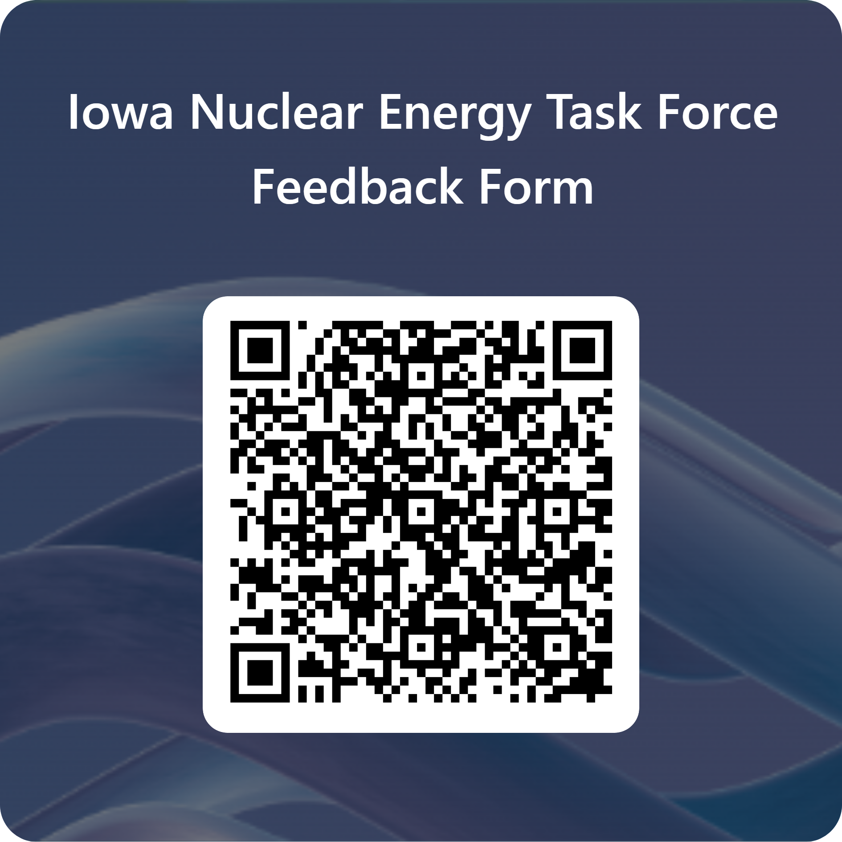
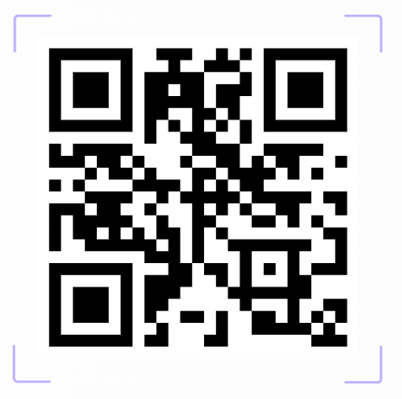
Resources and Next Steps
Iowa Nuclear Energy Task Force Website
Iowa Nuclear Energy Task Force Meeting 6
June 16, 2026, 9:00 am CDT
Des Moines, IA

