Slide 1
Introduction & Purpose
Iowa SMR Task Force
Workforce & Readiness Status Update
Presenters
Anne M. Lucietto, PhD – Workforce Development Section Lead
William Boyer – Research & Analysis Support Workforce Development
Purpose of Today’s Update
Provide a status report on what we’ve learned about Iowa
Preview what we’ll examine next
This is a progress update, not a recommendation or decision point.
Notes:
Purpose of this document
This document is intended to support Task Force discussion alongside the accompanying slides. It summarizes, in narrative form, what has been learned to date about Iowa’s readiness for Small Modular Reactors (SMRs), with a particular focus on workforce, labor engagement, and institutional capacity. It reflects progress to this point in the work and provides context for transitioning to the next phase of analysis.
This is not a recommendation document and does not presuppose deployment decisions.

Slide 2
Scope of Work Completed
What We’ve Looked At So Far
Iowa’s nuclear and energy context
Workforce readiness and capacity
Labor, industry, and regulator engagement
Education and training infrastructure
Workforce gaps and integration opportunities
What This Phase Did Not Cover
SMR technology selection
Siting or deployment decisions
Cost or procurement analysis
Notes:
Where the work has focused so far
To date, the Task Force’s work has concentrated on understanding Iowa itself: its current energy context, its workforce assets, its education and training systems, and the perspectives of key in‑state stakeholders. Interviews and discussions have been conducted with representatives from organized labor, regulators, educators, and individuals with experience in both nuclear and adjacent energy sectors.
This Iowa‑focused phase was intentionally scoped to establish a realistic baseline before expanding to technology‑specific or comparative evaluations. The goal has been to answer a simple question first: If Iowa were to consider SMRs someday, how ready is it—today—from a workforce and institutional standpoint?

Slide 3
Starting at Indiana
Starting Point: Indiana
Indiana SMR study conducted first
Workforce analyzed proactively, before deployment decisions
Asked: What would actually constrain SMRs on the ground?
Indiana Workforce Findings
Workforce is a critical path constraint
Training and licensing timelines run multiple years
Construction and operations have very different workforce needs
Existing energy and manufacturing workers are essential, but require reskilling
Notes:
Narrative:
We began with Indiana. The question there wasn’t whether SMRs were technically viable, but what would realistically enable or constrain deployment—especially from a workforce perspective.
Indiana made clear early on that workforce readiness is not a secondary issue. Even with strong institutions and industry, people—and timing—set the pace.
Critical Occupational Categories
The study identifies several core workforce groupings needed for SMR deployment:
a. Nuclear Engineers and Technical Specialists
Nuclear, mechanical, electrical, systems, and civil engineers
Reactor systems and instrumentation & controls specialists
Radiation protection and nuclear safety analysts
[engineerin...purdue.edu], [in.gov]
b. Skilled Trades and Craft Labor
Electricians, pipefitters, welders, HVAC technicians
Maintenance mechanics with nuclear-quality assurance training
Construction supervisors with experience in regulated infrastructure
The study notes strong skill adjacency between coal plant workers and SMR needs, but emphasizes required upskilling and recertification. [ans.org]
c. Licensed Operators and Plant Personnel
NRC-licensed reactor operators and senior reactor operators
Operations engineers, shift supervisors, and outage planners
Emergency preparedness and cybersecurity staff
[engineerin...purdue.edu], [in.gov]
d. Regulatory, Safety, and Quality Professionals
Nuclear quality assurance (NQA-1) specialists
Environmental, health, and safety professionals
Regulatory compliance and licensing support staff
[in.gov]
Workforce Scale and Timing
Construction phase:
Each SMR facility is estimated to require ~2,000 workers during peak construction, drawing from skilled trades, engineering, project management, and specialized nuclear-qualified roles. [purdue.edu], [ans.org]
Operations phase:
Once operational, a single SMR plant is expected to employ ~140 highly skilled, full-time workers, a smaller but more technically specialized workforce than traditional coal plants. [purdue.edu]
Transition importance:
Workforce development must begin years in advance of deployment, given the time required for education, licensing, and nuclear-specific credentialing. [in.gov]

Slide 4
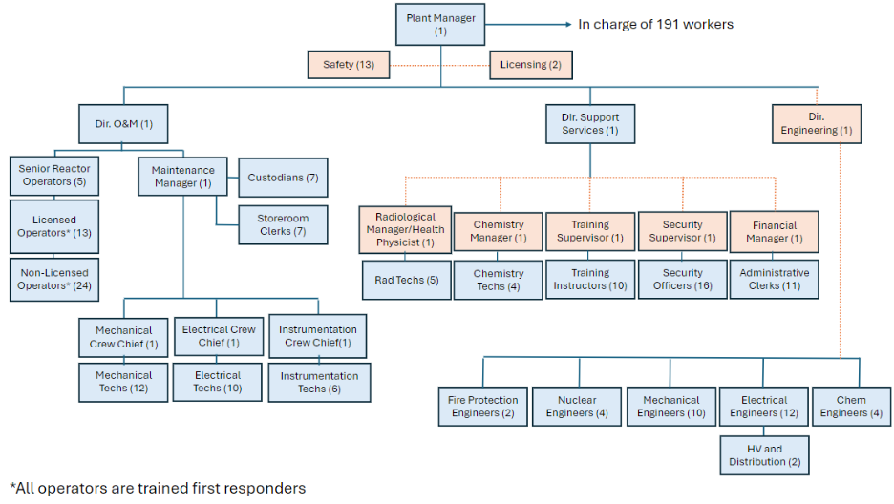
What Indiana Identified
Notes:
The organizational chart outlines recommended staffing levels based on workforce analyses from European and U.S. nuclear facilities, validated by comparisons with large commercial nuclear and fossil-fuel plants in the United States. Core leadership and operational roles—such as the Plant Manager, Director of Operations and Maintenance, Support Services, and Maintenance—should be dedicated to each individual plant, while specialized functions including Licensing, Radiation Protection, Chemistry, Training, and Finance can be shared across nearby facilities. This shared staffing approach is well established in the nuclear industry, with companies such as Westinghouse and General Electric routinely leveraging shared and contracted personnel to manage demand surges, provide specialized expertise, and improve plant operations by drawing on global experience.
Key SMR Workforce Themes
Engineering or technical degrees dominate, with AS degrees common for technicians
NRC licensing and requalification are essential for operations staff
Cross-training replaces large single-discipline teams
Shared and regional specialists reduce total staffing requirements

Slide 5
How Indiana Strengthens the Iowa Story
Indiana as the Baseline
Indiana findings now validated cross-state
Confirms workforce issues are structural, not local
Reinforces need for early, intentional workforce strategy
Supports treating workforce development as core infrastructure planning
Energy & Innovation Leadership
Indiana: Experience with large, centralized power generation
Iowa: National leader in clean energy deployment with strong experience integrating advanced generation into the grid
Workforce Strengths
Indiana: Skilled workforce from fossil and industrial power sectors
Iowa: Highly skilled electrical, mechanical, and systems workforce well positioned to expand into advanced nuclear technologies
Infrastructure & Adaptability
Indiana: Established heavy industry and manufacturing base
Iowa: Proven success deploying new energy technologies at scale, indicating strong adaptability for SMRs
SMR Readiness Pathway
Indiana: Leverages workforce transition from existing generation assets
Iowa: Well-suited for SMRs as a clean, firm complement to renewables, building on its reputation as an energy innovation leader
Notes:
Narrative:
Seen together, Indiana and Iowa tell a consistent story. Indiana identified the issues first; Iowa confirmed them. That strengthens confidence that workforce readiness is a leading indicator for SMR viability.
Reskilling and Coal-to-Nuclear Transition
A unique Indiana opportunity identified in the study is the reuse of retiring coal plant sites and workforces:
Coal plant operators and maintenance staff possess relevant operational culture and safety discipline
Significant reskilling is required in nuclear safety, radiation protection, and regulatory compliance
Targeted bridge programs could reduce community disruption while accelerating SMR readiness
[ans.org], [purdue.edu]
Indiana and Iowa differ primarily in energy mix, workforce alignment, regulatory familiarity, and industrial infrastructure. Indiana has a strong legacy in fossil-fuel power generation, heavy industry, and manufacturing, providing a workforce well-suited for retraining in SMR operations, maintenance, and construction roles. Iowa, by contrast, has a more renewable focused energy profile—dominated by wind—resulting in a workforce with strengths in electrical systems and grid integration but less direct alignment with nuclear operations and regulatory frameworks. Indiana’s industrial base, proximity to nuclear supply chains, and experience with large, centralized power facilities position it favorably for early SMR deployment, while Iowa’s strengths lie more in distributed energy systems and renewable integration. As a result, Indiana’s approach would emphasize workforce transition and operational readiness, whereas Iowa’s would require more foundational development of the nuclear workforce and regulatory infrastructure.

Slide 6
What We’ve Learned About Iowa
Iowa’s Starting Position
Prior commercial nuclear operating experience
Existing skilled trades and engineering workforce
Strong, organized labor engagement and interest
Familiarity with regulation, safety culture, and oversight
Iowa Reinforced Indiana’s Results
Workforce emerged again as a primary constraint
Long lead times dominated deployment discussions
Limited nuclear-specific labor amplified competition
Reliance on adjacent skill sets mirrored Indiana
Key Message:
Iowa is not starting from scratch.
Notes:
A consistent finding across interviews and discussions is that Iowa is not starting from zero. The state previously operated a commercial nuclear facility, and that history still matters. While the facility is no longer operating, Iowa retains important forms of institutional memory—among workers, regulators, and communities—that distinguish it from states with no nuclear experience at all.
Workforce emerged as Iowa’s most significant readiness strength. Iowa has:
Skilled trades accustomed to working in highly regulated, safety‑critical environments
Engineers with transferable experience in power systems, controls, and industrial infrastructure
Workers with direct nuclear or nuclear‑adjacent experience
Established apprenticeship systems that already deliver licensed, certified trades
Importantly, discussions consistently reinforced that nuclear construction and maintenance do not require training the entire workforce locally. A nationally mobile, already‑qualified skilled‑trade workforce exists and has historically supported large nuclear projects. This significantly reduces local capacity risk during construction phases and reframes workforce preparation as an integration challenge rather than a volume challenge.

Slide 7
Workforce Readiness: Key Findings
Strengths Identified
Workforce experience across:
  Construction
  Operations
  Maintenance
  Safety and Quality
Licensed trades supported by established apprenticeships
Nationally mobile trade workforce reduces local capacity strain
Gaps Identified
Cross‑training between engineers, trades, and operators needs to be considered.
Public and stakeholder understanding of energy systems
Longer‑term faculty, facility, and workforce pipeline planning
Key Message:
Workforce readiness is Iowa’s strongest asset, with manageable gaps.
Notes:
Education and Training Capacity
Education and training partners in Iowa are well positioned to support readiness, but not as stand‑alone workforce producers. Community colleges were repeatedly identified as most effective when acting as integrators: aligning existing programs, adding targeted nuclear‑adjacent content, and supporting apprenticeships and earn‑while‑you‑learn pathways. Universities play a complementary role through certificates, interdisciplinary coursework, and applied research, rather than through large‑scale workforce production.
A recurring insight was the importance of avoiding duplication. Iowa already has training systems that work. The readiness question is how to align and adapt them thoughtfully, rather than building parallel programs.
Cross Training as a Central Theme
One of the clearest themes to emerge from interviews was the need for better cross‑training and cross‑understanding between engineers, trades, operators, and other technical roles. This was framed not as a soft or abstract goal, but as a practical need with real implications for safety, efficiency, and trust.
Cross‑training was consistently described as a way to:
Strengthen nuclear safety culture
Reduce friction between design and field execution
Improve sequencing, constructability, and problem‑solving
Build mutual respect across disciplines
This suggests that cross‑training represents a meaningful near‑term readiness activity that can be pursued independent of deployment decisions.
Gaps Identified
The gaps identified at this stage are largely gaps of coordination, understanding, and alignment—not fundamental capability gaps.
Near‑term gaps include:
Cross‑disciplinary understanding between technical roles
Public and stakeholder understanding of how energy systems operate
Awareness of existing workforce and training capacity
Longer‑term considerations include:
Faculty and instructor capacity
Facilities and equipment needs
Multi‑year pipeline planning tied to any future deployment timeline
These gaps are considered manageable and addressable, particularly if approached deliberately and in coordination with existing systems.

Slide 8
Synthesis
Combined Takeaway
Workforce strategy must lead SMR deployment
Early planning matters more than workforce size
Reskilling existing energy workers is essential
Education, licensing, and siting decisions must align, not duplicate
This holds across state boundaries
Implications for the Task Force
Workforce readiness can move forward without committing to deployment
Preparation logically comes before siting or technology decisions
Cross‑training is a practical, near‑term action
Key Message:
Readiness preserves flexibility and builds credibility.
Notes:
Narrative:
Indiana gave us the early signal. Iowa confirmed it. Across both states, the conclusion is the same: SMRs move at the speed of workforce readiness.
Cross-Cutting Workforce Challenges
The study highlights several systemic challenges that must be addressed:
National nuclear workforce shortages, with competition from other SMR-deploying states
Aging workforce in energy and skilled trades
Long lead times for licensing and nuclear qualification
Need for improved public understanding and social license, which indirectly affects workforce attraction
[in.gov], [ans.org]
Key Workforce Recommendations
The Indiana SMR study recommends that the state:
Invest early in nuclear-specific education and training
Formalize university–community college–industry partnerships
Create targeted reskilling pathways for fossil energy workers
Align workforce strategy with site selection and SMR timelines
Coordinate with federal programs to offset training and credentialing costs
[in.gov], [in.gov]
At this point in the work, several conclusions are supported by the findings:
Iowa can pursue workforce and institutional readiness without committing to SMR deployment
Workforce preparation logically precedes siting, technology selection, or cost discussions
Existing labor and education systems provide a strong foundation for readiness
Readiness work preserves flexibility and supports informed decision‑making
In short, Iowa is in a position to prepare responsibly while maintaining optionality.

Slide 9
Summary & What Comes Next
Where We Are
Iowa workforce and readiness baseline established
Labor, education, and industry engagement completed
Key strengths and gaps identified
What Comes Next
Examine beyond Iowa:
  Other state approaches
  Technology‑neutral SMR considerations
  Deployment scenarios and timelines
Closing Message
This phase established Iowa’s foundation.
The next phase broadens the lens—without changing the conclusion.
Notes:
Transition
With the Iowa‑focused assessment largely complete, the next phase of work will broaden the lens. Future discussions will look beyond Iowa to consider:
How other states are approaching advanced nuclear readiness
Technology‑neutral SMR characteristics and deployment models
Workforce implications under different deployment scenarios and timelines
This next phase builds on the foundation established here; it does not replace or negate the Iowa‑specific findings.
Closing Note
This document, like the slides it supports, is intended to facilitate discussion rather than drive conclusions. Its purpose is to ensure the Task Force has a shared understanding of where things stand, what has been learned, and why the work is progressing in a particular sequence.

