Slide 1
Iowa Nuclear Energy Task Force Meeting 4
April 20, 2026

Slide 2
Timeline, approximate
Mtg. | Date | Location | Topic
1st | 2/23 | IEDA Offices | Nuclear Energy Overview
2nd | 3/24, 12-4 | IEDA Offices | Federal + State Policy
3rd | 4/6, 9-1 | IEDA Offices | Economic Impact and Opportunities, Waste Management​, Siting
4th | 4/20, 9-1 | Cedar Rapids, IA | Local Considerations, Workforce Development, Industry / Supply Chain​
5th | 5/18, 9-1 | Ames, IA | Strategy Session, Readout Open Questions
6th | 6/16, 9-1 | IEDA Offices | Final Report Readout
Notes:
Logistics
Comments welcome now or later on topics
We’ll be reaching out to all…
Please let us know if you want to talk

Slide 3
Iowa Nuclear Task Force Meeting Agenda
  Call to Order | Dr. Mark Nutt
  Nuclear Supply Chain| Owen Ward, Solestiss 30 min.
  Nuclear Workforce Development| Anne Lucietto, Purdue 30 min.
  Break 5 min.
  Nuclear Host Community Considerations| Charlie Nicols, Linn County 30 min.
  Guided Discussion 30 min
  Break 5 min.
  Open Questions 20 min
  Final Report Outline, Strategy Session Topics 30 min.
  Close Out | Dr. Mark Nutt

Slide 4
Meeting Recap and Discussion

Slide 5
Discussion Questions
Task Force Reactions to Meeting Topics:
  Supply Chain Opportunities and Barriers
  Workforce Development Requirements and Gaps
  Host Community Considerations
[Repeat] What are potential specific goals for Iowa for nuclear development in the state?
  Economic development, grid strengthening/resilience, etc.

Slide 6
Open Questions
Existing Ad-Hoc Questions (in progress)
  Advanced Ratemaking
  Advanced Reactors’ Ability to Meet Iowa Grid Needs (e.g. Load Following)
  Nature of Iowa’s Expected Load Growth
  Benefits of Load Growth
  Tax Benefits of New Reactor Deployment
  Other States' Waste Policies
Other New Ad-Hoc Questions

Slide 7
Task Force Deliverables Discussion

Slide 8
Report Outline
Cover Letter to Governor from Dr. Mark Nutt
Executive Summary
Iowa’s Energy Landscape
  Review leadership in RPS / wind generation
  Current grid overview
  Iowa capacity demands and electricity needs (forecast, importance of industry/manufacturing, data center trends, etc.)
The Opportunity of Nuclear
  Growing Momentum of Nuclear in the US
    Key attributes of Nuclear Energy Generators
    Nuclear Energy Technology: Existing and Future reactor technologies
    Nuclear Energy Market signals
    Existing Policy (executive orders, federal fiscal policy, federal reg. policy, state policy benchmarking)
    Ongoing challenges of project costs, risks and financing
Notes:
There is a direct link between ESN work and more than $630M in new investments in Indiana that would not have happened otherwise.
This multiplier effect has been what has attracted and kept industry investing year over year
TOM – ESN’s measures of success seem to be well aligned with IEDC measures of success as I understand them from my time on the IEDC Board

Slide 9
Report Outline (continued)
The Opportunity of Nuclear (continued)
    Nuclear in Iowa
      Iowa Nuclear History
      Iowa’s existing relevant policy framework
      Gaps to develop nuclear energy-ready workforce in Iowa
      Iowa skilled workforce resources
    Potential Impact on Iowa
      Nuclear reactors’ economic impact during construction and operation
      Nuclear reactors’ local costs and impacts during construction and operations
      Opportunities in Nuclear Supply chain
      Barriers to joining nuclear supply chain
      Mechanisms to enable ecosystem development
      Waste management best practices
Notes:
There is a direct link between ESN work and more than $630M in new investments in Indiana that would not have happened otherwise.
This multiplier effect has been what has attracted and kept industry investing year over year
TOM – ESN’s measures of success seem to be well aligned with IEDC measures of success as I understand them from my time on the IEDC Board

Slide 10
Report Outline (continued)
Task Force Recommendations
  State Policy Recommendations. Including executive actions, legislative actions, guidance for the state’s regulatory agencies, and recommendations for Iowa economic development investment activities.
  Recommendations for engagement with the federal government or national organizations
  Recommendations for further research or decision-making.
  Recommendations for continued engagement of Nuclear industry players in the state.
Appendices
  Executive Order
  Taskforce members and meetings
  Workforce development strategy supporting information
  Supply Chain supporting information
Notes:
There is a direct link between ESN work and more than $630M in new investments in Indiana that would not have happened otherwise.
This multiplier effect has been what has attracted and kept industry investing year over year
TOM – ESN’s measures of success seem to be well aligned with IEDC measures of success as I understand them from my time on the IEDC Board

Slide 11
Policy Discussion Topics for Strategy Session
State Policies
Federal or National Org. Engagement
Further Research or discussion
Continued engagement
Incentives
Siting
Public Education
Workforce Development
Waste Management
State Point of Contact
Ongoing Collaboration Venues
Federal policy lobbying
State associations
Particular states leading strategy
Incentives
Siting
Cost/Risk

Slide 12
Timeline, approximate
Mtg. | Date | Location | Topic
1st | 2/23 | IEDA Offices | Nuclear Energy Overview
2nd | 3/24, 12-4 | IEDA Offices | Federal + State Policy
3rd | 4/6, 9-1 | IEDA Offices | Economic Impact and Opportunities, Waste Management​, Siting
4th | 4/20, 9-1 | Cedar Rapids, IA | Local Considerations, Workforce Development, Industry / Supply Chain​
5th | 5/18, 9-1 | Ames, IA | Strategy Session, Readout Open Questions
6th | 6/16, 9-1 | IEDA Offices | Final Report Readout
Notes:
Logistics
Comments welcome now or later on topics
We’ll be reaching out to all…
Please let us know if you want to talk

Slide 13
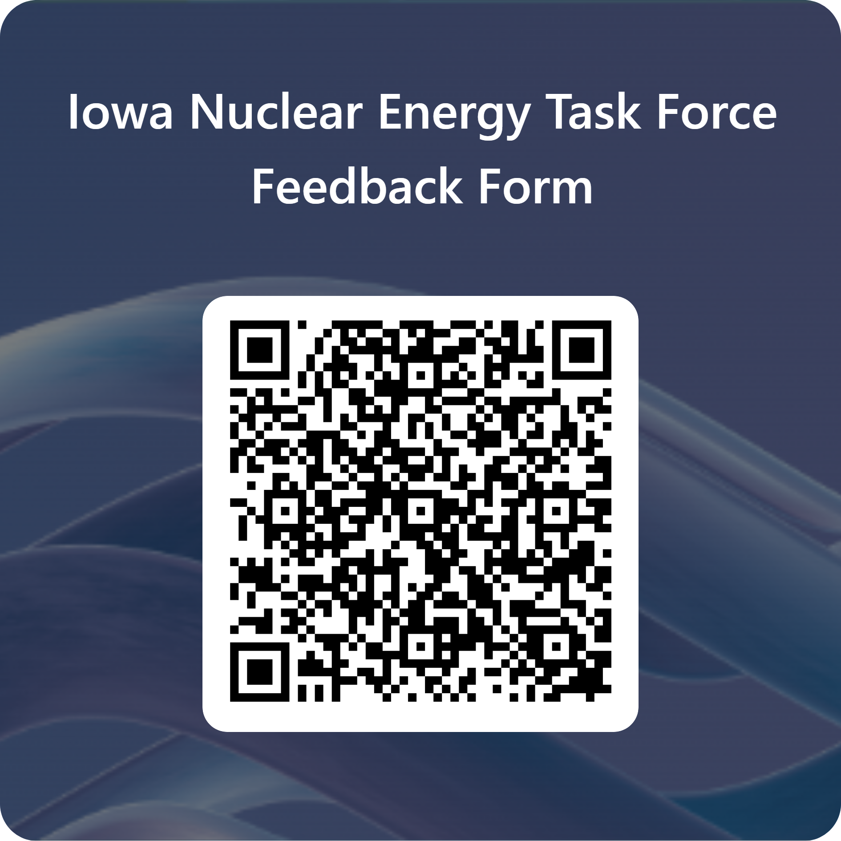
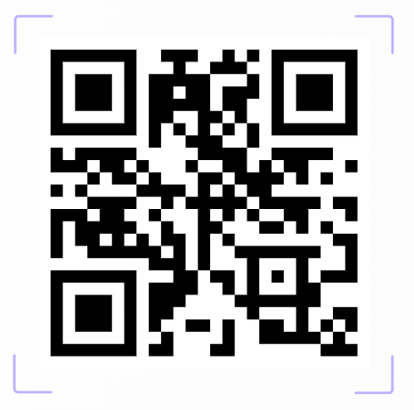
Resources and Next Steps
Iowa Nuclear Energy Task Force Website
Iowa Nuclear Energy Task Force Meeting 5
May 18, 2026, 9:00 am CDT
Ames, IA

