Slide 1
Iowa Nuclear Energy Task Force
Site Selection
April 6, 2026

Slide 2
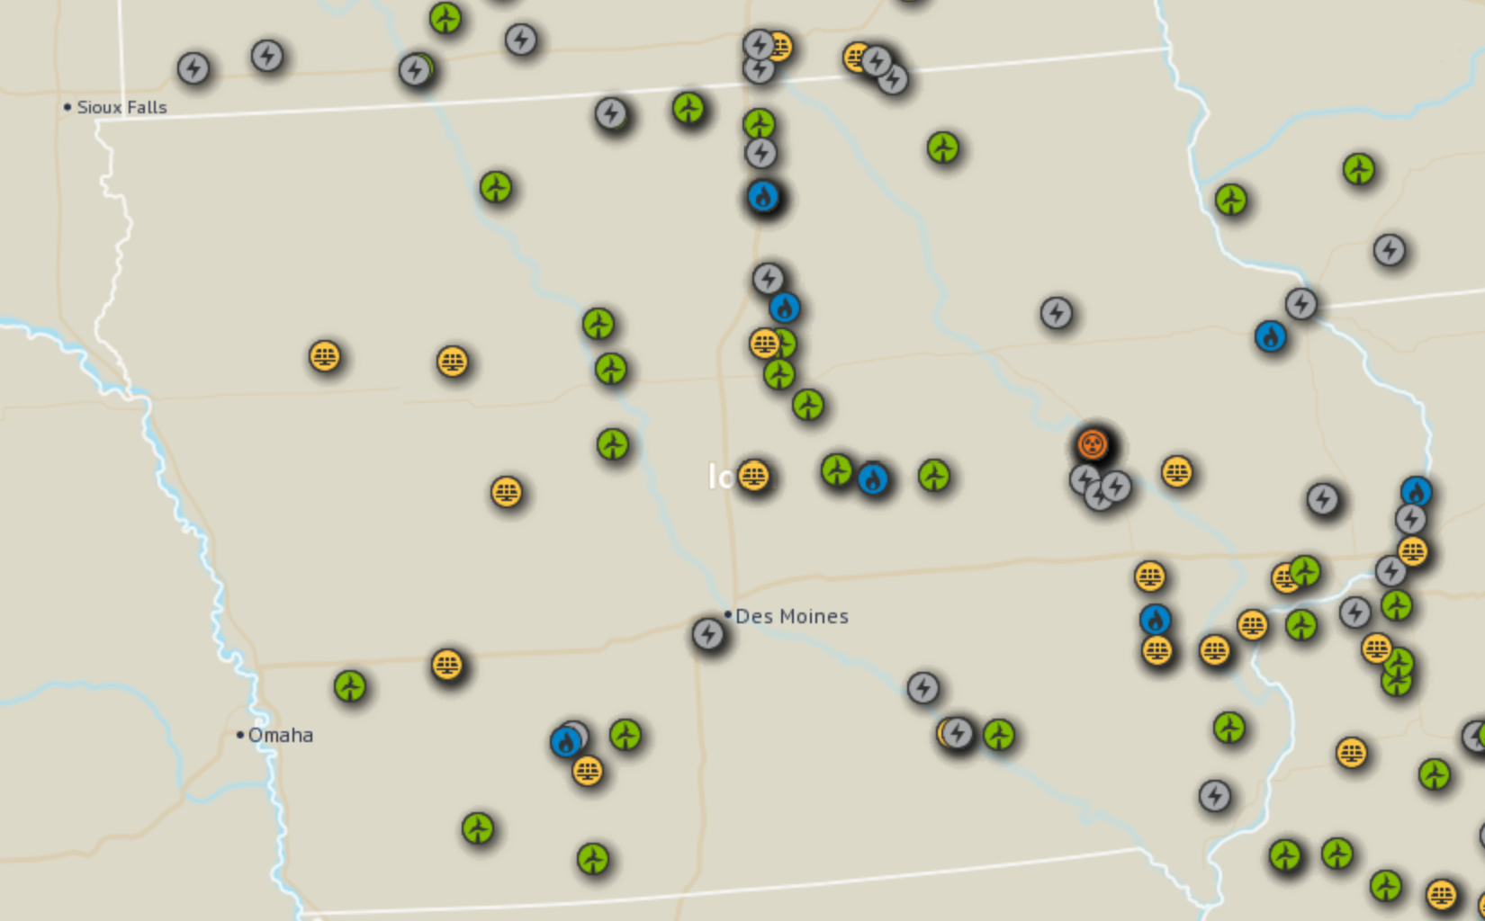
Agenda
Nuclear Siting Framework
  Siting Considerations
  Exemplary Siting Timeline and Budget
  Siting examples
Siting Overview for Iowa
  Technical Siting Overview
  Non-Technical Siting Overview

Slide 3
Nuclear Siting Framework

Slide 4
Pillars of site feasibility
Community Support
Regulatory Fea.
Economic Fea.
Demonstrated support and line-of-sight to permitting nuclear power plant and, if required, large load off-takers.
Communities seek cost support and safety assurance
Ability to source and/or support construction and operation workforce.
Siting feasibility for New Nuclear Power Plant (according to NRC regulations), and other power plants as required
  Geological
  Meteorological
  Population Proximity
  Water Related
  Environmental & Community
Site-costs: Construction, interconnection, operations and resources
Value: Local value of power, and/or site value to large load off-takers
Local and federal site- specific incentives, e.g. Energy Communities per IRA
Risk associated with site.

Slide 5
Early Development timeline and budget
 | Year 1 |  |  |  | Year 2 |  |  |  | Year 3
Initial Project and Site Diligence | $50k
Site Screening and Preliminary Commercial Readiness |  | $400-$600k
Preliminary NRC Siting studies and Tech/EPC selection |  |  |  |  | $5-12 MM
Prepare & Submit CP, Financial Due Diligence, Interconnection Application* |  |  |  |  |  |  |  |  | $43-$70 MM + Upfront NU Costs (~$20-$40 MM)
Opportunities to bring on partners or investors, or sell the project

Slide 6
Breakdown of activities by phase
Initial Diligence
Site Screening
Tech Studies and Selection
Technical Siting study using existing data and standard processes to evaluate the feasibility of the site. (In line with EPRI’s Canvassing Study to determine Potential Sites)
Project planning and scoping for the early development effort
Business plan development and early engagement with potential commercial partners, as needed/requested.
Technical Site Screening study in line with EPRI Site Screening Process
Shortlist of Technologies and EPC partners
Preliminary discussions to refine and determine PPA or other Offtake terms
Negotiations to define the involvement of additional project partners or investors
Key technical studies for NRC permitting, prelim.
Technology and EPC partner request for proposals, evaluations, due diligence, and selection.
State agency and local government early engagement.
Community engagement
Pre-application engagement with the NRC and EDF
PPA negotiation and contract finalization (if required)

Slide 7
Siting Examples: ADRP Projects
Terra Power selected Kemmerer, WY
  Site selected Nov 2021 (among 4 CPP’s under consideration)
  Construction Permit: Applied March 2024, received March 2026
  Near Naughton Power plant, a coal power plant, per Terra Power strategy
  Terra Power cited various rationale: Skilled labor, community support, land availability, retirement date of CPP
X-Energy selected Seadrift, TX
  Site Selected May 2023 among various DOW chemical sites on Gulf Coast
  Construction permit: Submitted Mar, 2025
  Siting rationale: DOW Chemical’s UCC Seadrift, closely matches the power and high-temperature (565C) steam output of the X-Energy HGTRs. Plant will be comprised of Four XE-100’s for 320 MW of electricity or 800 MW thermal power.

Slide 8
Siting Examples: DOE’s Gen III+ Tier 1 Program
TVA selects Clinch River for the GE-Hitachi BWRX-300
  Submitted the ESP in May 2016 for 2 SMR’s and received it in Dec. 2019
  Construction Permit submitted April-May 2025
  TVA cited brownfield status (excavated but never used), proximity to transmission lines, access to highways and availability of skilled workforce (Oak Ridge NL and Watts Bar NPP)
Holtec selects Palisades for the Holtec SMR-300
  Submitted a Partial Construction License Application Dec 2025-Jan 2026
  Holtec owns Palisades Nuclear Power Plant and is restarting that plant currently.
  Holtec notes: Owned by Holtec, community acceptance, workforce availability, site is known and understood by the NRC.

Slide 9
Siting Examples: Other Private Developers
Constellation: Constellation has announced that they are evaluating strategies to pursue SMR development both their existing Clinton NPP in Illinois (Aug 2025) and their existing Nine Mile Point NPP in New York (Jan 2025)
Fermi America: Selects Amarillo TX site for Project Matador, an AI site with various on-site generation sources (11 GW total) including four AP 1000s (4.4 GW nuclear) in June 2025 citing access to gas, fiber and a partnership with Texas Tech University.

Slide 10
Iowa Siting Potential, Technical

Slide 11
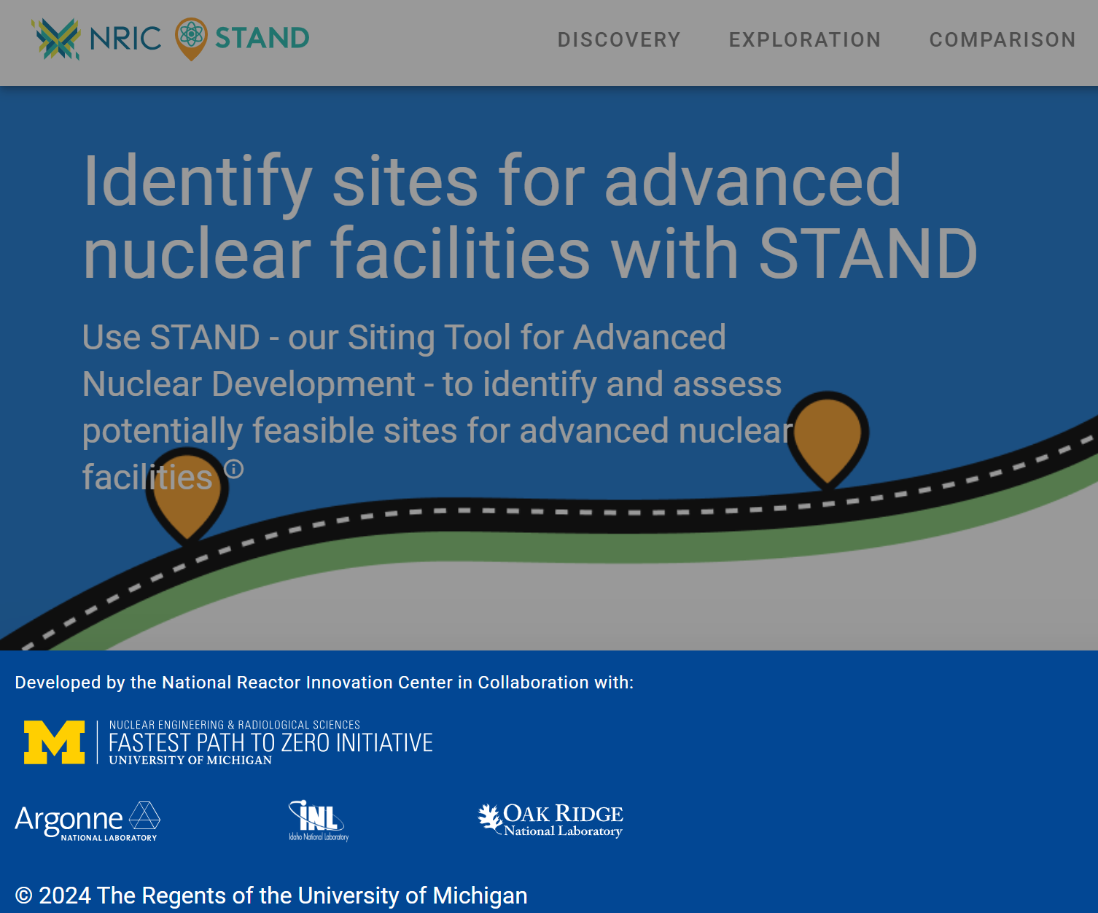
Technical Siting Overview
NRC has technical siting requirements tied to operational and accidental nuclear safety.
Also include economic, community and environmental concerns, to some degree
Oak Ridge Siting Analysis for power Generation Expansion (OR-SAGE) examines NRC concerns fully.
Preliminary tool, DOE’s STAND tool is shown herein
Image source: University of Michigan NRIC STAND Tool, homepage

Slide 12
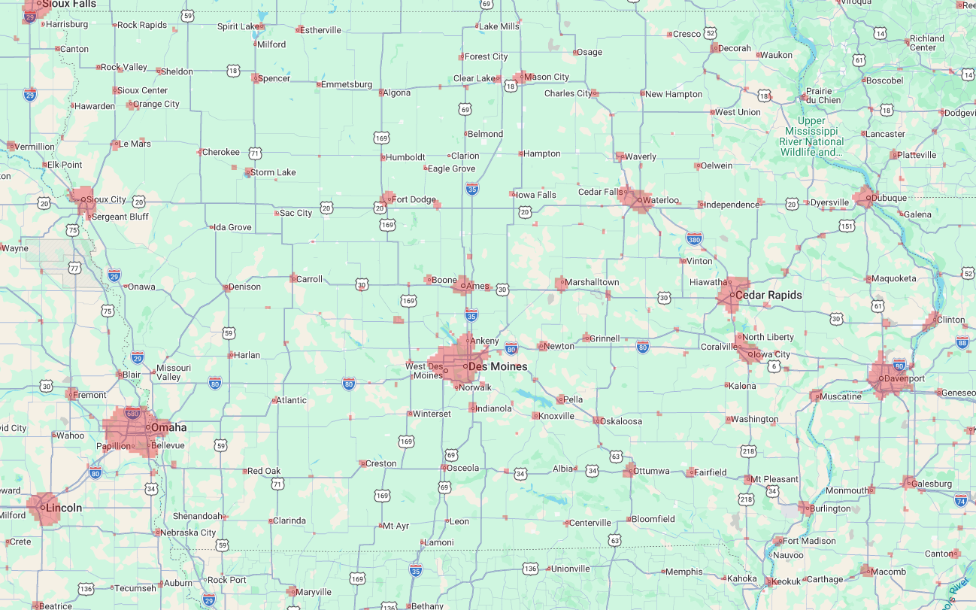
Technical Siting in Iowa: NRC guidance
Population
  10 CFR 100 defines
    “Exclusion zone”
    “Low population zone”
    Allowable distance to Population centers of 25,000 or more
  Distances depend upon the radiation from a single reactor failure
    Updated in 2023 from simple 20-mile benchmark
Recommended Exclusions for 2 mi. Buffer for > 500 people/mi² (2030)
Image source: University of Michigan NRIC STAND Tool

Slide 13
Technical Siting in Iowa: NRC guidance
Seismic
  Safe Shutdown Earthquake
    Land with safe-shutdown earthquake (SSE) peak ground acceleration (2% chance in a 50 year return period) between 0.1g -0.6 g.
      0.3 g for Large LWR
      0.5 g for SMR
  Faults within 200 miles
  Iowa has no seismic exclusion zones

Slide 14
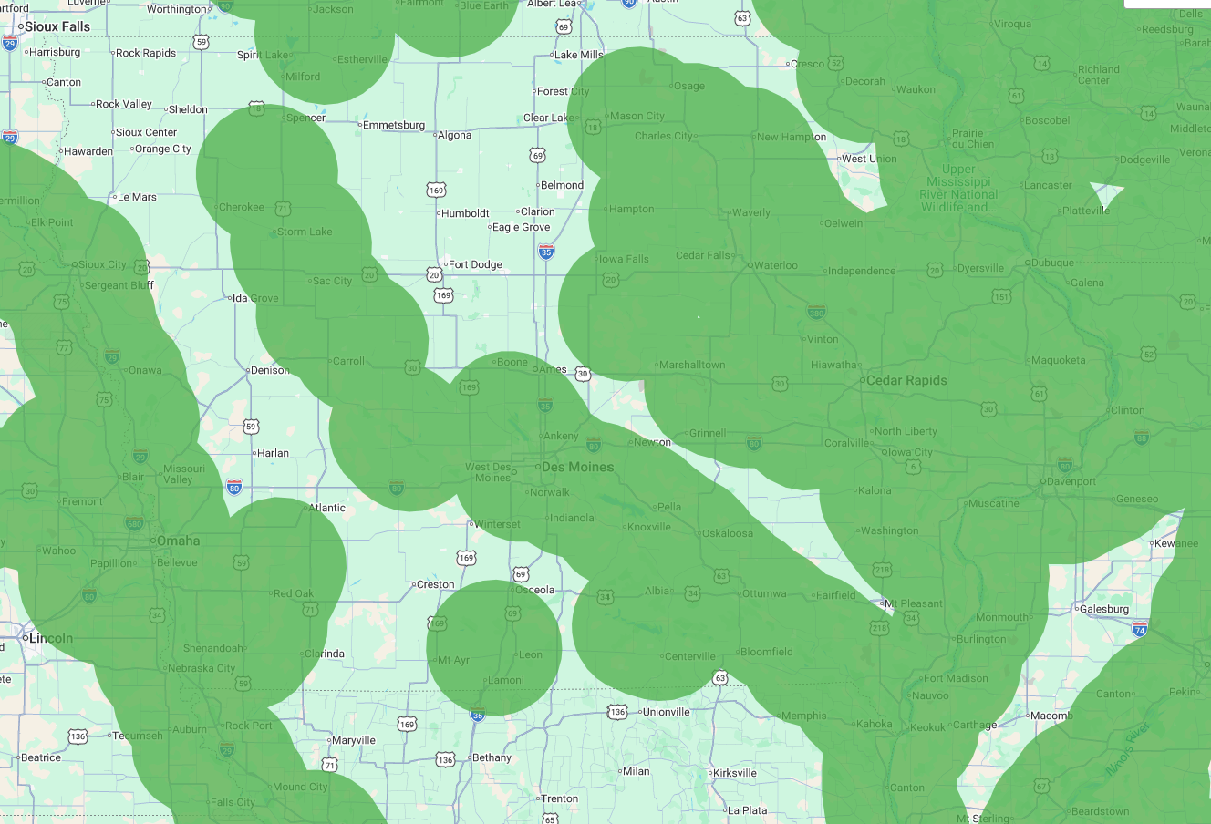
Technical Siting in Iowa: NRC guidance
Adequate Streamflow
  Land areas that are within 20 miles of sufficient freshwater cooling water makeup sources for nominal nuclear plant closed-cycle-cooling applications (limiting makeup water removal by the power plant to no more than 10% of the available flow
  Some Adv. Reactors do not use cooling water at all
  SMRs need >50,000 GPM
Within 20 miles of > 50k Gallons of Makeup Water
Image source: University of Michigan NRIC STAND Tool

Slide 15
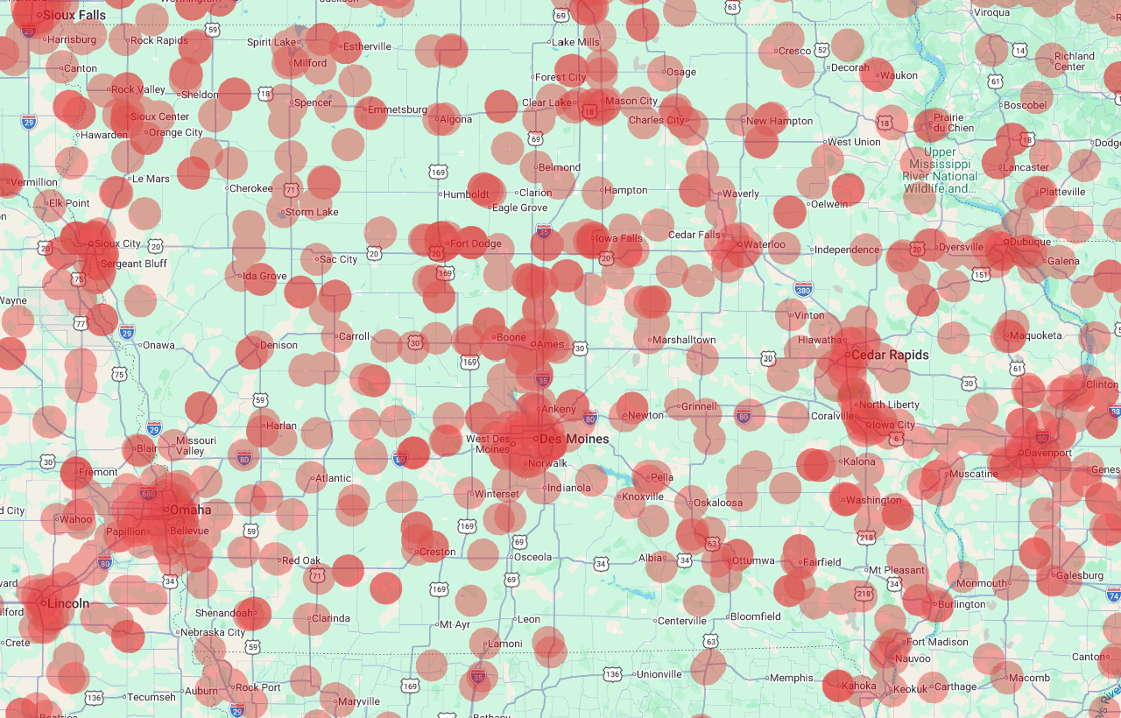
Technical Siting in Iowa: NRC guidance
Hazardous Facilities
  Does not necessarily preclude siting
  Must be considered, in process, however
  OR-SAGE screens out sites with > 3 hazardous facilities within 5 miles
All Hazardous Facilities
Image source: University of Michigan NRIC STAND Tool

Slide 16
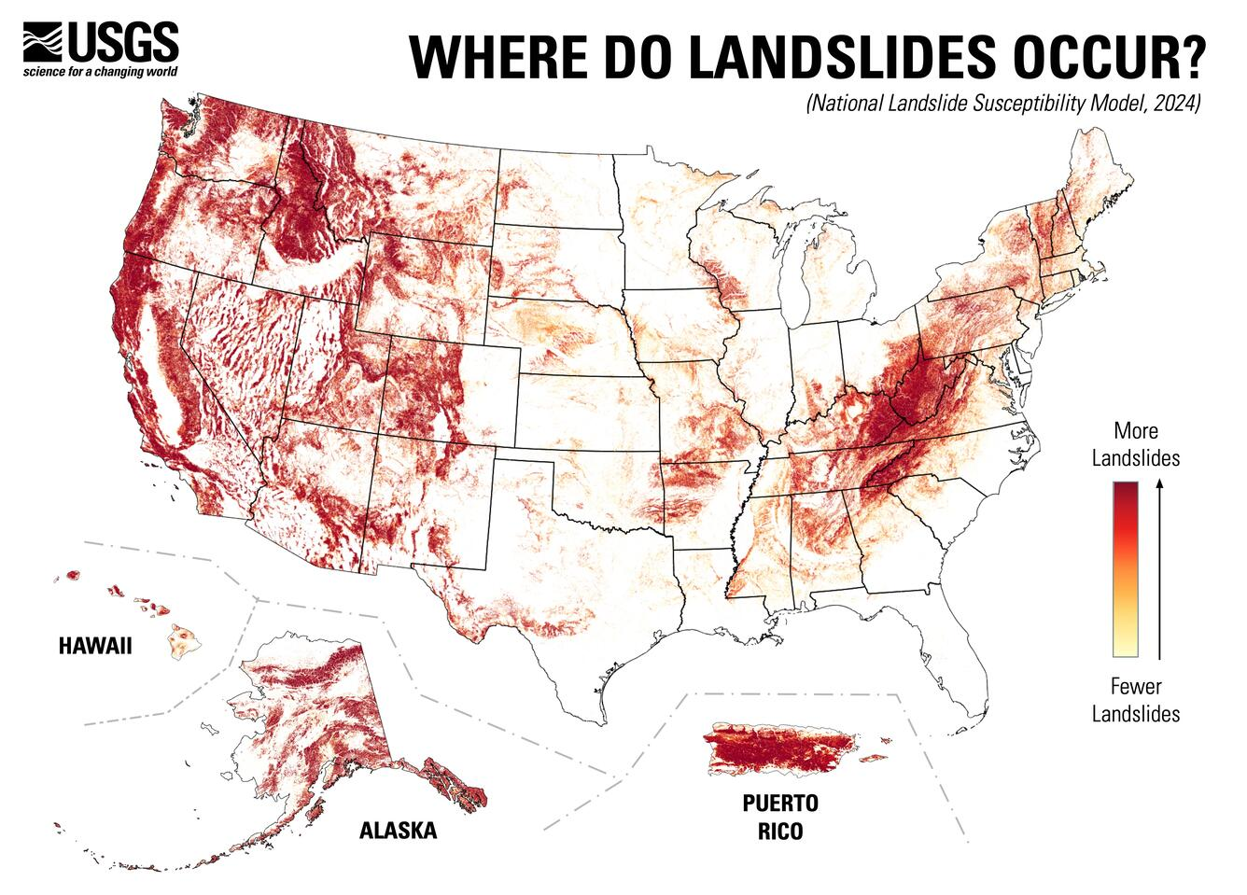
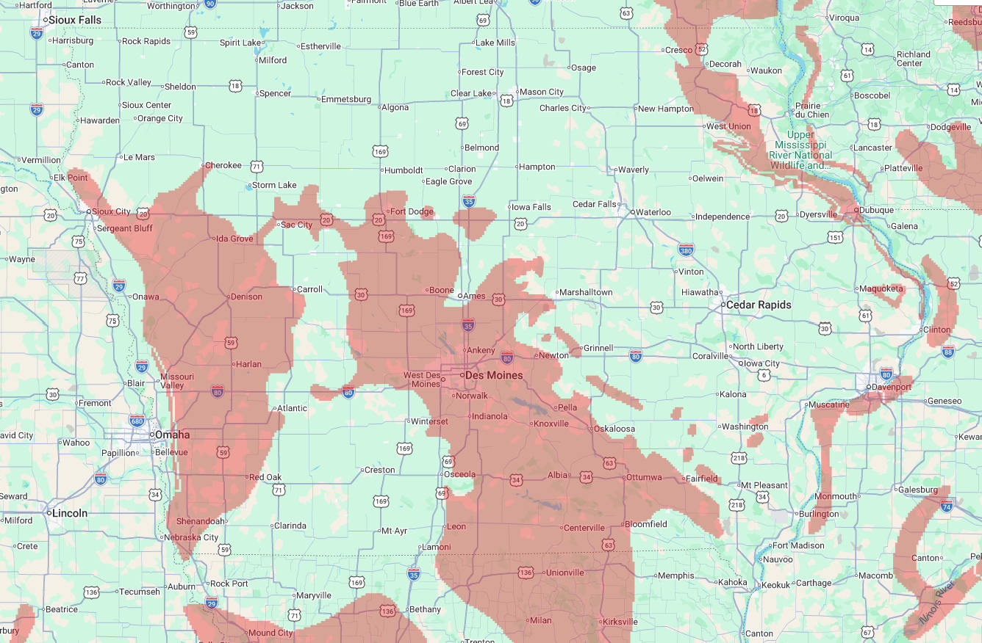
Technical Siting in Iowa: NRC guidance
Landslide Hazard
  Mentioned in NRC guidance, but without specific restrictions
  "nuclear power stations must be designed to prevent the loss of safety-related functions. Generally, the most restrictive safety-related site characteristics considered in determining the suitability of a site are surface faulting, potential ground motion and foundation conditions (including liquefaction, subsidence, and landslide potential), and seismically induced floods."
USGS Moderate of High Landslide Risk
Image source: University of Michigan NRIC STAND Tool
Image source: USGS

Slide 17
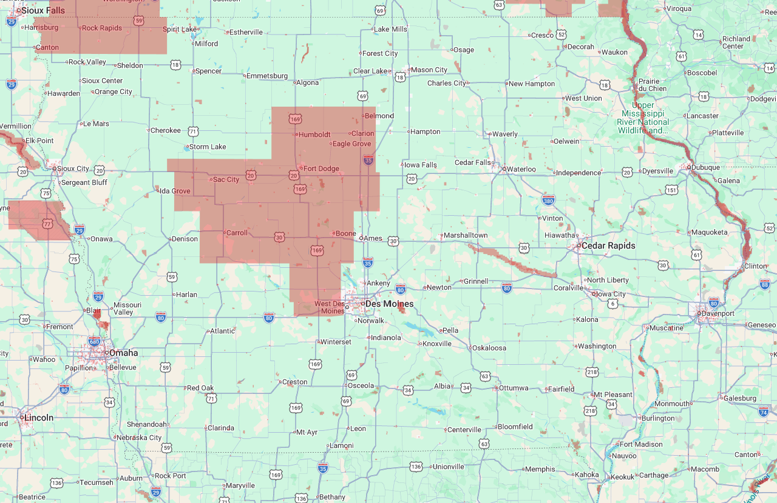
Technical Siting in Iowa: NRC guidance
All Protected Lands
Protected Lands
  Does not necessarily preclude NPP siting in these areas
  May be an area to address in application
  Proximity to public lands will mean that more people may be allowed to intervene
  Recent changes to NEPA may lessen requirements
Critical Habitats
Wildlife Refuge
Image source: University of Michigan NRIC STAND Tool

Slide 18
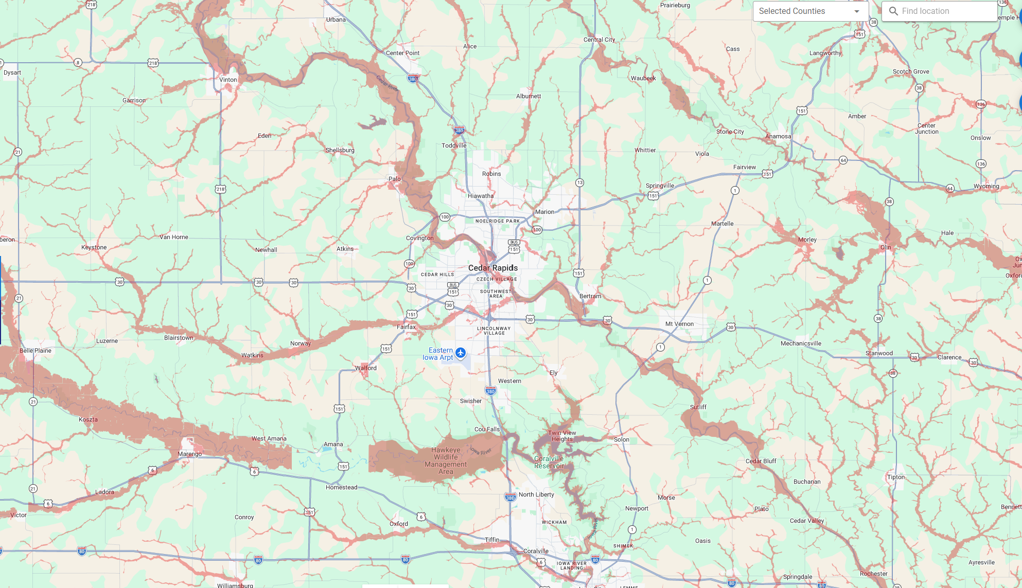
Technical Siting in Iowa: NRC guidance
100-Yr Flood Zone – Just Part of Iowa Shown
Floodplain
  100 yr floodplain, shown here, makes permitting difficult but not impossible.
  500-1000 yr flood levels will also be considered. It is feasible to engineer around floods at this level.
Image source: University of Michigan NRIC STAND Tool

Slide 19
Iowa Siting Potential,
Non-Technical

Slide 20
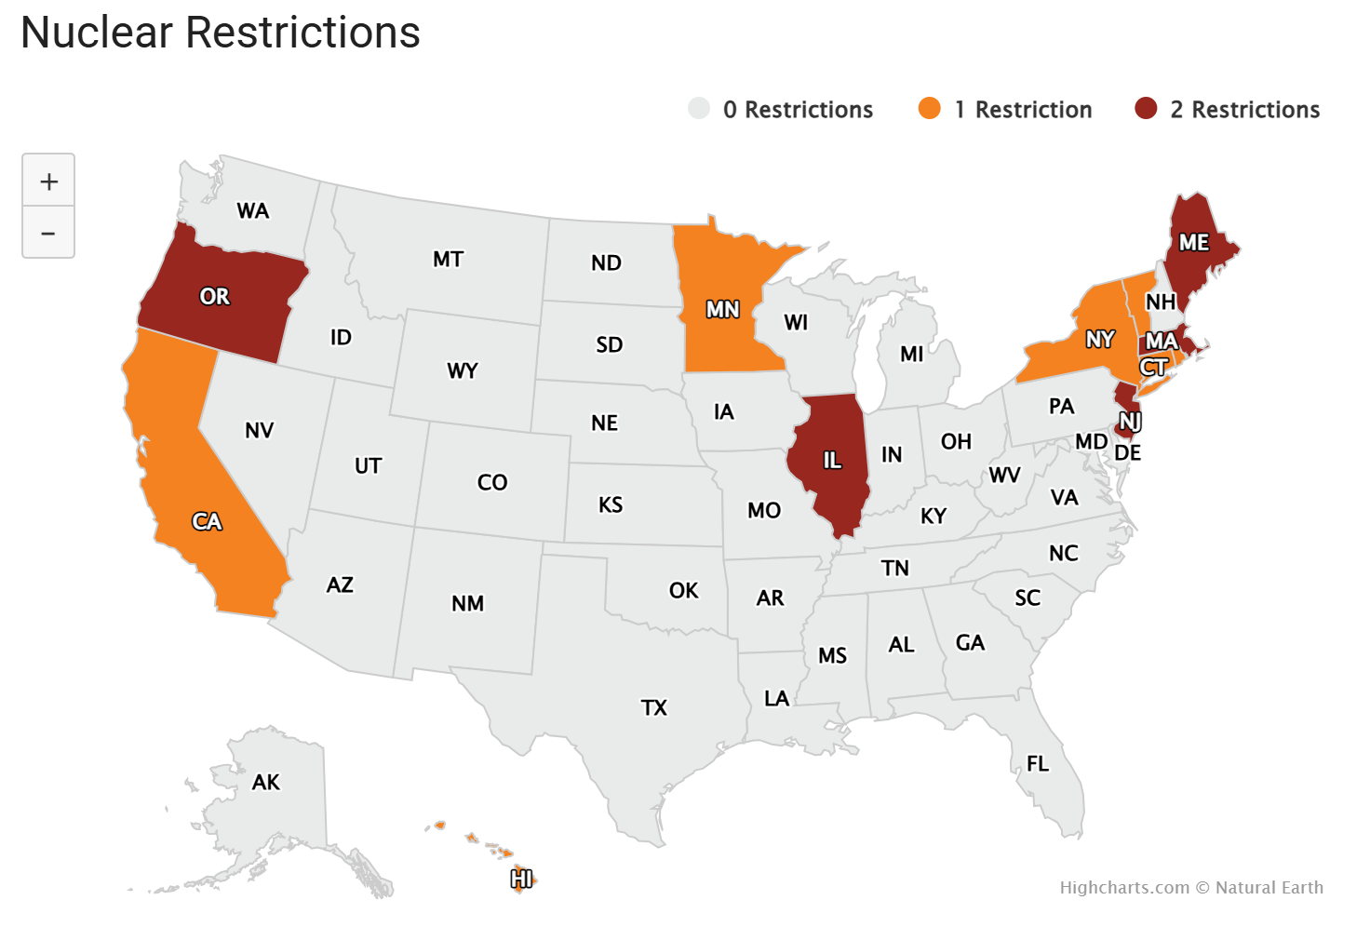
Line-of-Sight to Permitting
State laws
  Assurance the state level permitting, environmental, e.g. are feasible
  This task force, original exec order add level of state interest
County acceptance
  Local ordinances and zoning considerations
Public acceptance
  (next slide)
Nuclear Restrictions
Image source: University of Michigan NRIC STAND Tool

Slide 21
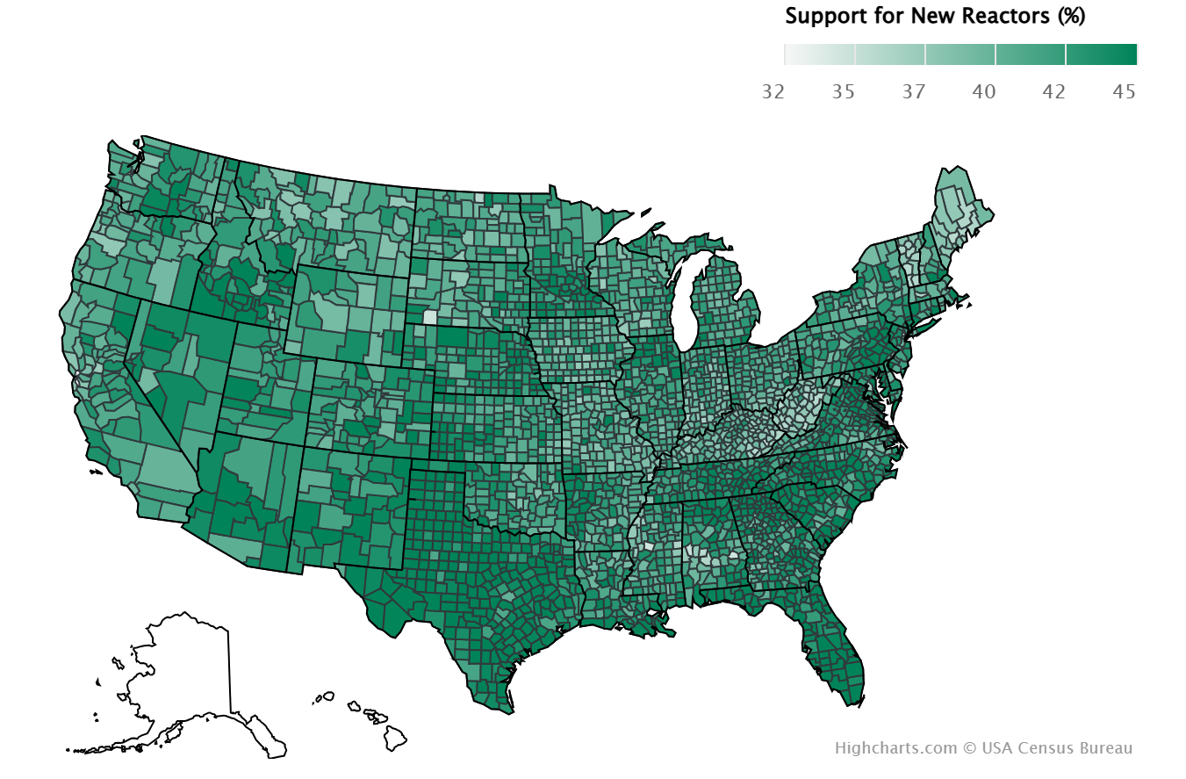
Line-of-site to Permitting
Public Acceptance
  Dated data (2011-2021), other sources now list U.S. average acceptance at 65-72%
  Range of measured nuclear sentiment is not strongly related to geography.
  Proximity to NPPs is correlated with positive sentiment, nationally.
  Education perceived by many experts as major barrier.
Nuclear Sentiment
Source: University of Oklahoma Center for Risk and Resilience (data), DOE Stand tool (Image)

Slide 22
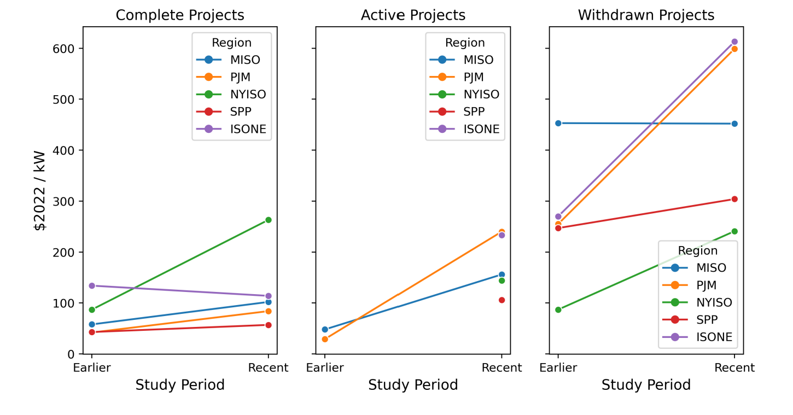
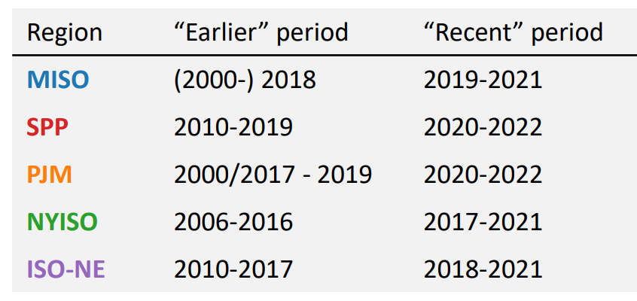
Economic Considerations in Iowa
Interconnection Costs
  Interconnection costs can vary widely by site and by study period.
  Prediction is difficult, due to ever-changing transmission system and inclusion of other projects
  MISO has committed to getting to a one-year-long interconnection study time by 2028 (per FERC 2023 compliance filing). This change will increase certainty but it may not reduce cost.
  MISO has relatively low interconnection costs, all considered.
Interconnection Costs by Request Status (2023)
Source: Berkley Lab: Seel, et al. Berkely Lab. Interconnection Cost briefing, June 2023.

Slide 23
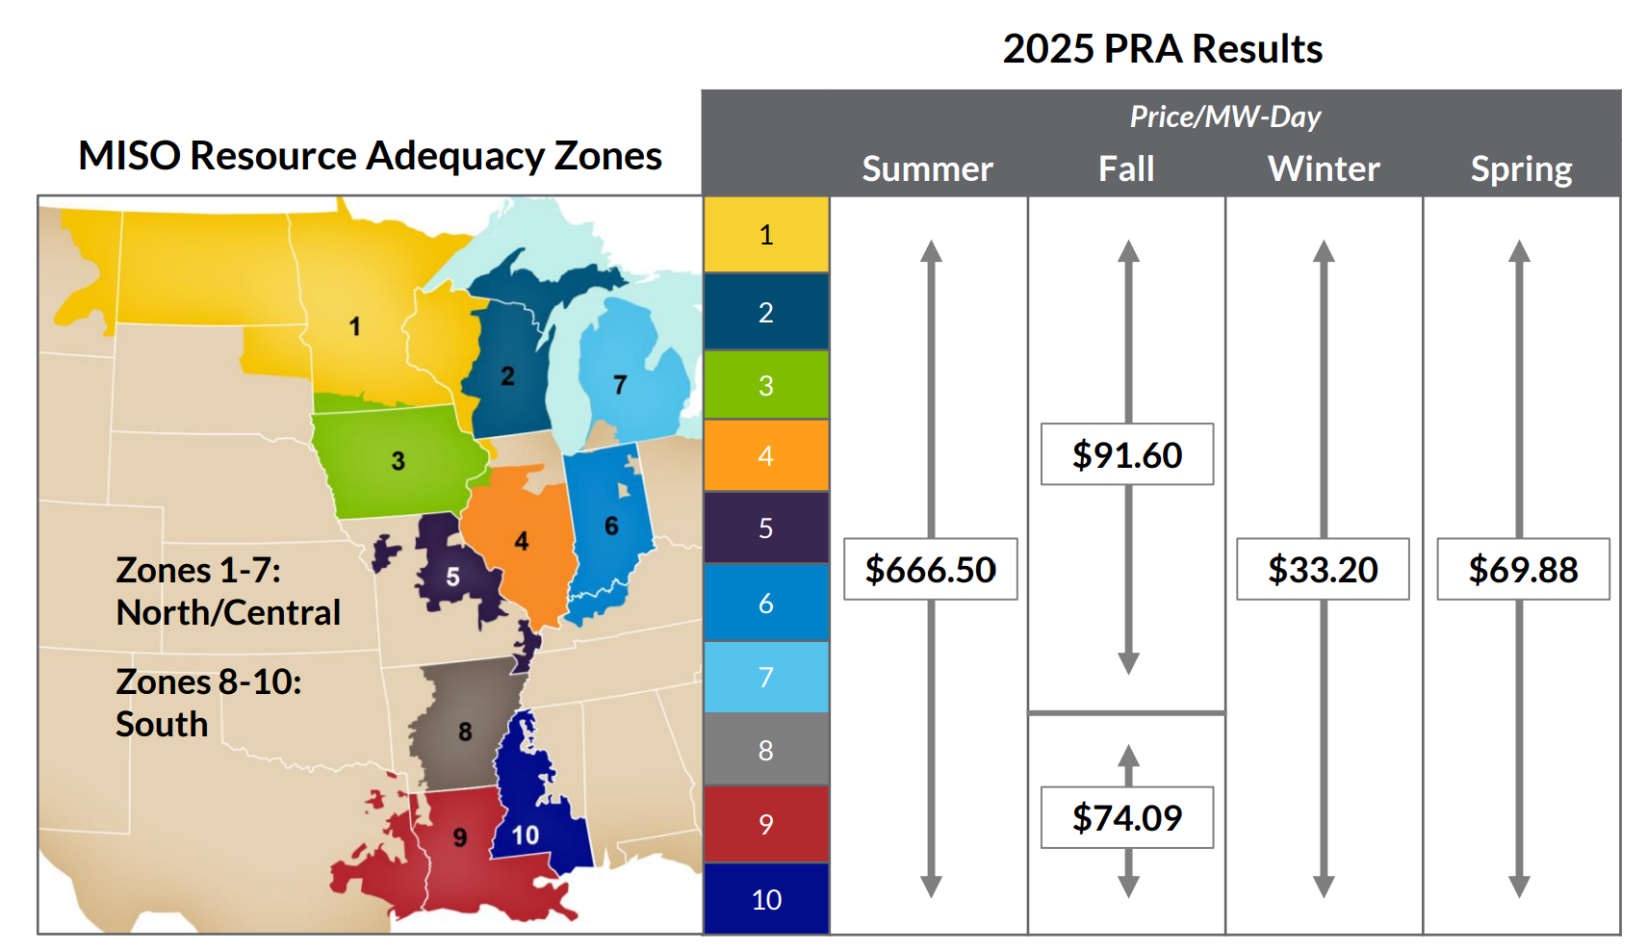
Economic Considerations in Iowa (cont.)
Local value of Power
  Need for power (constraints)
    Increasing Demand
    Retirements
  Value of energy and capacity locally/regionally
    Tight, and tightening capacity market throughout MISO region indicates growing capacity value
    Lowering accreditation of wind capacity value is driving need and demand in Iowa
  Desirability of site for new power user
Miso 2025-2026 Planning Resource Auction

Slide 24
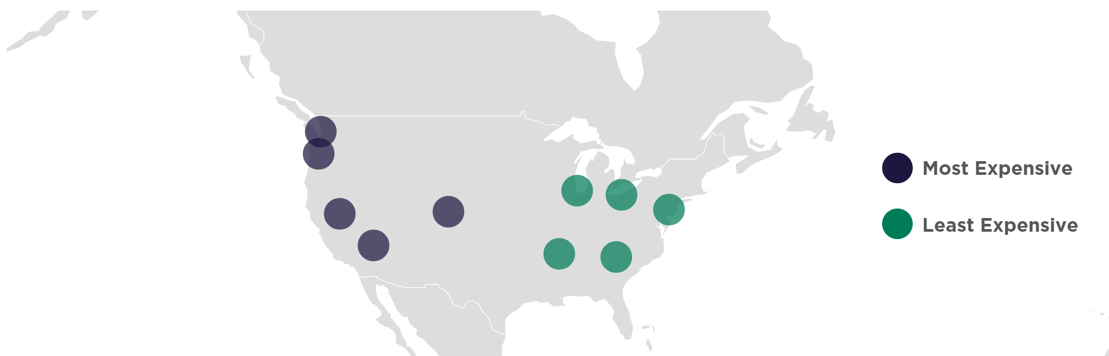
Economic Considerations in Iowa (cont.)
Construction and Operational Costs
  Materials and construction costs of region
  Workforce availability today and pipeline potential
  Supply chain availability and potential
  Analysis more specific to a technology and site may give further insights to this topic.
    Proximity to rail or waterways
    Proximity to materials or goods
Energy Communities, as defined by IRA are still highly favored
  10% adder for the Investment tax credit
  See: Department of Energy. Energy Community Tax Credit Bonus Portal.
Industrial Construction Costs, Large Projects
Cushman Wakefield. Industrial Construction Cost Guide

Slide 25
State Siting Work

Slide 26
State siting studies
Kentucky (SB 57, Awaiting Gov. Signature April 2026): Creates Nuclear Reactor Site Readiness Pilot Program, housed under KNEDA, with $25 M budget, to cover up to 1/3 of NRC license application costs.
Wisconsin (S.B. 125, July 2025): Calls for a state-wide siting study
Adjacent State-level Activities
  Texas’ Advanced Nuclear Development Fund (HB 14, 2025) includes $12.5 M (of $350 total) for early development funding and supply chain.
  Arizona consortium: Three AZ utilities working together on a three-year siting study
  New York Power Authority: RFI to identify interested communities

Slide 27
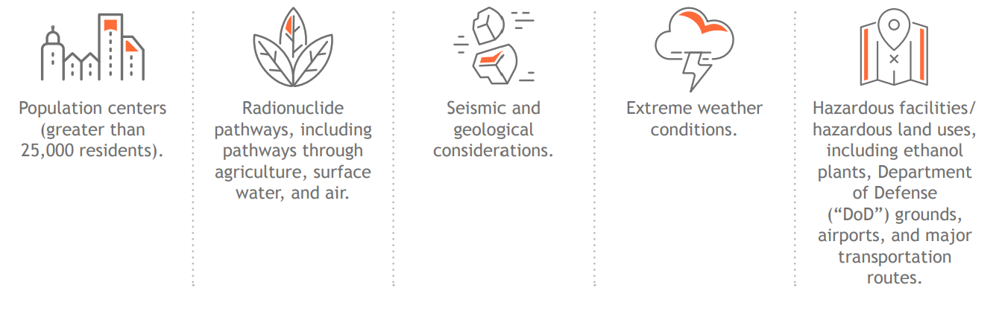
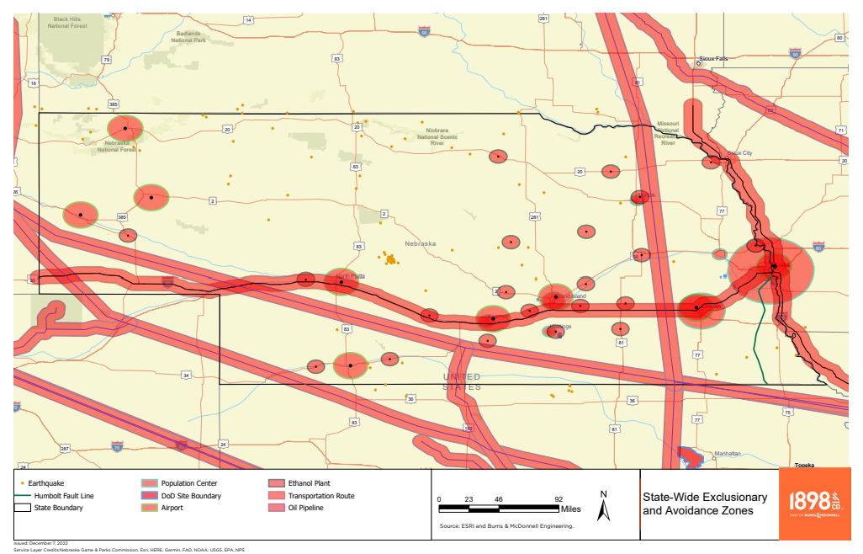
Nebraska Siting Study (2023)
1) Identify any Exclusionary or Avoidance Zones

Slide 28
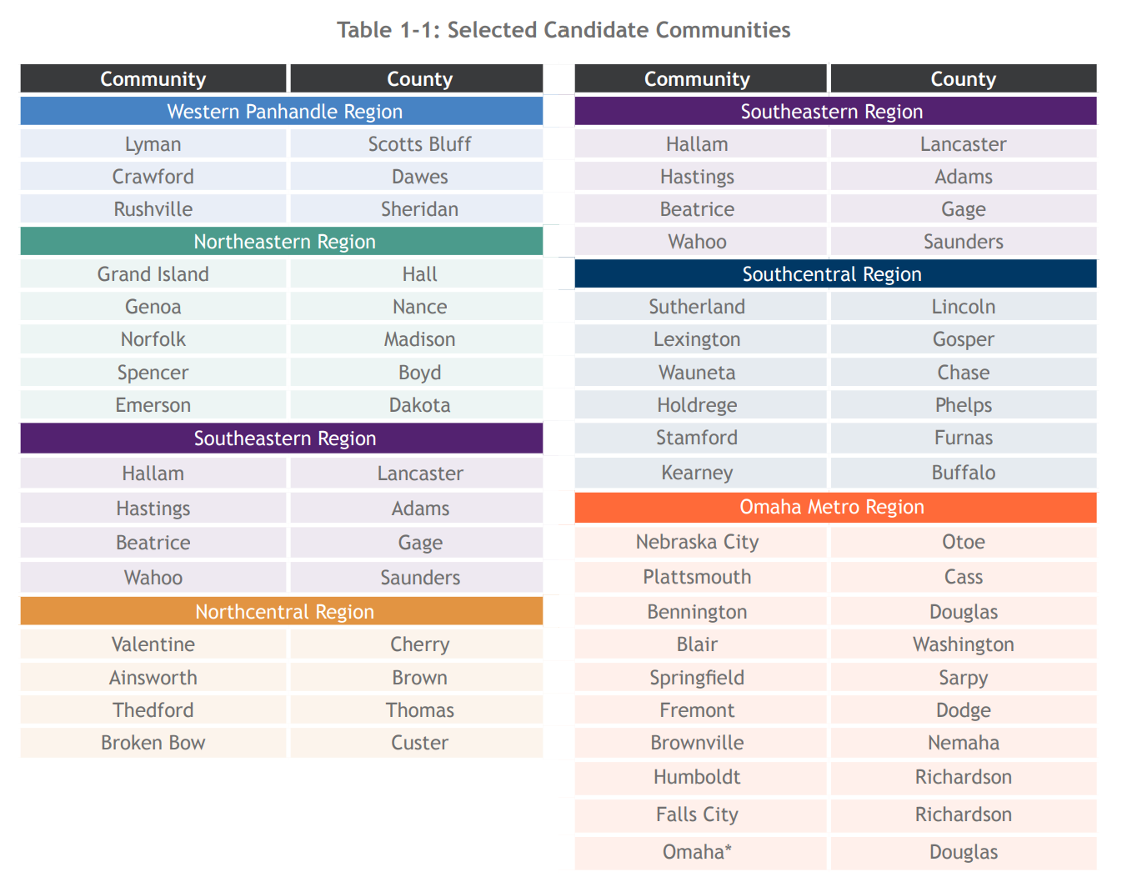
Nebraska Siting Study (2023)
2) ID Candidate communities
  Interested Communities
  Communities with existing power generation
  Communities not excluded

Slide 29
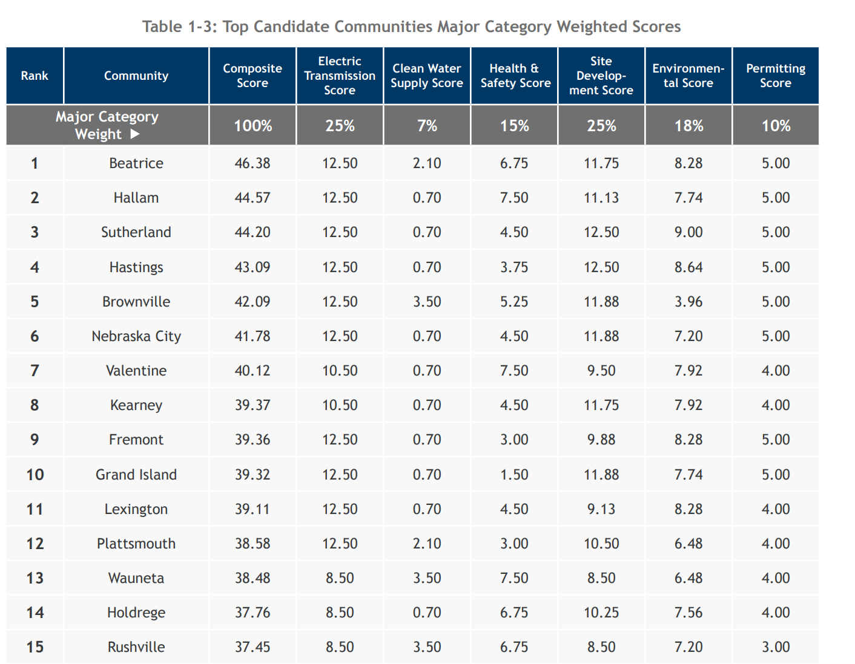
Nebraska Siting Study (2023)
3) Analyze and Evaluate

Slide 30
Appendix

Slide 31
Citations
Siting Examples
  Kemmerer:
    https://wyofile.com/terrapower-selects-kemmerer-for-advanced-nuclear-power-plant/
  Seadrift:
    https://investors.dow.com/en/news/news-details/2023/Dows-Seadrift-Texas-location-selected-for-X-energy-advanced-SMR-nuclear-project-to-deliver-safe-reliable-zero-carbon-emissions-power-and-steam-production/default.aspx
    https://www.world-nuclear-news.org/articles/dow-s-seadrift-site-selected-for-x-energy-smr-proj
    https://cdn.x-energy.com/wp-content/uploads/2026/02/06175359/beyondelectricityuk.pdf
    https://corporate.dow.com/en-us/news/press-releases/dow-x-energy-collaborate-on-smr-nuclear.html
  Clinch River
    https://www.tva.com/energy/our-power-system/nuclear/clinch-river-small-modular-reactor
    https://www.nrc.gov/reactors/new-reactors/large-lwr/esp/clinch-river
  Pallisades
    https://www.ans.org/news/2026-01-14/article-7673/holtec-submits-partial-construction-permit-application-for-smrs-at-palisades/
    Email with Patrick Obrein of Holtec International on 3/31/2026 (Send to Becca Gillespie)

Slide 32
Citations
Siting Examples
  Amarillo
    https://www.ans.org/news/article-7875/project-matador-joins-eis-pilot-program-nrc-seeks-public-input/
  Constellation:
    https://www.constellationenergy.com/news/2025/constellation-meta-sign-20-year-deal-for-clean-reliable-nuclear-energy-in-illinois.html
    https://www.powermag.com/constellation-seeking-permit-for-small-modular-reactor-at-nine-mile-point/
NRC siting requirements
  https://www.nrc.gov/reading-rm/doc-collections/cfr/part100/part100-0011
  https://www.nrc.gov/reading-rm/doc-collections/cfr/part100/part100-appa
  https://www.pillsburylaw.com/en/news-and-insights/nrc-reactor-siting-guidance.html
Technical Siting
  Most images from DOE STAND tool: https://nric.inl.gov/stand-tool/
  DOE Stand tool further references
    Population: ORNL Landscan data and US Census data
    Floodplain data source: https://www.fema.gov/flood-maps/national-flood-hazard-layer 100-Year Flood Zone: Spatial location of areas with a 1% annual chance of flooding. These areas are also referred to as the base floodplain and include Zone A, AE, A1–A30, AO, and AH flood zones as defined by FEMA.
    Streamflow: USGS/EPA National Hydrologic Dataset Plus
  Landslides: https://www.usgs.gov/media/images/where-do-landslides-occur

Slide 33
Citations
Non Technical Siting
  Miso 2025-2026 Planning Resource Auction
  University of Oklahoma Center for Risk and Resilience
  http://www.ncsl.org/research/environment-and-natural-resources/states-restrictions-on-new-nuclear-power-facility.aspx
  https://www.bisconti.com/blog/public-opinion-2025
State Siting Studies
  https://www.ans.org/news/2026-02-20/article-7773/gov-evers-announces-siting-study-for-new-wisconsin-nuclear/
  https://apps.legislature.ky.gov/record/26rs/sb57.html
  https://www.aps.com/en/About/Our-Company/Newsroom/Articles/AZ_Electric_Utilities_Team_Up_To_Explore_Adding_Nuclear_Generation
  https://trerc.tamu.edu/news-talk/texas-outlines-350m-advanced-nuclear-funding-programs/

Slide 34
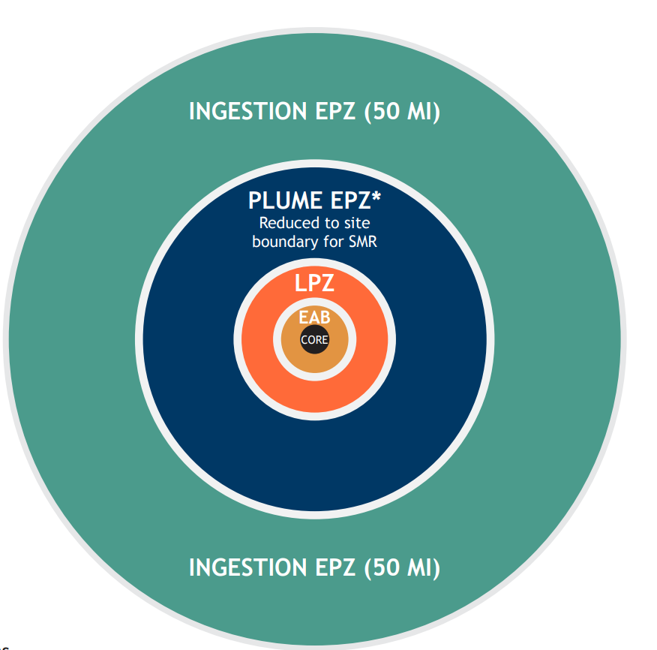
The exclusionary area boundary (“EAB”) is set at the location at which a person no longer receives a dose exceeding 25 rem to the whole body over a two-hour period of exposure after a radionuclide release event.
The LPZ is determined by the location at which a person no longer receives a dose exceeding 25 rem to the thyroid over a two-hour period of exposure after a radionuclide release event.
The LPZ boundary must lie 1.333 times the distance from the reactor core to the boundary of a population center, and therefore a site must not be constructed within or adjacent to the border of a population center.
Historically 10 mi

Slide 35
NRC Regulatory Guide 4.7 provides guidance that a reactor should preferably be located in such a place that the population density, including weighted transient population, averaged over any radial distance out to 20 miles, does not exceed 500 persons per square mile.
NRC Regulatory Guide 4.7 define a population center as a population of roughly 25,000 residents.
Historically 10 mi

