Slide 1
Nuclear Costs and Economic Impact
Michelle Zietlow-Miller – GAIN Public Engagement Manager
April 6, 2026
Notes:
Thank you chair and members of the committee for having me here today. I’m Chris Lohse Innovation and Technology Manager from the Gateway for Accelerated Innovation in Nuclear which is a DOE-Nuclear Energy Program.
I’d like to cover some of the nuclear energy deployment models and some of the new roles we are seeing in the industry. And importantly, how some of these financial support mechanisms could help de-risk these projects.
First, I’d like to start with what a nuclear project looks like.
“Analyze the long-term economic benefits and costs of SMR deployment, comparing nuclear energy pricing to other energy sources, evaluating job creation potential, and assessing local economic impacts.”

Slide 2
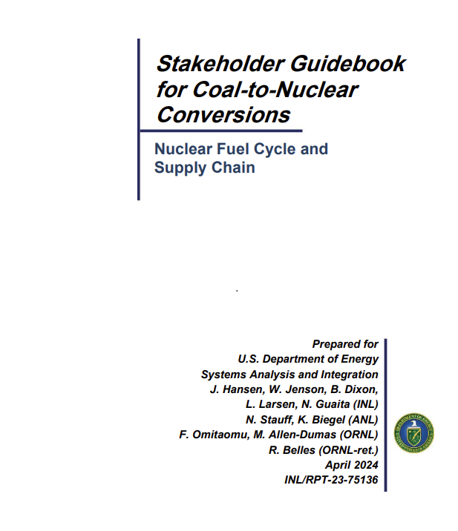
Coal to Nuclear Stakeholder Guidebook
Published in 2024
Utilized Terrapower and Nuscale employment projections from 2021/2022 timeframe for nuclear power plants and Hitachi Velocity Suite employment projections from coal plans
Considered 300 possible scenarios of adding nuclear to an existing brownfield site based on varying population (<20,000 – 200,000+) and plant capacity sizes (100 MWe – 900 Mwe)
Notes:
Source: https://www.energy.gov/ne/articles/coal-nuclear-transitions-information-guide
Highlight how coal jobs compare to nuclear jobs

Slide 3
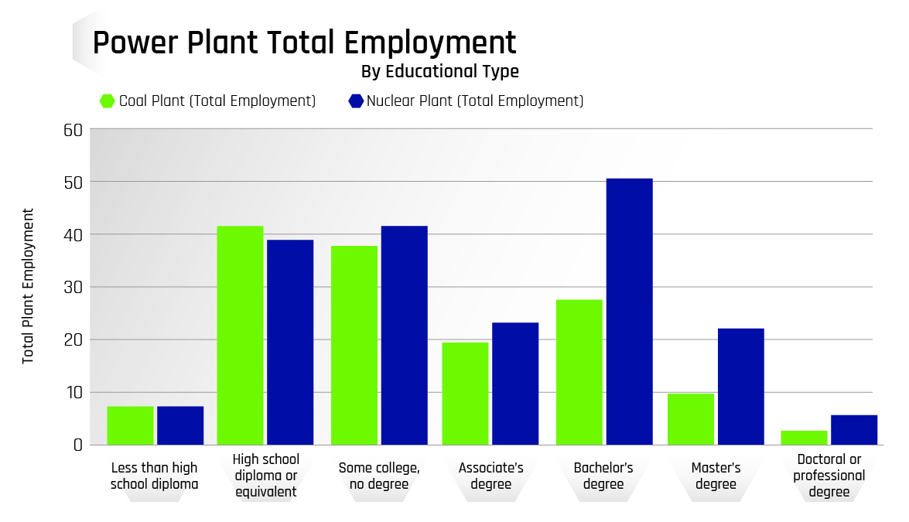
Overlap in job types and education levels
Compared occupation codes shows the similarity in roles from each power plant type.
Many occupations at a coal power plant have the educational background to work at the nuclear power plant.
Analysis does not account for nuclear, industry-specific training.
45%
of added nuclear jobs share identical occupation codes with a coal plant
72%
of the added jobs share similar occupation codes
Notes:
Source: https://www.energy.gov/ne/articles/coal-nuclear-transitions-information-guide
Highlight how coal jobs compare to nuclear jobs

Slide 4
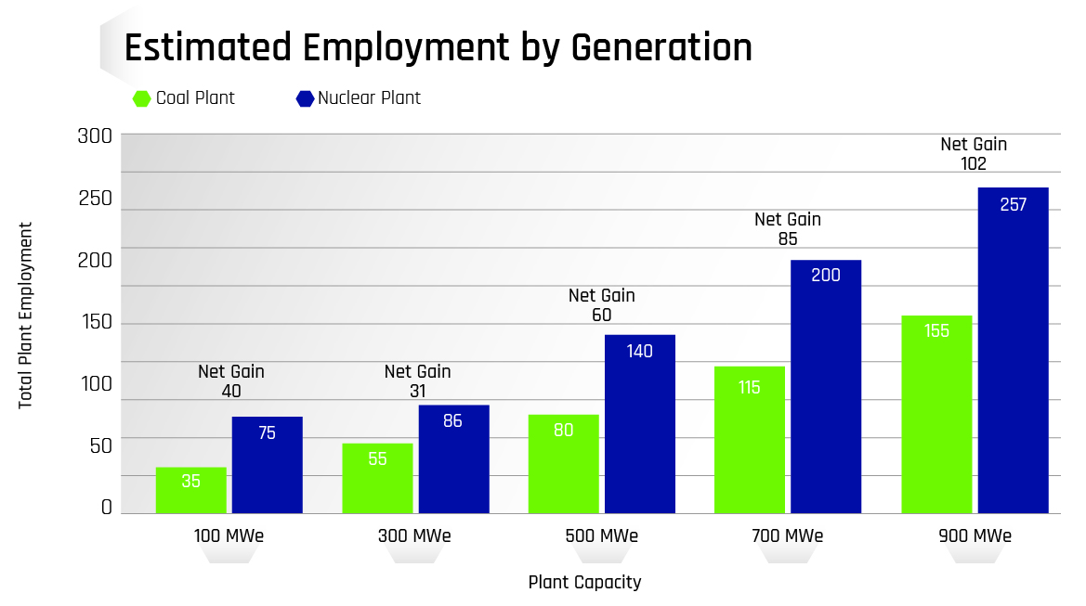
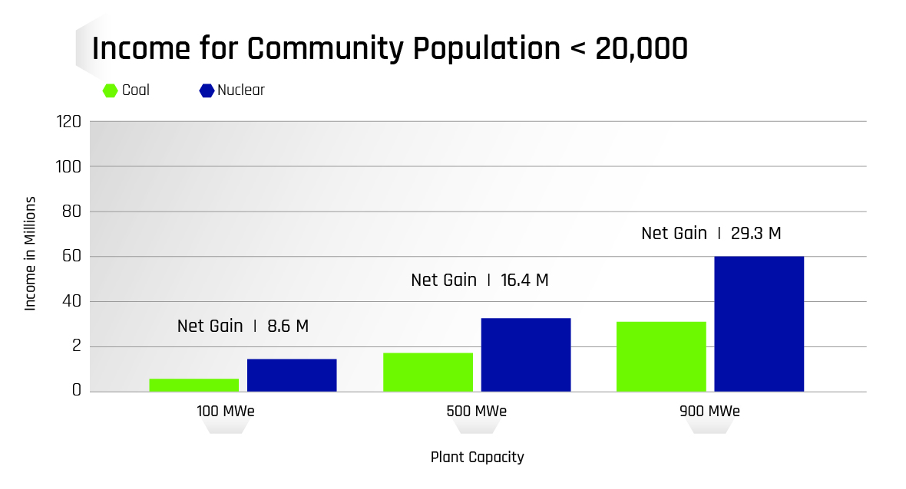
What does nuclear power addition offer a community?
Nuclear can bring lasting jobs to a plant for 40-80 years
There are both direct jobs created as well as indirect and induced jobs
Many other technologies such as wind, solar, and gas only bring construction jobs
For every $100 of electricity produced, $50 of economic activity occurs in suppliers and support industries
Notes:
Source: https://www.energy.gov/ne/articles/coal-nuclear-transitions-information-guide
Add in Outages – average 25 days – additional 1500 people onsite - boost to local economies
Property Taxes – depends on each community/state; The average nuclear power plant pays about $16 million in state and local taxes annually. These tax dollars benefit schools, roads and other state and local infrastructure
Each nuclear energy facility generates about $470 million annually in sales of goods and services in the local community. Approximately $40 million is spent annually in wages at each facility. Nuclear companies procure over $10 billion each year in materials, fuel and services from domestic suppliers. Nuclear procurement takes place in all 50 states (30 states have nuclear power plants). The average procurement per state each year is over $270 million.
.

Slide 5
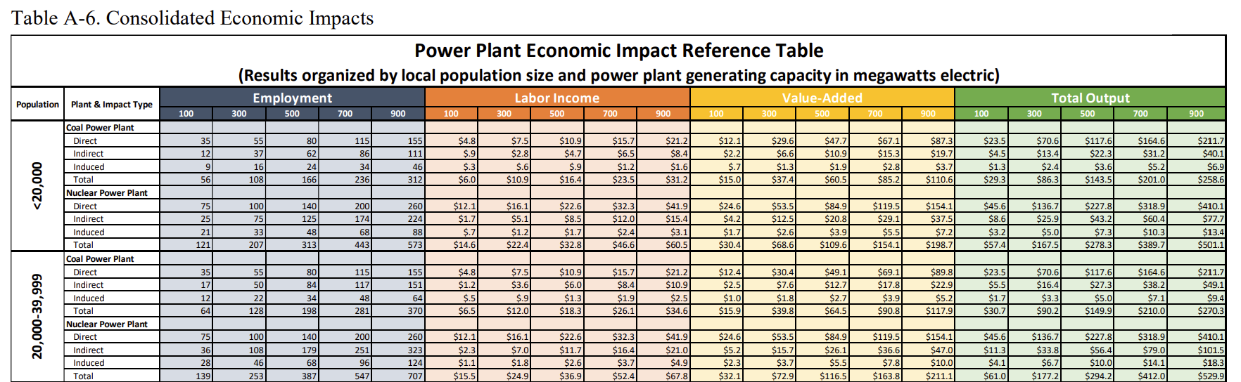
Consolidated Economic Impacts

Slide 6
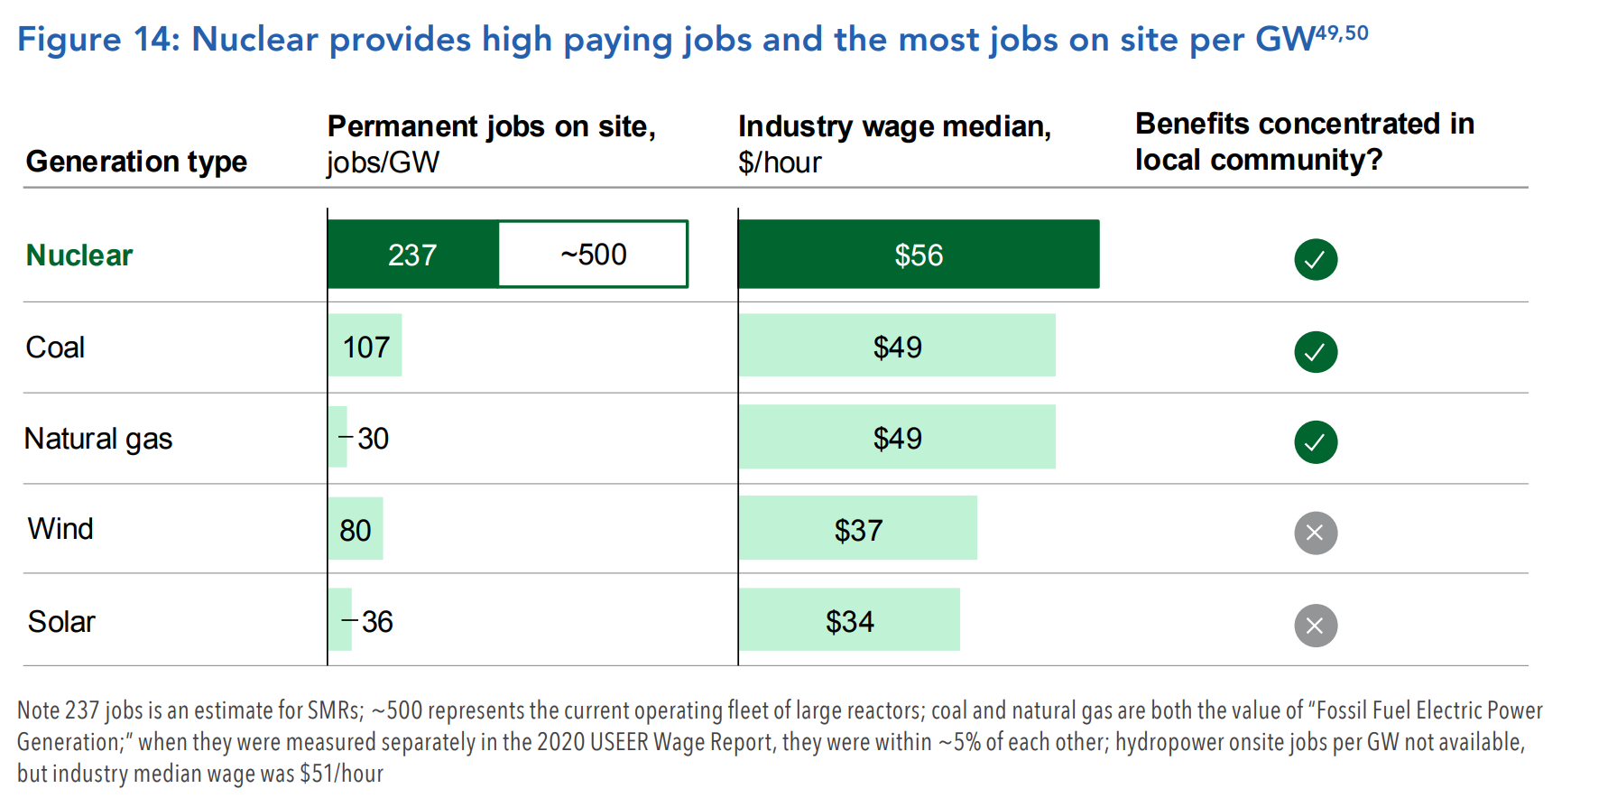
Ref: DOE Nuclear Liftoff Report
Notes:
In 2023/2024 INL Published a stakeholder guide to nuclear power plant conversions. The study looked at population tiers from 20,000 people to over 200,000 and the economic impacts on those communities when transitioning a specific amount of power from coal to nuclear. In this case it analyzes 5 different scenarios – 100 Mwe to 900 Mwe, the
For economic impact analysis six communities were selected to represent each tier for a total of 30 communities.
Decision-makers within CPP communities considering nuclear replacements may be interested in a range of plant sizes that align with energy needs that may have changed since the CPP was initially constructed. For this purpose, economic impacts were calculated for five generating capacity increments, 100, 300, 500, 700, and 900 MWe.

Slide 7
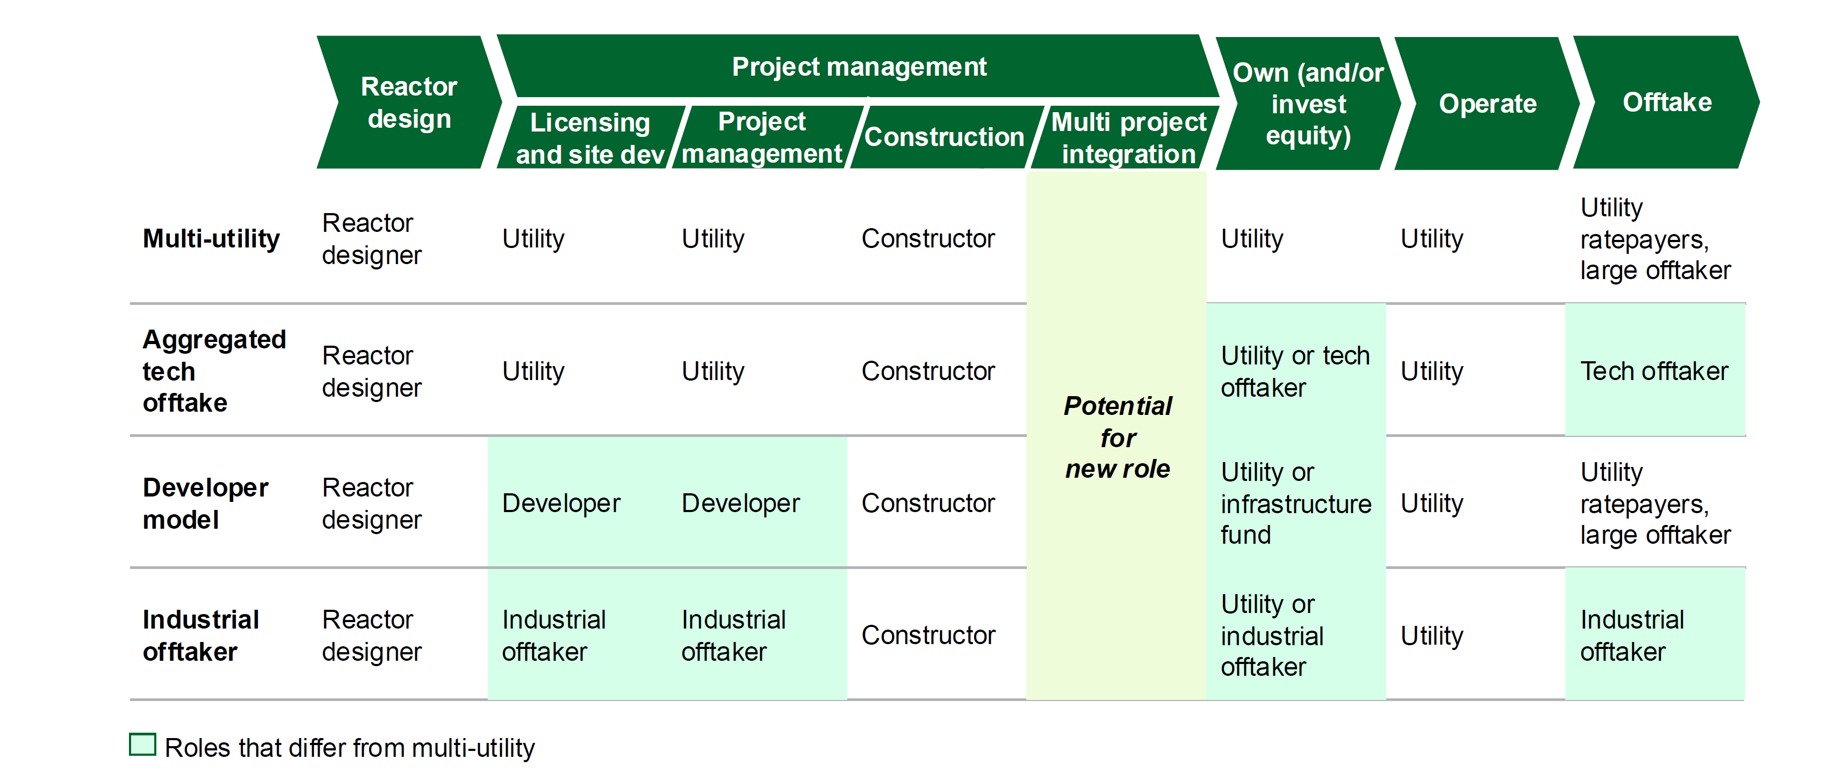
Deployment Models
Image: DOE Liftoff – Advanced Nuclear
Notes:
This is out of the liftoff report, but is a good summary of some of the models that have been discussed and who supports various aspects of the build.
Levi will run through a few examples here of prior projects and how they were built as well as derisking options that could support the model.

Slide 8

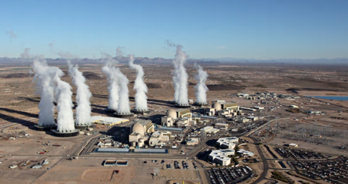



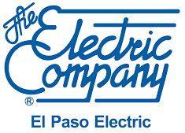

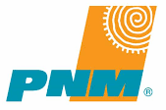


Example of Utility Led Project: Palo Verde Generation Station
APS lead the project
Financing & Risk Considerations
Done with combination of debt & equity - utility issues notes or uses LPO
Utility carries the most risk (utilities are generally very risk averse)
  Depending on market, cost overruns are absorbed or passed-on
Derisking options that can/have been used:
  Recover costs during construction
  Investment tax credits
  Overrun insurance
Palo Verde Plant Ownership Table
29.1% | Arizona Public Service
20.2% | Salt River Project
15.8% | El Paso Electric Company
15.8% | Southern California Edison
7.5% | PNM Resources
5.9% | Southern California Public Power
5.7% | Los Angeles Dept. of Water & Power
APS selected a Westinghouse
PWR Technology
APS selected Bechtel to manage the project (EPC and AE)
Notes:
One or more Utilities Lead the project
Selects reactor technology
Selects AE and EPC to finish design and lead construction
Utility owns and operates
Financing
Typically done with combination of debt and equity with utility holding the debt on the project. Can use utility debt (issue notes) or work with LPO.
Cost recovery will differ based on state rules
Another example is Vogtle
Risks – Utility usually has the most risk here. Utilities right now are unwilling to take balance sheet risk and any overruns are typically placed on the rate payers
Potential facilitators – Ability to recover costs during project, investment tax credits, some form of cost backstop to limit tail risks

Slide 9
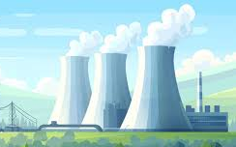
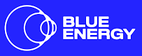




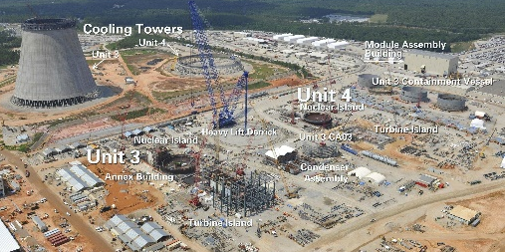


Developer Led – New Nuclear Model: “Build and Transfer”
Integrated project developer builds the plant with intent to sell to company (utility or other) once complete
Financing & Risk Considerations
Developer raises all capital and debt to build project
Developer carries all (or most) the risk
  Uncertainty still exists around who bears what risk in these projects
  Risk profile changes given developer may build a substantial number of a given reactor
Derisking options that could be used:
  Orderbook pricing (similar to consortium builds)
  Recover costs during construction
  Investment tax credits
  Overrun insurance
Developer selects a reactor technology company to partner with
Developer selects EPC and AE firms to manage the project
“The company’s fleet-scale model combines using proven, licensed technology and a design-once, build-many approach with developing coalitions across communities, regulators and financial stakeholders.” – The Nuclear Company Website
Notes:
An integrated project developer builds the plant with intent to sell to a utility once complete
Developer selects reactor technology and manages reactor technology company, AE and EPCs to complete project
Typically called build and transfer
Utility would be the ultimate end owner
Financing
Developer would need to raise capital to build the project. LPO may be one option.
Risks
Developer and others have construction risk as utility usually would only take ownership after completion
How would a cost overrun be handled? Who will complete the project and share in excess costs?
Examples
Elementl
The Nuclear Company
Blue Energy

Slide 10
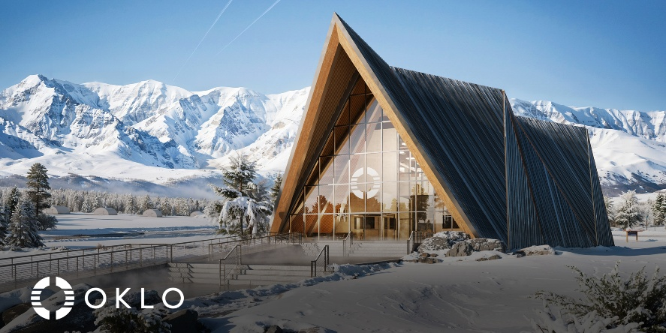

New Independent Power Producers – New Nuclear Model
Nuclear technology developer
builds, owns and operates the plant
Financing & Risk Considerations
Nuclear technology developer raises all capital and debt to build project
  May utilize equity markets, but similar debt mechanisms
Nuclear technology developer carries all the risk since they will own and operate.
  Ability to mitigate risk will be based on their supply chain and other contractors that are supporting the reactor build.
  Also incur power market risk as they will be signing PPAs for offtake.
Derisking options that could be used:
  Investment tax credits
  Production tax credits
  Overrun insurance
Nuclear technology developer uses own reactor technology
Partner with all firms (EPC or AE) to complete project
Notes:
An integrated project developer builds the plant with intent to sell to a utility once complete
Developer selects reactor technology and manages reactor technology company, AE and EPCs to complete project
Typically called build and transfer
Utility would be the ultimate end owner
Financing
Developer would need to raise capital to build the project. LPO may be one option.
Risks
Developer and others have construction risk as utility usually would only take ownership after completion
How would a cost overrun be handled? Who will complete the project and share in excess costs?
Examples
Elementl
The Nuclear Company
Blue Energy
PAUSE – Questions about the models??????

Slide 11

Reference cost ranges for large and small modular reactors
Costs are shown as between-of-a-kind (BOAK) or costs after first-of-a-kind demonstrations have taken place, but before n^{th}-of-a-kind learning as materialized
The INL report behind these values includes important information to energy mix planners about how to adequately capture advanced nuclear technology (e.g., capital costs, construction times, ramp rates)
 | Large Reactor |  |  | SMR
 | Advanced | Moderate | Conservative | Advanced | Moderate | Conservative
Nuclear Fuel Costs ($/MWh) | 9.1 | 10.3 | 11.3 | 10.0 | 11.0 | 12.1
Nuclear Fuel Costs ($/MBTU) | 0.88 | 0.99 | 1.09 | 0.97 | 1.06 | 1.17
Fixed non-fuel O&M ($/kWe-yr) | 126 | 175 | 204 | 118 | 136 | 216
Fixed O&M ($/MWh) @ 93% capacity factor | 15.5 | 21.5 | 25.1 | 14.5 | 16.6 | 26.5
Variable non-fuel O&M ($/MWh) | 1.9 | 2.8 | 3.4 | 2.2 | 2.6 | 2.8
Total O&M ($/MWh) | 26 | 35 | 40 | 27 | 30 | 41
Reference O&M costs for large reactors and SMRs
Reference overnight capital costs (OCC) for large reactors and SMRs
Notes:
Here are the ranges developed. There are 3 ranges developed. Q1 is conservaitve, Q2 is moderate, Q3 is advanced (Q1 is the high side, Q3 is the low side, Q2 is the median)
It should also be noted that there is a cost reduction assumed based on deployment scenarios. The cost reductions are based on learning rates from bottom up learnings in the literature and an assumed reactor deployment mix.
There has been further work to look at how these cost reductions actually can happen.

Slide 12
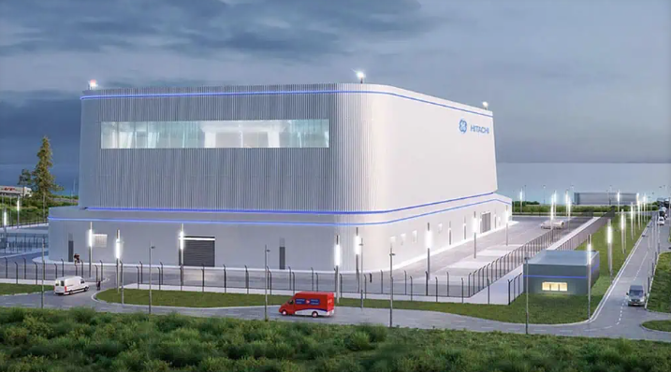
What’s the cost of new nuclear?
OPG and GE Announced Green Light to proceed on Darlington Project
4 GE BWRX-300 Units, 1200 MW total
First Reactor estimated at $4.4B with additional 1.2B for common Infrastructure
Total $15.0B (all in cost)
First Unit expected by 2030, project will continue into the 2030’s
Estimated to create 18,000 jobs
 | Unit 1 | Unit 2 | Unit 3 | Unit 4 | Common | Total
Overall Cost | 4.4B | 3.7 B | 3.1B | 2.6 B | 1.2B | 15.0B
Owner Capex Cost ($/KWe) | $14,640 | $12,444 | $10,248 | $8,784 | NOTE: GAIN developed this table based on highlighted key data from OPG
% Reduction |  | 85% | 70% | 60%
Warning: Do not compare these numbers to the previous slide. They all have their own context/units.
Learning Curves will result in better cost performance, do impact cost performance
Notes:
Current projections for construction:
Unit 1 Construction begins in 2026, Unit 1 commercially available 2030. Units 2-4 available by 2035.
This lines up with the Meta Analysis by the 3rd Unit – however meta analysis does not include capital, financing, escalation, etc and OPG numbers do so we can’t compare costs
Source: https://www.insauga.com/21-billion-ontario-new-nuclear-project-given-green-light/

Slide 13
The Path Forward
Without broad commercialization cost uncertainty (risk) is high
Despite high-cost uncertainty for nuclear, in the near term, a path to broad commercialization is possible. This path likely includes the following:
Sequential builds that yield real learnings in labor forces, supply chains, and construction/designs
A mechanism for offsetting FOAK risk to encourage first movers
Continued intervention until costs can reduce enough to make plants viable for mainstream markets
Technology fails to commercialize broadly
Adoption yields cost reductions and broad commercialization
Risk reduction requires increased adoption
(more builds)
High first mover risk dampens interest in new builds
First mover risk is mitigated and adoption is widespread
Notes:
So in this flowchart, we have our current path where we have high uncertainty and risk. We need to reduce risk by building, but then the first movers take longer and high risk which causes people to step back and then we fail to commercialize.
But if first mover risk is mitigated to allow for more widespread builds, we can get more adoption and cost reductions which will allow for more broad commercialization.
And building sequential builds is what has been shown in the past to work where learnings can be implemented and then drive down the future costs that allow for more widespread adoption.
Now a few examples of de-risking options and how they impact the projects.

Slide 14
Derisking Projects: Tax Credits
The Inflation Reduction Act (IRA) of 2022 supports advanced nuclear technologies through Section 45Y PTC and Section 48E ITC.
  These credits offer distinctly different financial incentives and include bonuses for domestic content and location
PTC Impact Region
ITC Impact Region
Low
High
Low
High
 | Capital Costs
O&M Costs
 | Capital Costs
O&M Costs
Low
Low
Green = Profitable Outcomes
High
Red = Unprofitable Outcomes
High
When more concerned about capital cost risks: Pick ITC
When more concerned about O&M cost risk: Pick PTC
Notes:
Andrew has already talked about or will be talking about the tax credits.
But one way to look at this is that they offer an ITC or a PTC.
Scenarios have been run in various markets demonstrating the various ranges of project capital cost vs. operating costs and where these have profitable outcomes for the utility/operator.
The summary is that when a project is more concerned with capital costs, the company should take the ITC. But if there is more O&M cost risk then a PTC may be better.
Now for an ITC, it also can have an impact on how a company can recover these costs.

Slide 15
Derisking Projects: Tax Credits - ITC
50% ITC
30% ITC
ITCs can be used to offset first mover risk by making the “net cost” lower for projects with cost overruns
States could implement ITCs in addition to the federal ITC – ITCs directly address capital cost uncertainty

Slide 16
Derisking Projects: Facilitating Consortiums
Consortium Orderbook Average =
When plants are financed and built one at a time, firms are disincentivized to be first movers
Consortiums spread risk across multiple builds and enables consortiums to share the benefits of learning

Slide 17
Derisking Projects: Early Revenue Capture
Net Present Value of ITC: $3,105 Million
Net Present Value of ITC: $4,155 Million
By claiming the ITC throughout construction, the value to the firm increases by 34%
Notes:
Early revenue capture for projects can change the value of money reclaimed. Here this is all about having money tied up and the time value of money.
In scenario 1 (image on the left), the ITC is claimed at the start of operation. When discounted back to the start of the project, construction year 1, (assuming a 10% discount rate), the present value is just over $3.1 billion ($3,104,606,615).
- In scenario 2 (image on the right), the ITC is claimed throughout the construction, assuming a normal distribution and each amount discounted back to the start of the project, construction year 1, (again at a 10% discount rate). This time, the present value of the ITC is over $4.15 billion ($4,154,805,000).
- So the ability to claim the benefit throughout the project results in a 34% higher NPV of the ITC.
This example is shown as an ITC, but similar values would also be seen through other cost recovery mechanisms like construction work in progress where utilities could claim early cost recovery.
These are examples that have been run for demonstration, but one thing I’ll leave you with is that GAIN does have a program where companies can access national laboratory expertise.

