Slide 1
Iowa Nuclear Energy Task Force Meeting 3
April 6, 2026

Slide 2
Timeline, approximate
Mtg. | Date | Location | Topic
1st | 2/23 | IEDA Offices | Nuclear Energy Overview
2nd | 3/24, 12-4 | IEDA Offices | Federal + State Policy
3rd | 4/6, 9-1 | IEDA Offices | Economic Impact and Opportunities, Waste Management​, Siting
4th | 4/20, 9-1 | Cedar Rapids, IA | Local Considerations, Workforce Development, Industry / Supply Chain​
5th | 5/18, 9-1 | Ames, IA | Strategy Session, Readout Open Questions
6th | 6/16, 9-1 | IEDA Offices | Final Report Readout
Notes:
Logistics
Comments welcome now or later on topics
We’ll be reaching out to all…
Please let us know if you want to talk

Slide 3
Iowa Nuclear Task Force Meeting Agenda
  Call to Order | Dr. Mark Nutt
  Nuclear Economic Impacts and Challenges | Michelle Zeitlow-Miller, INL GAIN 30 min.
  Nuclear Waste and Fuel Considerations | Miriam Juckett, PNNL 30 min.
  Siting Framework | Becca Gillespie, ESN 30 min.
  Break 5 min.
  Meeting Recap and Guided Discussion 30 min.
  Task Force Final Report Outline + Next Steps 20 min.
  Close Out | Dr. Mark Nutt

Slide 4
Meeting Recap and Discussion

Slide 5
Discussion Questions
Task Force Reactions to Meeting Topics:
  Economic Impacts and Opportunities
  Waste Considerations
  Siting Considerations
What are potential specific goals for Iowa for nuclear development in the state?
  Economic development, grid strengthening/resilience, etc.
What would it take for you to move forward with nuclear development in the state of Iowa?

Slide 6
Task Force Deliverables Discussion

Slide 7
Draft Report Outline
Cover Letter to Governor from Dr. Mark Nutt
Executive Summary
Background: Nuclear Energy
  Iowa Electricity Demand and Capacity Needs
  Nuclear Energy Technology: Existing & Future Reactor Technologies
  Key Attributes of Nuclear Energy Generators
  Nuclear Energy Market Signals, Key Projects
  Iowa Nuclear History, Siting Readiness
  Nuclear Technology Integration to Iowa Grid
Existing Policy
  Federal Incentives & Loan Guarantees for New Nuclear
  Federal Regulatory Policies & Jurisdictional Bounds
  Benchmark Other State’s Nuclear-related Policies
  Iowa’s Existing Relevant Policy Framework
Nuclear Reactor Costs & Benefits
  Nuclear Reactor Benefits
    Grid Reliability and Resilience
    Efficiencies (air quality, low land use, low carbon)
    Economic Development (follow-on projects, property tax revenue for local communities)
  Nuclear Reactors’ Local Costs & Impacts During Construction & Operations
  Nuclear Reactor Project Cost Risk & Financing
Notes:
There is a direct link between ESN work and more than $630M in new investments in Indiana that would not have happened otherwise.
This multiplier effect has been what has attracted and kept industry investing year over year
TOM – ESN’s measures of success seem to be well aligned with IEDC measures of success as I understand them from my time on the IEDC Board

Slide 8
Draft Report Outline (cont’d)
Nuclear Energy Supply Chain Gaps & Opportunities
  Opportunities and Barriers to Nuclear Supply Chain Development in Iowa
  Costs and Benefits of Nuclear Supply Chain Development in Iowa
  Mechanisms to Enable Ecosystem Development
  Waste Management and Fuel Reprocessing Best Practices
Nuclear Energy Workforce Development Gaps & Opportunities
  Workforce requirements for nuclear energy development
  Iowa skilled workforce resources
  Gaps to develop nuclear energy-ready workforce in Iowa
Task Force Recommendations
  State Policy Recommendations: Including Executive Actions, Legislative Actions, Guidance for the State’s Regulatory Agencies, Recommendations to Support Workforce Training, and Recommendations for Iowa Economic Development Investment Activities.
  Recommendations for engagement with the federal government
  Recommendations for further research or decision-making
  Recommendations for continued engagement of Nuclear industry players in the state
Appendix
  Executive Order
  Task Force members, process and timeline
  Detailed Workforce Strategy
  Detailed Analysis of Supply Chain barriers and opportunities
Notes:
There is a direct link between ESN work and more than $630M in new investments in Indiana that would not have happened otherwise.
This multiplier effect has been what has attracted and kept industry investing year over year
TOM – ESN’s measures of success seem to be well aligned with IEDC measures of success as I understand them from my time on the IEDC Board

Slide 9
Timeline, approximate
Mtg. | Date | Location | Topic
1st | 2/23 | IEDA Offices | Nuclear Energy Overview
2nd | 3/24, 12-4 | IEDA Offices | Federal + State Policy
3rd | 4/6, 9-1 | IEDA Offices | Economic Impact and Opportunities, Waste Management​, Siting
4th | 4/20, 9-1 | Cedar Rapids, IA | Local Considerations, Workforce Development, Industry / Supply Chain​
5th | 5/18, 9-1 | Ames, IA | Strategy Session, Readout Open Questions
6th | 6/16, 9-1 | IEDA Offices | Final Report Readout
Notes:
Logistics
Comments welcome now or later on topics
We’ll be reaching out to all…
Please let us know if you want to talk

Slide 10
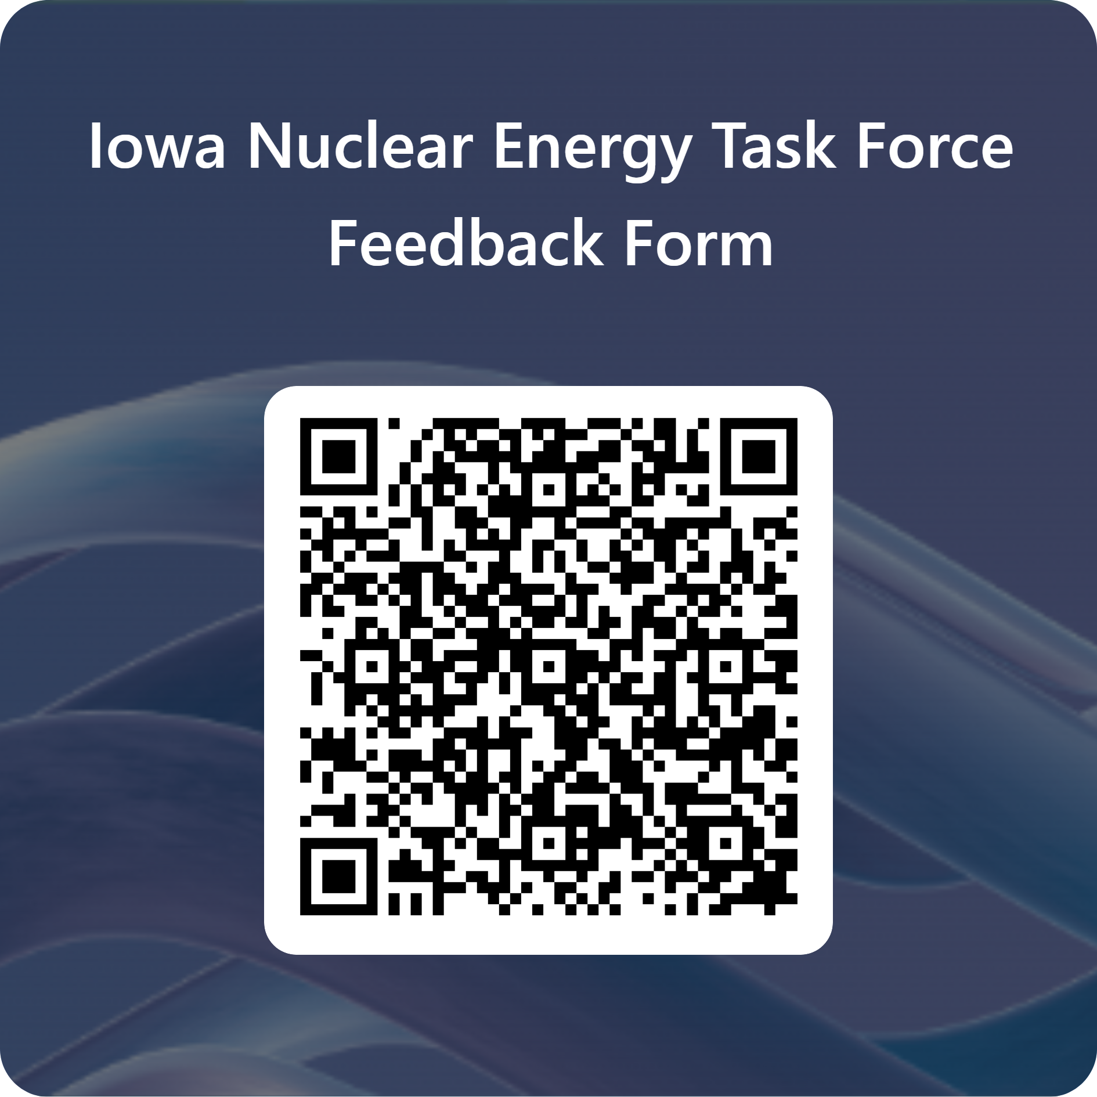
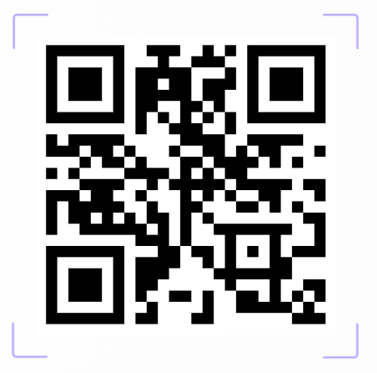
Resources and Next Steps
Iowa Nuclear Energy Task Force Website
Iowa Nuclear Energy Task Force Meeting 4
April 20, 2026, 9:00 am CDT
Cedar Rapids, IA

