Slide 1
CDBG-DR Non-Federal Match Program
Voluntary Home Buyout and Demolition
Application & Implementation
Robert Wick | CDBG Team Lead
Iowa Economic Development Authority

Slide 2
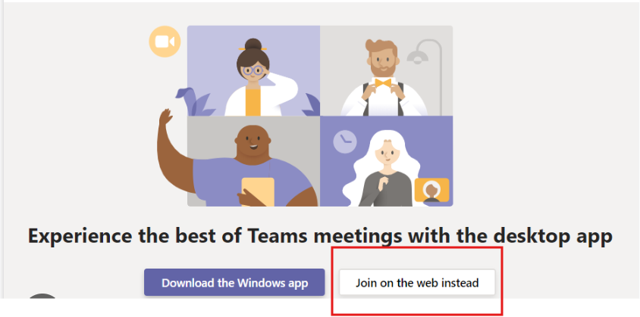
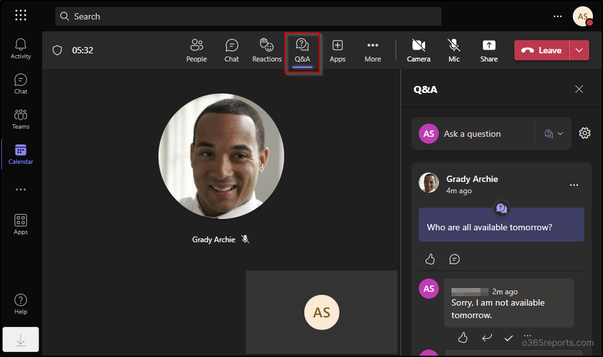
Housekeeping
How to access a live Teams meeting on your web browser
To join the meeting:
Select “Join on the web” or “Continue in this browser.”
To comment:
Click the Q&A chat button and ask your question by putting your comment directly in the chat.
Notes:
When accessing a Microsoft Teams meeting through a web browser, the Q&A feature—if enabled by the meeting organizer—appears as a Q&A tab in the meeting interface. This tab is typically located alongside other meeting controls such as Chat, Participants, and Reactions. Clicking on the Q&A tab opens a pane where attendees can post questions, reply to others, and upvote questions.
Sign-In Requirement: To access the Q&A feature via a web browser, attendees must be signed in with a Microsoft account. Guests or anonymous users may not see the Q&A tab.
Browser Compatibility: The Q&A feature is supported in most modern browsers, including Chrome, Firefox, and Edge. However, functionality may vary, and using the latest version of the browser is recommended.
-> Can ask q’s in the chat at any time; however, due to the length of this webinar, we will NOT be having a live Q &A session – we want to get specific questions from applicants and provide detailed answers and instructions in the form of a n FAQ.
-> All submitted questions will be consolidated and a detailed FAQ will be posted to the website for all attendees to view.

Slide 3


For the Buyout & Demo portion of the Nonfederal Match Program, IEDA has acquired the assistance of ICF, Inc. to provide program management assistance.
Due to the nature of the project volume associated with this program, ICF will assist IEDA with the Recipient and Certified Grant Administrator engagements to resolve "first tier" review of Application Review, Status Reports and Claims.
This will help expedite Applications, Technical Assistance, and general project management for this program specifically.
IEDA will retain "second tier +" reviews and still be available to ALL project stakeholders throughout the entire course of the program!
Alexsis Fleener
Grant Manager Lead
Alexsis.Fleener@icf.com
Christopher Taormina
Grant Manager
Christopher.Taormina@icf.com
Notes:
For the Buyout & Demo portion of the Nonfederal Match Program, IEDA has acquired the assistance of ICF, Inc. to provide program management assistance.
Due to the nature of the project volume associated with this program, ICF will assist IEDA with the Recipient and Certified Grant Administrator engagements to resolve "first tier" review of Application Review, Status Reports and Claims.
This will help expedite Applications, Technical Assistance, and general project management for this program specifically.
IEDA will retain "second tier +" reviews and still be available to ALL project stakeholders throughout the entire course of the program!

Slide 4
Welcome/Agenda
Workshop Overview
  Purpose and Goals
Program Introduction
  2024 CDBG-DR and Non-Federal Match Program
  Voluntary Home Buyout and Demolition
Application Overview
  Updates
  Navigating the Application Process
Implementation
  Compliance
  Stakeholder Involvement

Slide 5
Workshop Objectives
By the end of this workshop, participants will be able to:
Understand the CDBG-DR Non-Federal Match Program
  AKA "Buyout & Demo program"
Leverage CDBG-DR Funding for Local Match
Plan for Implementation and Compliance
Engage Community Stakeholders
Navigate the Application Process

Slide 6
Program Background
Action Plan Summary
IEDA received $134.7 million in CDBG-DR funds for long term recovery from the June 2024 Midwest Flooding (DR-4796-IA)
Key priorities:
  Rebuilding resilient housing.
  Repairing and upgrading damaged infrastructure.
  Providing non-federal match for HMGP and PA projects.
  Ensuring at least 70% of funds benefit low – and moderate-income (LMI) populations.
  Ensuring 80% of funds are spent in HUD-identified Most Impacted and Distressed (MID) areas.

Slide 7
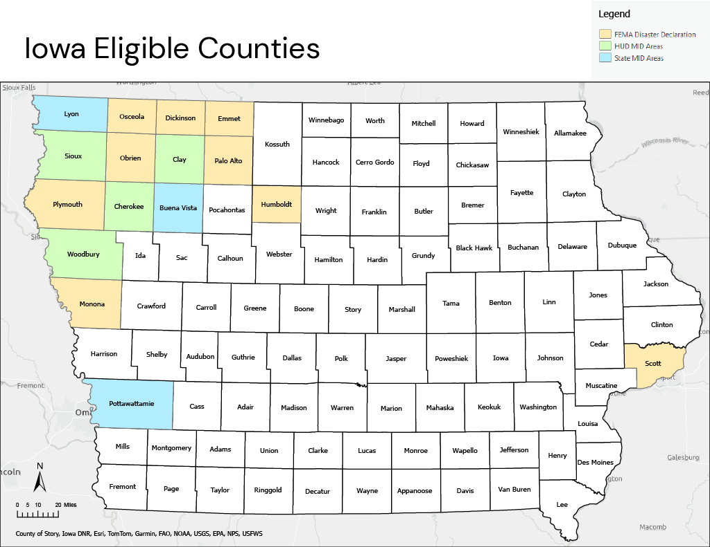
Eligible Counties
Buena Vista**
Cherokee*
Clay*
Lyon**
Pottawattamie**
Sioux*
Woodbury*
*HUD-Identified MID
**State Identified MID

Slide 8
Program Background
CDBG-DR Non-Federal Match Program
Designed to help local governments meet the 25% non-federal cost share required for FEMA's Hazard Mitigation Grant Program (HMGP) and Public Assistance (PA) project.
Local governments apply for CDBG-DR funds to cover all or part of the required 25% non-federal match.
The CDBG-DR funding is used to fulfill the Local Cost alongside PA and HMGP applications. This ensures that the financial burden to local government is sheltered.

Slide 9
CDBG-DR Voluntary Buyout and Demolition Overview
Key Program Eligibility and Considerations
Property Requirements
  Must be in a Special Flood Hazard Area (SFHA) and a federally declared disaster area.
  Properties listed in the CDBG-DR Application must match the HMGP application property list.
  Properties must be owner-occupied.
HUD Compliance
  Each property must meet a HUD National Objective.
  Low-to-Moderate Income (LMI) households automatically qualify.
  Urgent Need may be used.
Prioritization
  LMI counties prioritized in the Federal MID: Cherokee, Clay, Sioux, Woodbury.
  Clusters of repetitive-loss or flood-prone structures encouraged for maximum community benefit.

Slide 10
Implementation Considerations
Project Sequencing
  Align HMGP and CDBG-DR timelines to ensure match availability before closings.
  Submit CDBG-DR match applications once HMGP eligibility is confirmed.
Duplication of Benefits
  Track all recovery funding sources.
  Ensure CDBG-DR funds do not duplicate other federal aid.
Post-Demolition Land Use
  Plan for long-term maintenance and monitoring of open space.
  Develop local policies for signage, fencing, and community recreation access.

Slide 11
Project Budget & Cost Share
Funding Split
  75% FEMA (HMGP/PA), 25% CDBG-DR for local match.
Grant Management
  Up to 10% of budget for administration.
Typical Costs
  Appraisals, title searches, surveys.
  Acquisition fees, environmental abatement, demolition.
  Grant management.

Slide 12
IEDA & Local Roles
Agency Responsibilities
IEDA is the lead agency for CDBG-DR, setting program policy and overseeing all subrecipients, as well as overseeing;
  HUD requirements, duplication of benefits, procurement, and URA/Section 104(D);
  Grant administration and technical assistance;
  EHP review following FEMA guidelines;
  Collect subrecipient data, file quarterly performance report;
  Public engagement, including hearings and comment management.

Slide 13
IEDA & Local Roles
Local Responsibilities
Local Governments have responsibilities as subrecipients, such as;
  Prepare and submit complete applications, including required resolutions, policies, and supporting documentation related to implantation and contract management;
  Submit quarterly status reports;
  Track all spending to prevent DOB;
  Encourage public engagement and citizen participation;
  Submit timely reimbursement requests.

Slide 14
IEDA & Local Roles
Certified Grant Administrator (CGA) Responsibilities
Local Governments will be reliant upon CGA's to ensure applications and projects can be compliant and successful;
  Assist Local Government in all application preparation & completion steps;
  Assist Local Government in administration of awards, including timely quarterly status reports & claims;
  Assist Local Government & Vendors with compliance with all Cross-Cutting requirements (Davis-Bacon, Section 3, Procurement, etc.);
  Track all spending to prevent Duplication of Benefits;
  Meet requirements of IEDA's CGA Policy & CDBG Management Guide;

Slide 15
IEDA & Local Roles
Certified Grant Administrator (CGA) Responsibilities
NEW Grant Administrators must contact IEDA to start training for Certification
IEDA will provide any new COGs or Consultants with access to the revised CGA Policy for review and affirmation, as well as the new "CDBG Basics" 4-part course, which will require an 80% pass rate on the knowledge check to achieve a Conditional Certification to perform on CDBG or CDBG-DR Programs.
Upon completion of the cycle of 'Third Thursdays with CDBG', Conditional
Certification novates to full certification.

Slide 16
Application Review
Brief overview of the application process and guide through the application forms;
Opportunity to point out new changes for all CDBG and CDBG-DR apps in 2026

Slide 17
Application Process
Project Identification & HMGP Application
  Identify eligible properties and engage property owners.
  Complete HMGP application.
LMI Survey & Income Verification
    HUD compliant surveys must be completed for each household at the time of application.
2. Prepare CDBG-DR Application Materials
  Complete required forms, develop project budget and timeline
3. Submit CDBG-DR Application
  Upload all materials to IowaGrants.gov.
4. State Review
  IEDA reviews the application for eligibility and compliance.
5. Award & Contracting
  Receive award notification and execute grant agreement.

Slide 18


Slide 19
Buyout / Demo Program Required Documentation
Full HMGP Application
Approved Long Term Maintenance Plan
Property Owner Voluntary Participation Form
Duplication of Benefits (DOB) Worksheet
Title and Ownership Documentation
Appraisal and Just Compensation Documents
Summary Table of Participating Properties
Disaster Areas Risk Reduction Map

Slide 20
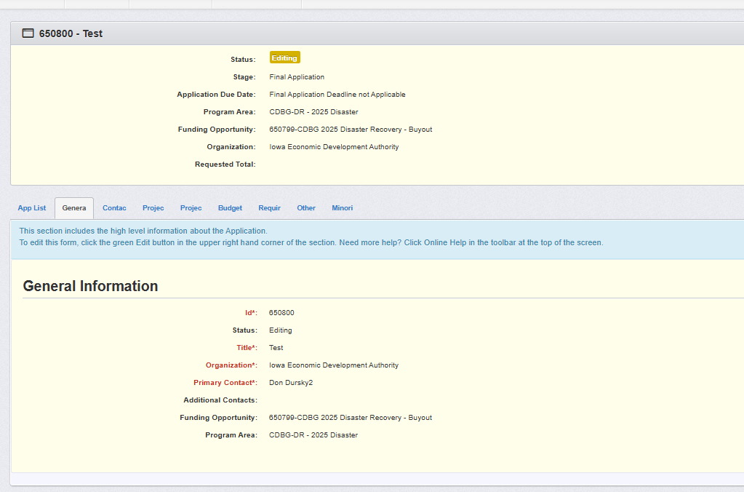
This section will populate once data in the app is entered & saved
Enter general data as shown here

Slide 21
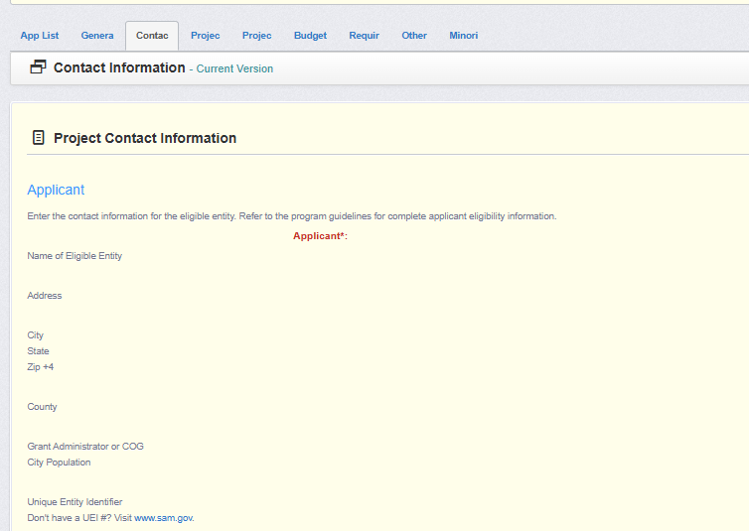
Enter general data as shown here
APPLICANTS MUST HAVE AN ACTIVE SAM/GOV ACCOUNT AND PROVIDE A UEI # IN ORDER TO APPLY!

Slide 22
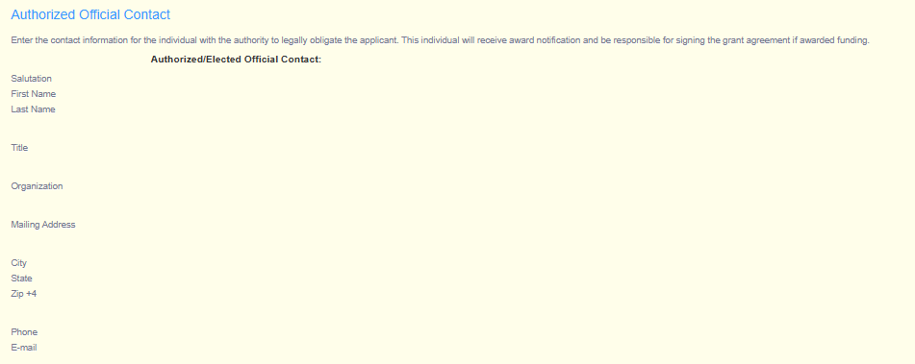
Enter general data as shown here

Slide 23
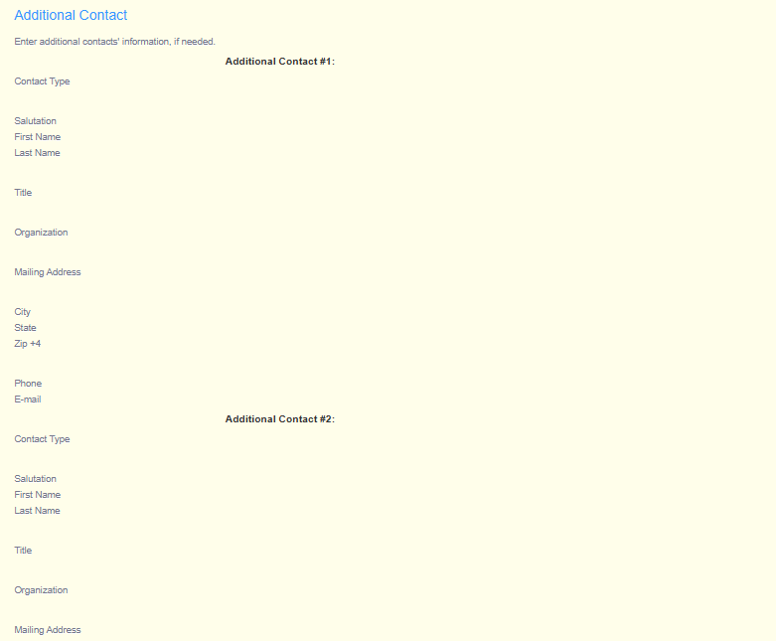
Additional Contacts section should be used for individuals performing unique roles, such as Architects / Engineers, Labor Compliance Officer or Project Managers, etc.

Slide 24
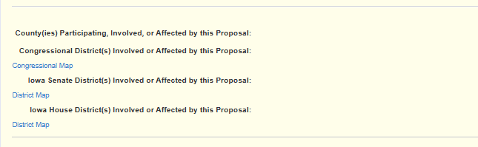
Include all political regional information

Slide 25
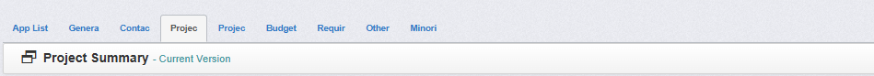
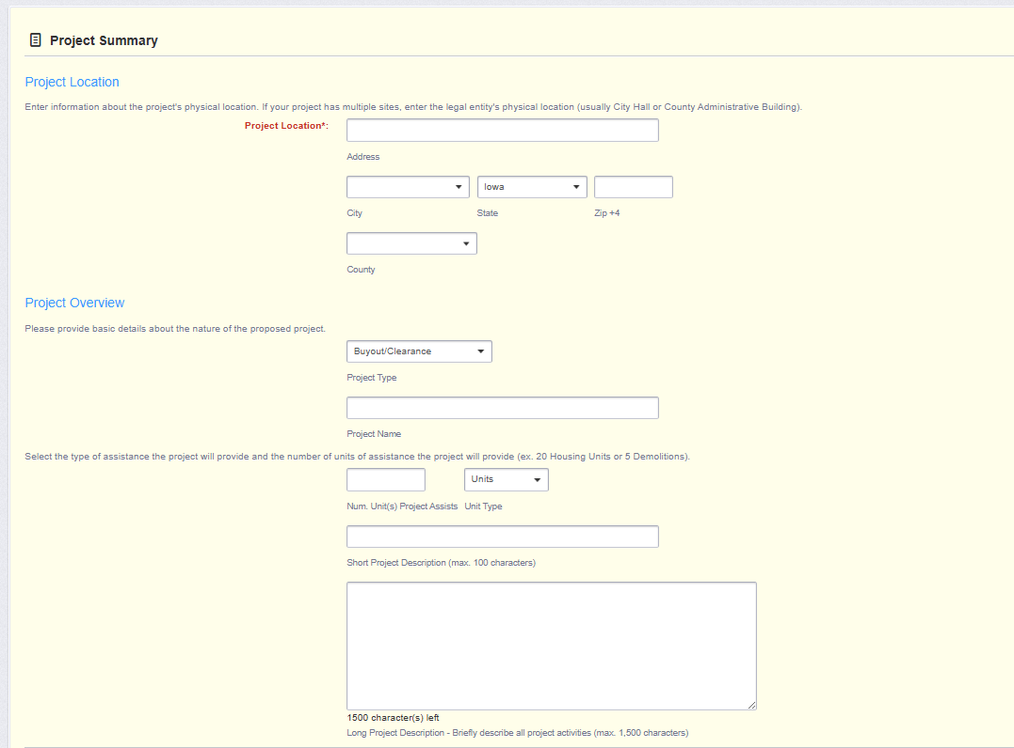
Project location information located in HMGP application; cite applicant primary address
Be sure to select “Buyout / Clearance from drop-down selection
Detailed narratives in this section

Slide 26
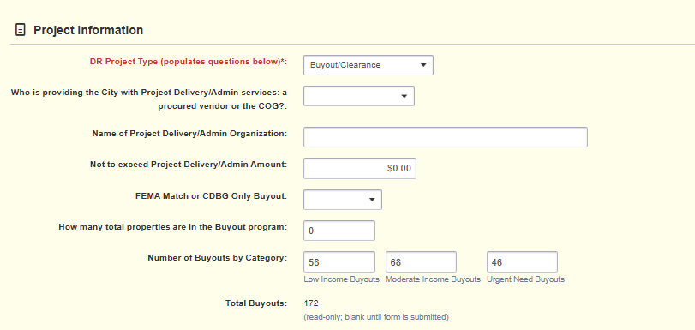
Again, be sure to select ‘Buyout / Clearance from the drop-down selection
Provide details for the Certified Grant Administrator the Applicant will be using.
(See IEDA’s CGA Policy)
Specify the beneficiary income group

Slide 27
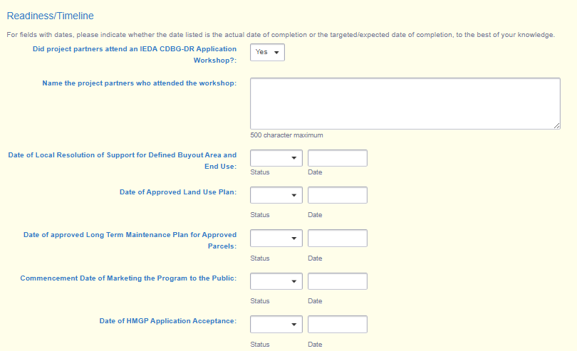
Provide “Targeted” or “Actual” milestone dates for each criteria listed

Slide 28
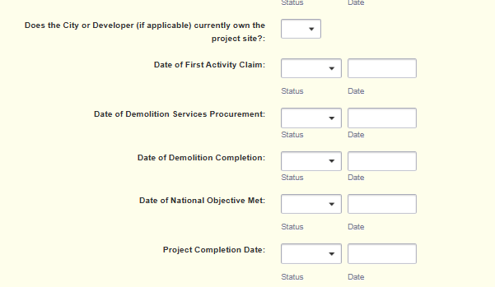
New for 2026 Applications under CDBG or CDBG-DR, the Applicant must provide targeted milestones that will be reflected in all awarded grant agreements and also will require similar status updates in Claim submissions.
Date of acquisition

Slide 29
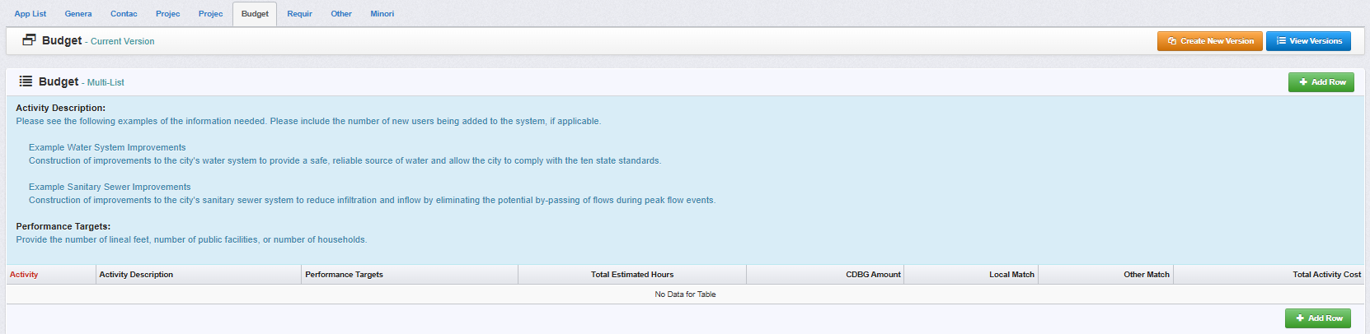
For the Budget section, we will show a few slides for entering in budgetary line items….

Slide 30
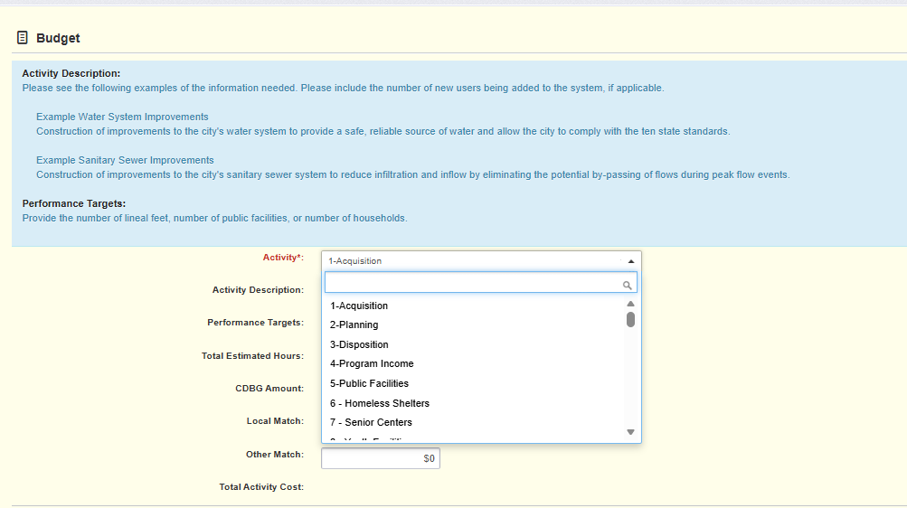
There are MANY options to select from; look for those specific to buyout and demo:
1- Acquisition (LMI)
75-Clearance/Demolition (LMI)
540PD-Buyout FEMA Match Project Delivery (LMI)
1- Acquisition (UN)
75-Clearance/Demolition (UN)
545PD-Buyout FEMA Match Project Delivery (UN)

Slide 31
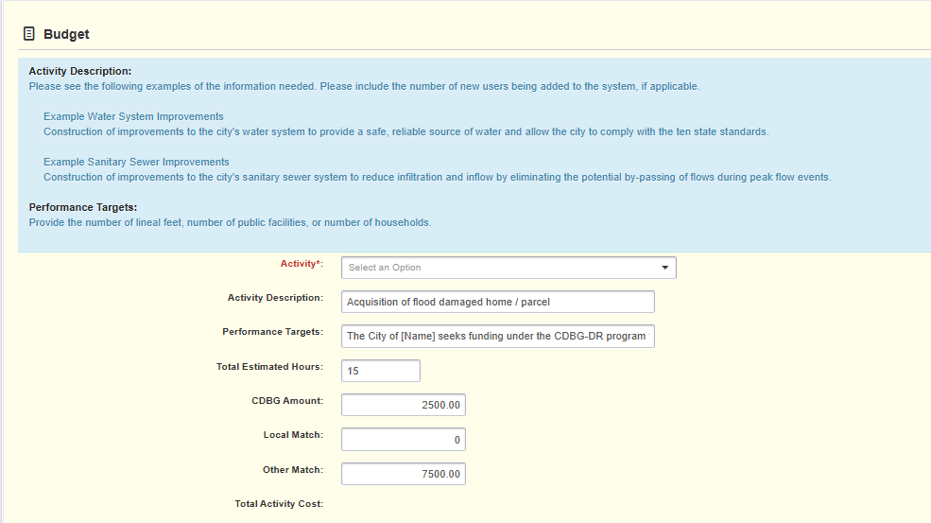
Use specific, realistic Performance Targets
Clearly cite the 25% share for the proposed CDBG-DR funds vs the “Other Match” 75% from FEMA HMGP Program

Slide 32
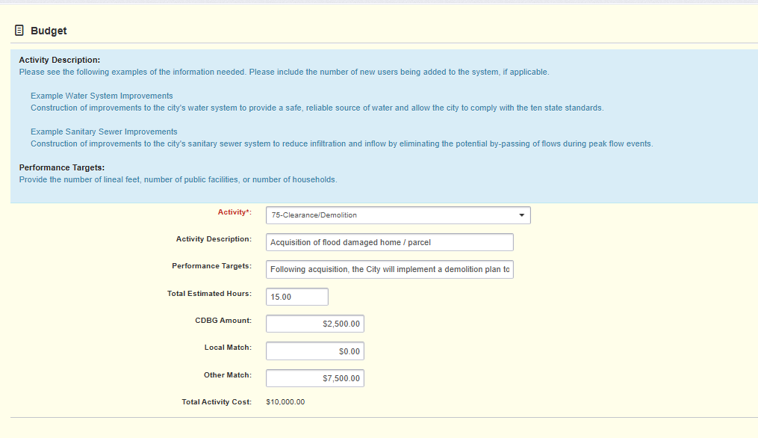
‘Clearance/Demo’ is the next Activity to select
Use specific, realistic Performance Targets
Clearly cite the 25% share for the proposed CDBG-DR funds vs the “Other Match” 75% from FEMA HMGP Program

Slide 33
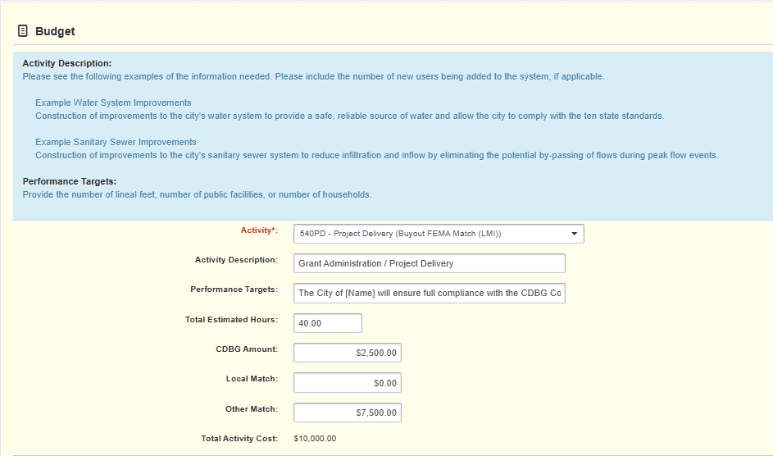
‘Project Delivery / LMI’ is the next Activity to select
Use specific, realistic Performance Targets
Clearly cite the 25% share for the proposed CDBG-DR funds vs the “Other Match” 75% from FEMA HMGP Program

Slide 34
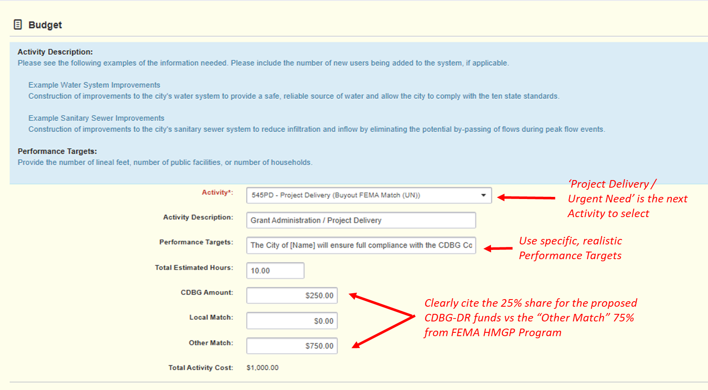

Slide 35
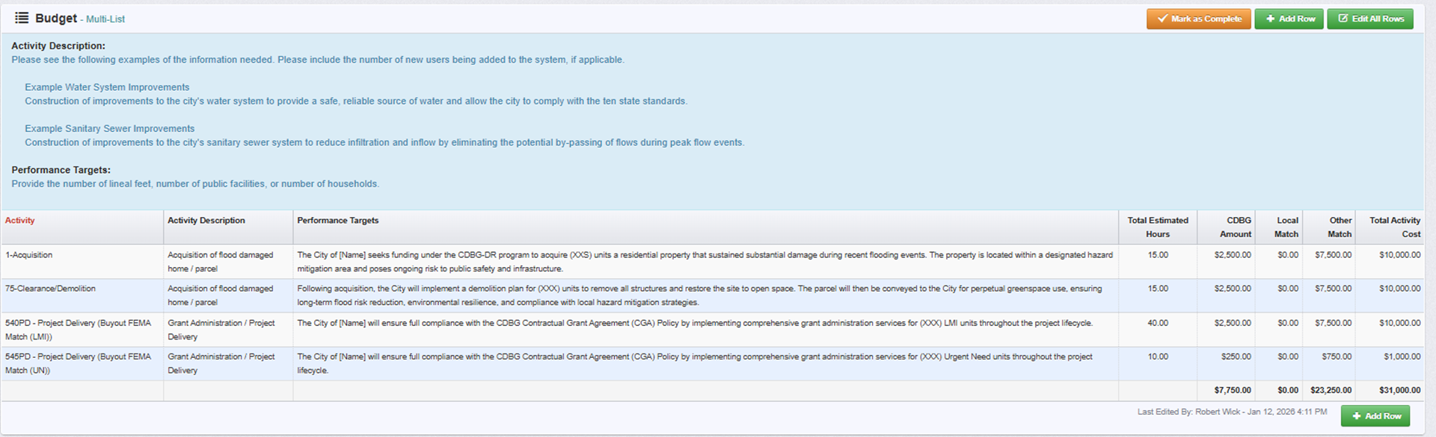
The end result!!
25%
75%

Slide 36
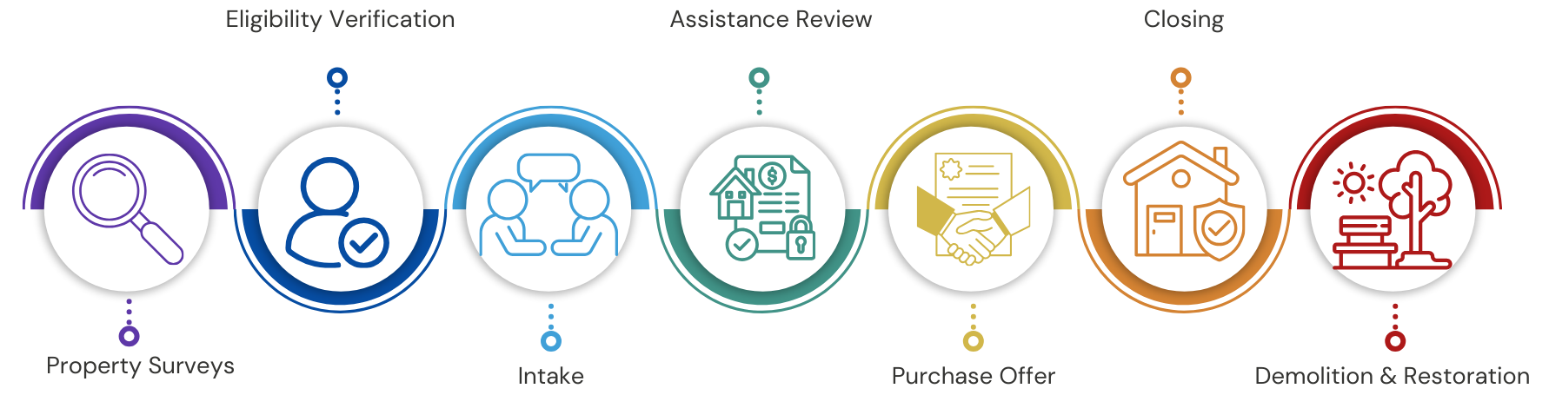
Implementation: Acquisition to Closeout

Slide 37
Environmental & Historic Preservation (EHP)
What is EHP?
A federally required review process under 24 CFR Part 58 to ensure projects comply with environmental laws and historic preservation standards before funds are committed or properties are acquired.
For this program, FEMA is Lead Agency for EHP processes; however, some properties may require additional coordination and documentation for site remediation, etc. Applicants should be prepared to collaborate with FEMA / HSEM and IEDA for adequate EHP document retention.
Key Requirements
EHP review must be completed prior to acquisition and/or demolition.
Items that must be included as part of an EHP review are as follows;
  Floodplain/wetland notices;
  Section 106 historic review;
  Endangered species checks, and;
  Public comment records.

Slide 38
Procurement & Compliance
Procurement Overview
All procurement must follow State & Federal guidelines, including;
  Public notifications / solicitations;
  Full and open competition;
  Written procedural programs;
  Conflict of Interest (COI) safeguards;
This applies to all contracts, goods, and services.
Action Plan Compliance Strategy
IEDA requires subrecipients to adopt procurement policies that comply with 2 CFR Part 200.
Templates provided by IEDA must be used for bid notices, evaluations, and contract awards.
Compliance is monitored for Civil Rights, Fair Housing, Section 3, and URA/Section 104(d) requirements.
Failure to meet these standards can result in repayment of funds or loss of eligibility for future awards.

Slide 39
Reporting & Claim Submittals
Quarterly Reporting
Submit status reports through IowaGrants.gov every quarter.
Reports must include project progress, financial updates, and compliance documentation.
Claims will not be processed if reporting is incomplete or late.
Claim Submittals (Requests for Reimbursement)
Use IEDA approved forms for claim submittals.
Attach all supporting documentation (receipts, invoices, etc.)
Maintain files for audit-readiness.

Slide 40
Best Practices for Participant Verification & Case Management
Informing Residents
Provide clear, concise talking points about the voluntary nature of the program.
The timeline should be clear and unambiguous.
Next steps should be outlined plainly.
Emphasize the benefits of risk reduction and the viability of financial assistance.

Slide 41
Best Practices for Participant Verification & Case Management
Person Centered Approach
Individualized support should be provided for each household interested and/or participating in the program.
All communications to residents should be culturally sensitive, clear, and accessible.
Translated materials should be available for non-English speaking households.

Slide 42
Resources & Tools
2024 CDBG-DR Flood Recovery | Economic Development & Finance Authority:
  https://opportunityiowa.gov/community/disaster-recovery/2024-cdbg-dr-flood-recovery
CDBG-DR Templates and Forms | IEDA:
  https://opportunityiowa.gov/community/community-infrastructure/cdbg-resources/management-guide#cdbg-management-guide-fillable-form-pdfs
Subrecipient Agreement | IEDA:
  https://opportunityiowa.gov/media/3201/download?inline

Slide 43
Resources & Tools
Certificate of Procurement | IEDA
  https://opportunityiowa.gov/media/3203/download?inline
eCFR :: 24 CFR 570.483 -- Criteria for national objectives.:
  https://www.ecfr.gov/current/title-24/subtitle-B/chapter-V/subchapter-C/part-570/subpart-I/section-570.483
HUD CPD Notice 14-13
  https://www.hud.gov/sites/documents/14-13cpdn.pdf

Slide 44
Resources & Tools
COSCDA Presentation on Income Surveys:
  https://coscda.org/wp-content/uploads/2023/03/CDBGIncomeSurveyToolkit_ErinnMartin-002.pdf
CDBG Income Survey Toolkit - HUD Exchange
  https://www.hudexchange.info/programs/cdbg/cdbg-income-survey-toolkit/
Conducting a Low-and Moderate – Income Survey:
  https://opportunityiowa.gov/community/community-infrastructure/cdbg-resources/cdbg-program-guidance-resources

Slide 45
Q&A
Questions? Please enter them into the chat, and we will provide a detailed FAQ!
Webinar recording, PowerPoint, FAQ and Program Guide will be available at:
https://opportunityiowa.gov/community/disaster-recovery/2024-cdbg-dr-flood-recovery

Slide 46
Please contact us if you have more questions!
Robert Wick | CDBG Team Lead
Iowa Economic Development Authority
Robert.wick@iowaeda.com
Alexsis Fleener
Grant Manager Lead
Alexsis.Fleener@icf.com
Christopher Taormina
Grant Manager
Christopher.Taormina@icf.com

Slide 47
THANK YOU
Robert Wick | CDBG Team Lead
Iowa Economic Development Authority

