Slide 1
2025
4% Housing Tax Credit Awards
December 3, 2025
Brian Sweeney | Tax Credit Director
Iowa Finance Authority

Slide 2
8
APPLICANTS
$18,201,281
4% TAX CREDITS REQUESTED
$125,027,383
TAX EXEMPT BONDS REQUESTED
5
AWARDS
$11,037,998
4% TAX CREDITS AWARDED
$76,402,467
TAX EXEMPT BONDS USED
781
LIHTC UNITS
Notes:
8 Applicants, $18,201,281 in 4% Tax Credits Requested, add $125,027,383 Tax Exempt Bonds Requested. 5 Awards, $11,037,998 Awarded and 781 LIHTC Units
3-4 Awards
$ Awarded
# LIHTC Units

Slide 3
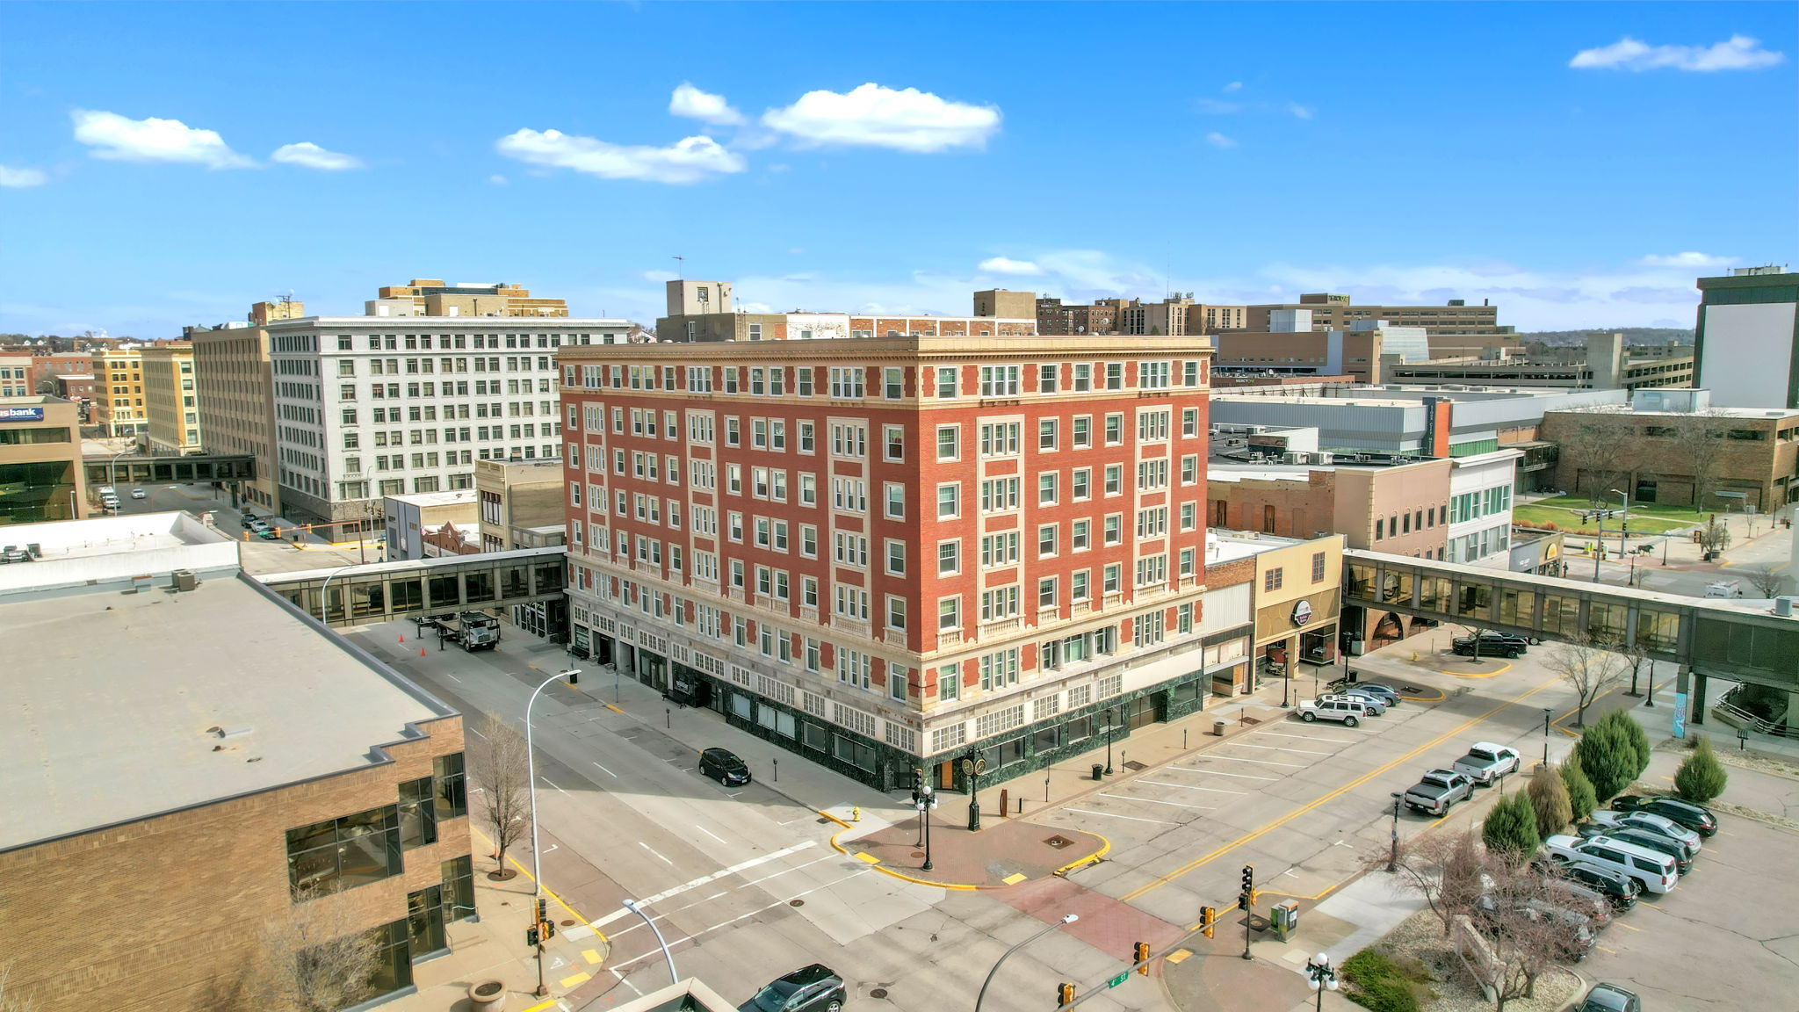
MARTIN TOWER APARTMENTS
SIOUX CITY
Acq/Rehab
Older Persons 62
86 LIHTC Units
Developer:
Steele Properties IV LLC
Total Development Costs: $16.7 Million
Tax Credits: $685,182
Tax-Exempt Bond: $5,215,000

Slide 4
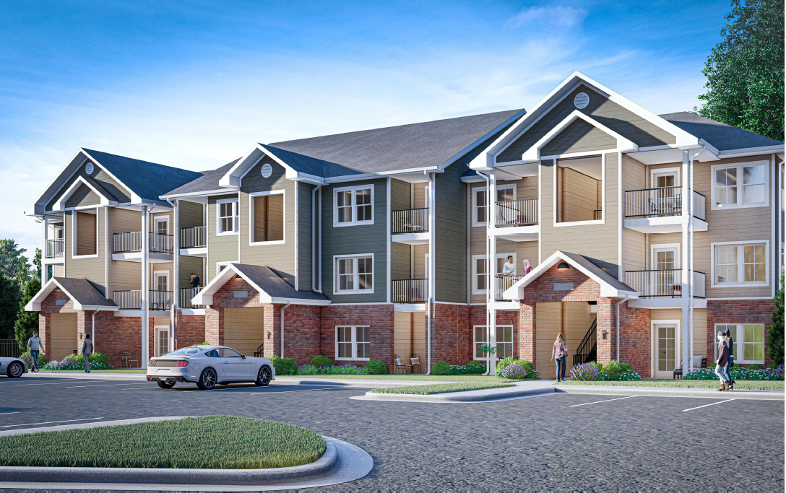
THE ATHENEUM
CEDAR RAPIDS
New Construction
Family
192 LIHTC Units
Developer:
Pedcor Development Associates, LLC
Total Development Costs: $62.2 Million
Tax Credits: $2,881,783
Tax Exempt Bonds: $20,282,551

Slide 5
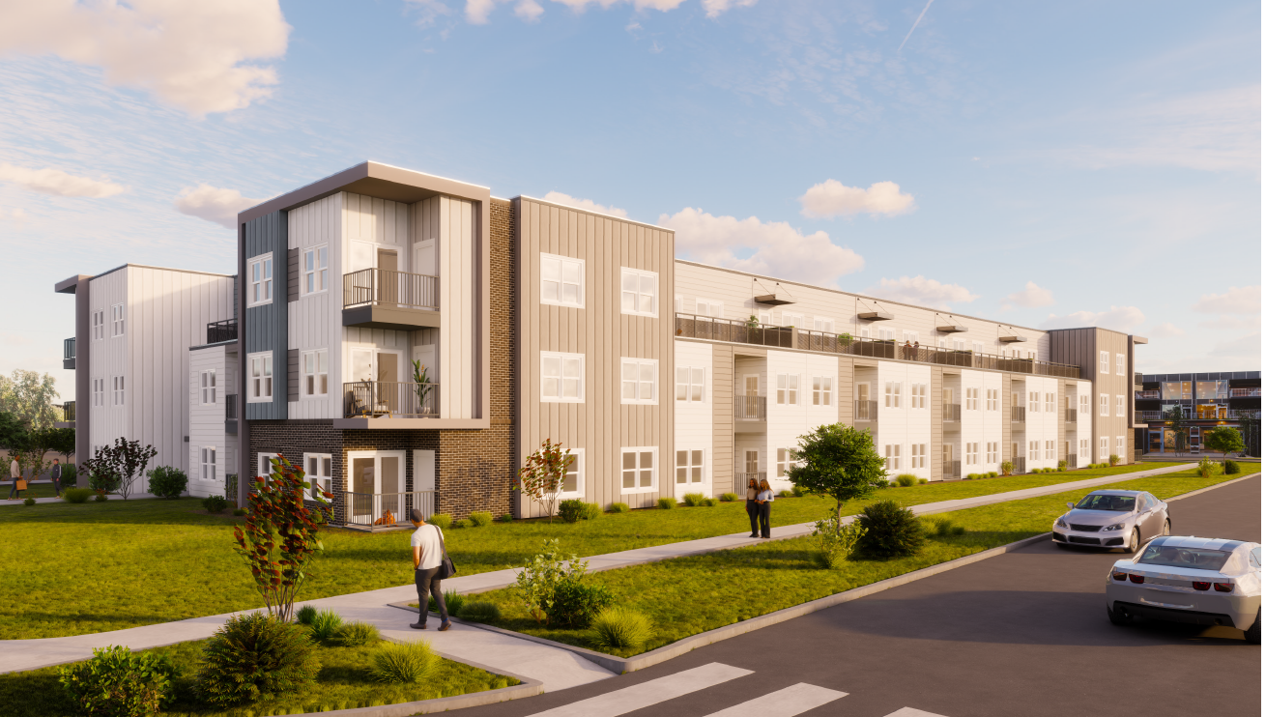
CENTRAL AT
ORCHARD COURT
IOWA CITY
New Construction
Family
183 LIHTC Units
Developer:
Union Development Holdings III, LLC
Total Development Costs: $61.9 Million
Tax Credits: $2,708,050
Tax Exempt Bonds: $19,794,458

Slide 6
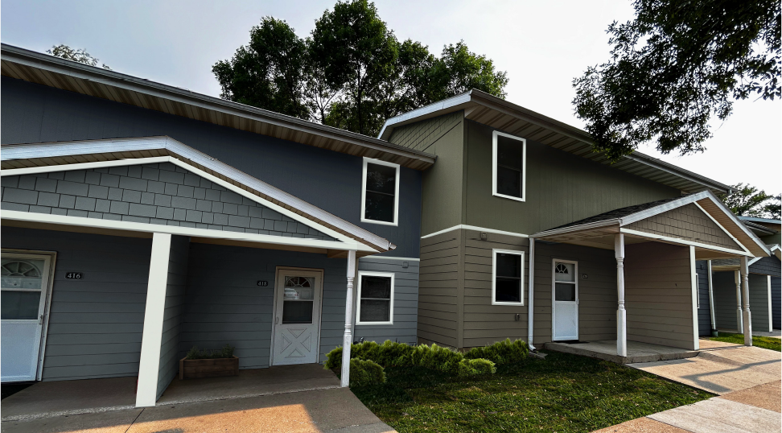
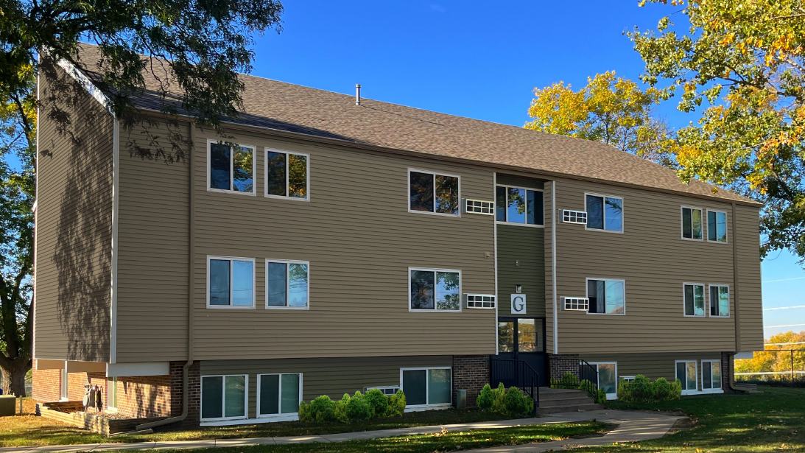
SIOUX CITY 3
SIOUX CITY
Acq/Rehab
Family
160 LIHTC Units
Developers:
Community Preservation Partners, LLC
Hampstead Development Partners, Inc.
Total Development Costs: $42.9 Million
Tax Credits: $1,790,122
Tax Exempt Bonds: $13,610,458

Slide 7
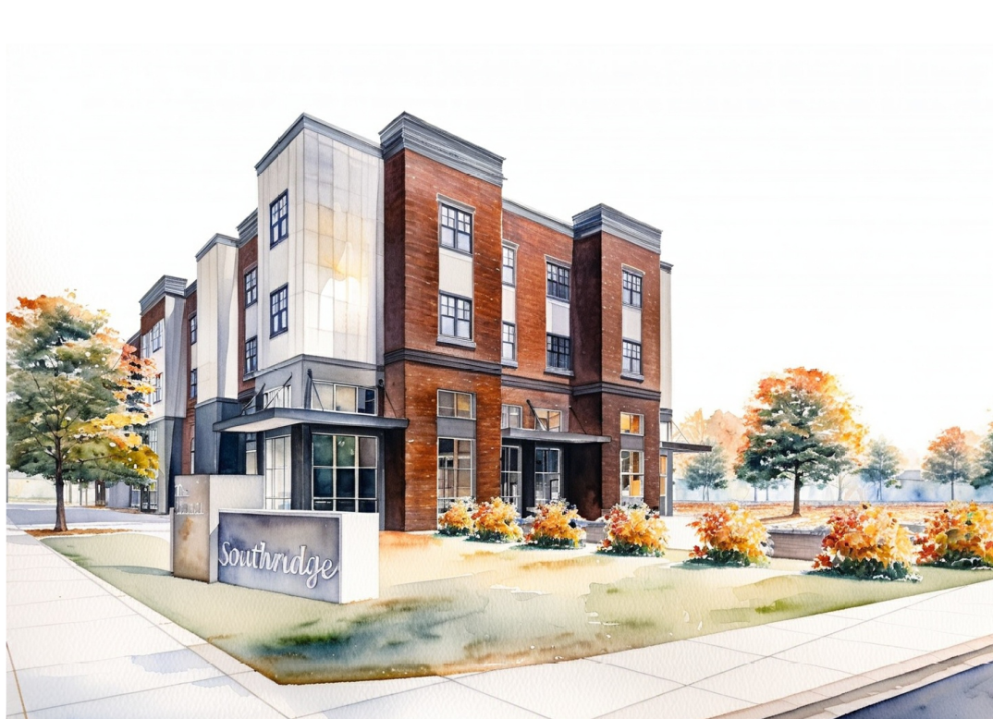
SOUTHRIDGE FLATS
DES MOINES
New Construction
Family
160 LIHTC Units
Developer:
ECG Southridge Developer, LLC
Total Development Costs: $62.1 Million
Tax Credits: $2,972,861
Tax Exempt Bonds: $17,500,000

Slide 8
THANK YOU
Brian Sweeney | Tax Credit Director | brian.sweeney@iowafinance.com | 515.452.0460
Iowa Finance Authority

