Slide 1
A holistic approach to affordable housing and community development

Slide 2
THE PROJECT
TOWNHALL FOODHALL & APARTMENTS
is a comprehensive model of neighborhood development that seeks to address the need for affordable housing while fostering inclusivity, community gathering, and economic opportunities.
TOWNHALL FOODHALL & APARTMENTS
Notes:
Kuuku: Introduce the project
Tell your story

Slide 3
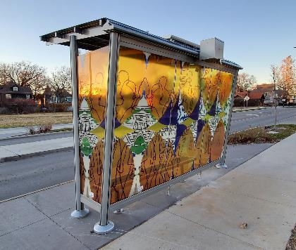
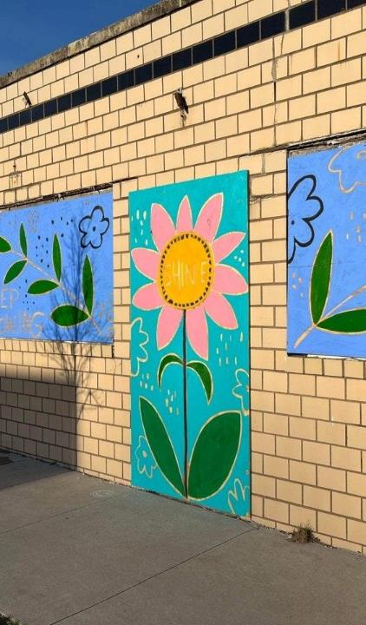
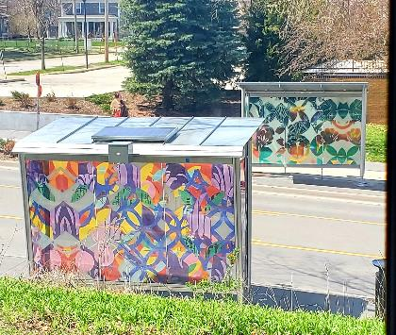
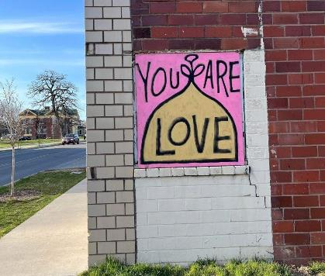
FOR THE NEIGHBORHOOD

Slide 4
TEAM
Kuuku Saah
Ntontan RE
Managing Partner
Rocio Hermosillo
Ntontan RE
Partner
Ryan Osburn
Ntontan RE
Project Manager
Frank Levy
Newbury Living
President
Bob Rafferty
Rafferty Group
Principal
Brent Schipper
ASK Studio
Architect
Rachel Hoffman
ASK Studio
Interior Designer
Meshallah Muhamad
ASK Studio
Interior Designer
TOWNHALL FOODHALL & APARTMENTS

Slide 5
LIVING BUILDING
Resident
+
Community
Ecology Of Place
Human-Scaled Living
Responsible Water Use
Energy & Carbon Reduction
Responsible Materials
Universal Access
Inclusion
Beauty & Biophilia
Education + Inspiration
Healthy Interior
TOWNHALL FOODHALL & APARTMENTS

Slide 6
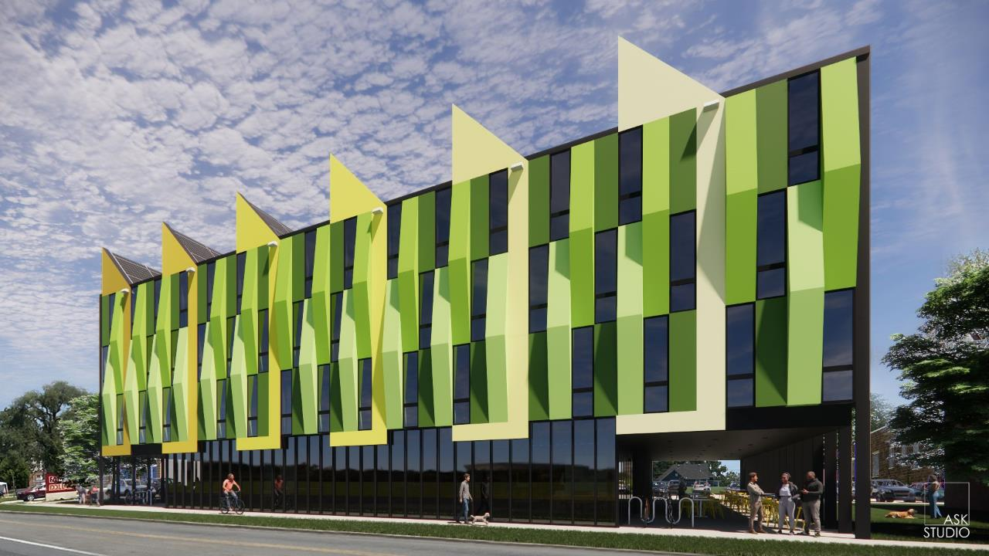

Slide 7
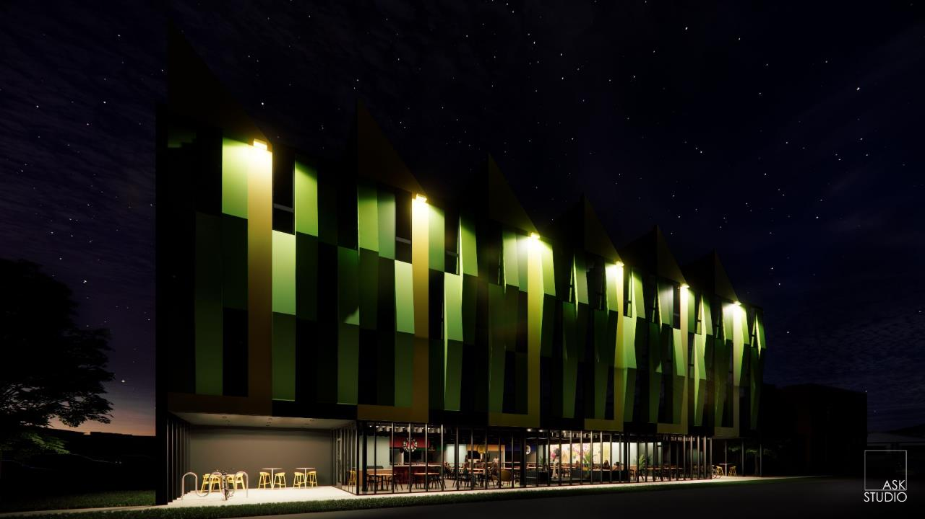
Notes:
Building at night to show the full day use

Slide 8
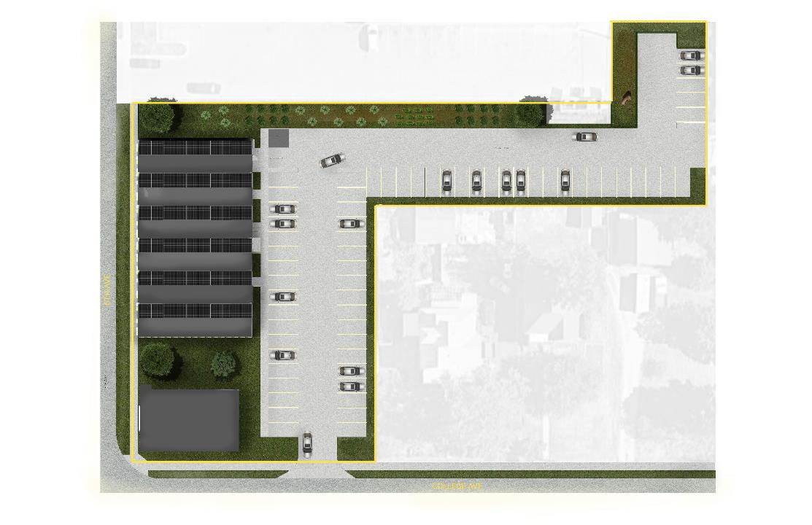
GREEN SPACES
TOWNHALL FOODHALL & APARTMENTS
Notes:
Community gardens
Pet area

Slide 9
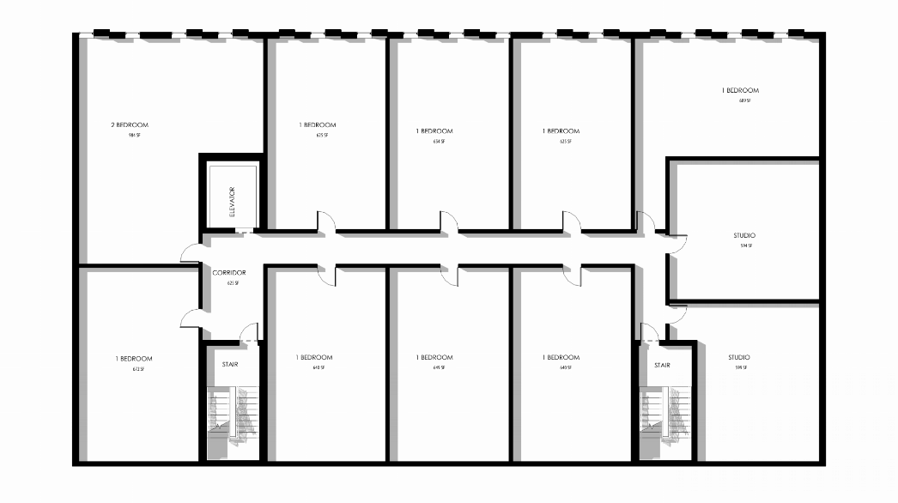
FLOOR PLAN
TOWNHALL FOODHALL & APARTMENTS

Slide 10
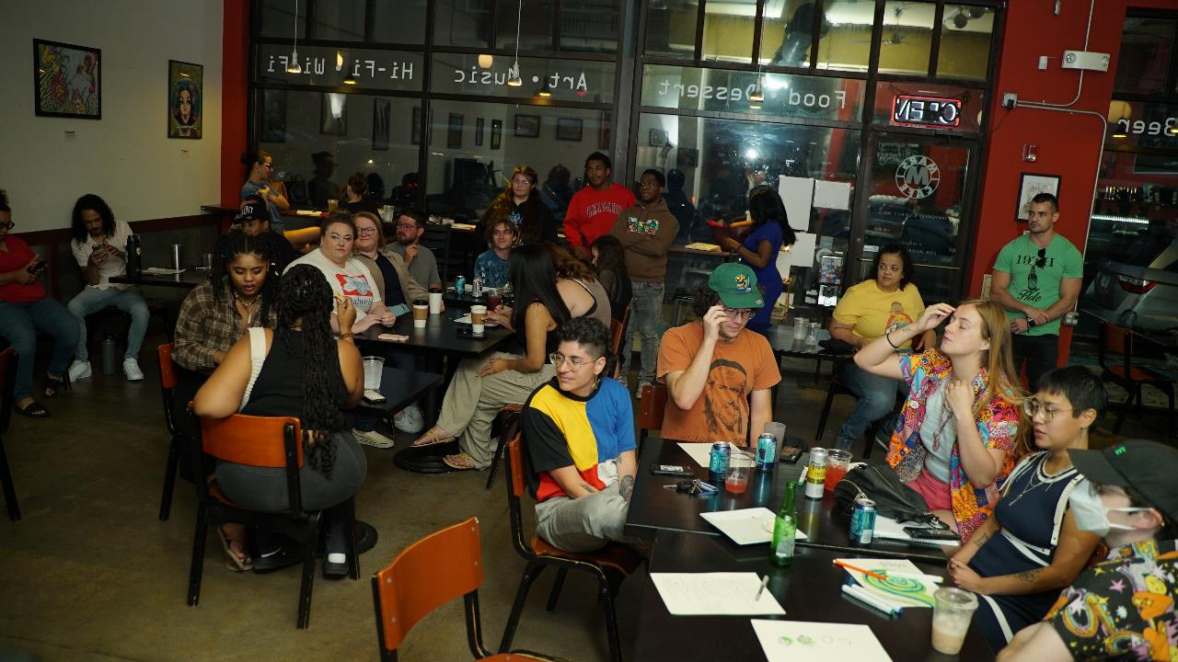
COMMUNITY SPACES
Notes:
The importance of gathering
Need for community space from survey
- Coffee Shop
- Bakery
- Casual Dining Eatery
Power of community spaces – Mars Coffee
- Chess with police officer
- Adam’s Alaska trip
- Chaden Tie

Slide 11
RISE OF THE HALL
TOWNHALL FOODHALL & APARTMENTS

Slide 12
RESTAURANT COSTS
Restaurants
Food Halls
$250k
to
$2m
Ghost Kitchens
Start-up Costs
$5k
$50k
$3.5k
$1.4k
$2k
Monthly Rent
TOWNHALL FOODHALL & APARTMENTS
Notes:
Problem
There is a correlation between neighborhoods that don’t have space for their youth to work or community to gather and crime.
People have gathered around food since the beginning of community.
There is a food gap in the Iowa market. The cost of starting a restaurant is prohibitively expensive. The cost of failure is high and ruinous.
A recent option has been Open Kitchens. Open Kitchens give the opportunity for people with good recipes to share with the world. Just because you make the best jollof doesn’t mean you are equipped to run a restaurant.
Longer leases for restaurants. Open kitchens can be rented per hour but don’t offer a lot of protection for users.
Solution
Food halls. They help bridge the gap between open kitchens and restaurants.
Startup costs are not ruinous. We are reducing the costs of failure which allows people to take a little more risk

Slide 13
THE FOOD HALL
4
Kitchens
1
Coffee Shop
$1,700
Rent
$25k - $50k
Startup costs
5,000sqft
Indoor Community Space
2,000sqft
Green Space
TOWNHALL FOODHALL & APARTMENTS

Slide 14
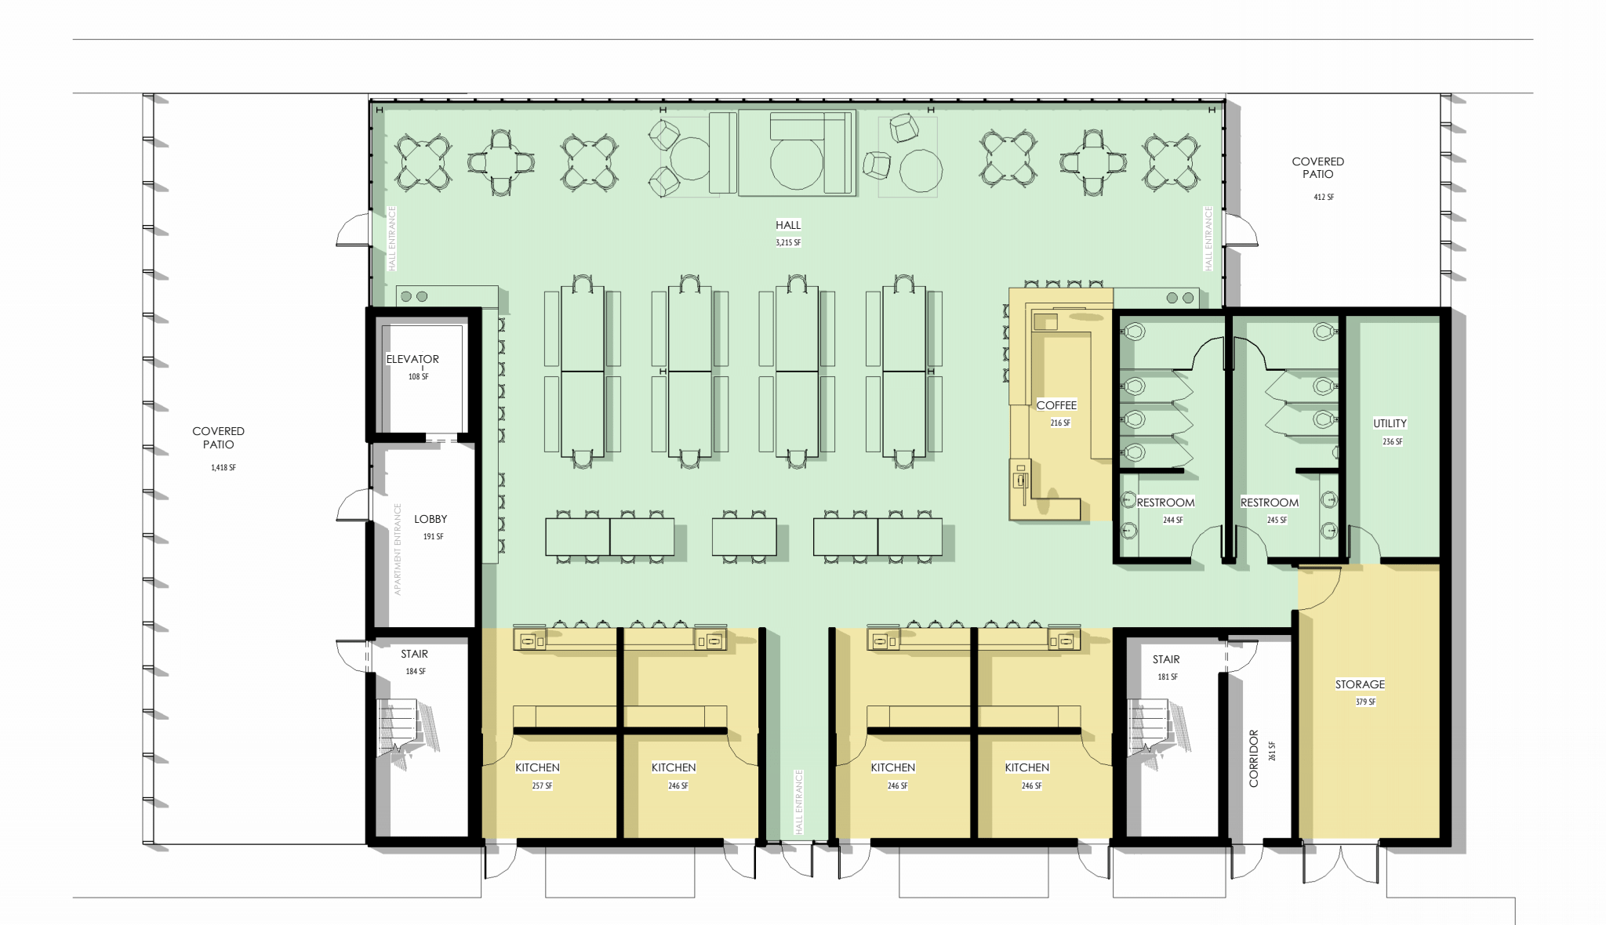
FLOOR PLAN
TOWNHALL FOODHALL & APARTMENTS

Slide 15
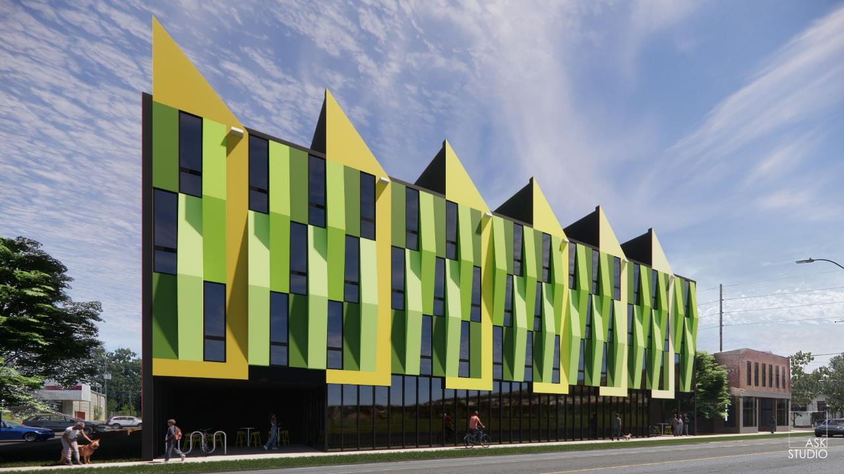
RESIDENTS AT THE CORE

Slide 16
NUMBERS
ESTIMATED Cost
$12,500,000
Income - residential
33 units
$240k/year
USES
Land - $1,350,000
HARD COSTS - $8,800,000
Soft Costs - $2,500,000
Expenses - residential
$6,000/unit/year
$200k/year
TOWNHALL FOODHALL & APARTMENTS

Slide 17
SUPPORT
The proposed project integrates an essential array of truly innovative and catalytic components for our district – equitable ownership and inclusive development, affordable housing that truly empowers residents, sustainable design, and accessible entrepreneurial opportunities.
Breann Bye
Executive Director, 6th Avenue Corridor
Fostering a future of sustainability in a neighborhood of such rich history will help connect the past, present and future in ways that will breathe new life into our community.
The Community Food Market concept is another exciting aspect of the proposal. It presents an opportunity to not only
provide a unique culinary experience for residents but also to support local artisans and entrepreneurs.
Kathy Hellstern
President, River Bend Neighborhood Association
The integration of sustainability, the focus on local entrepreneurship through the Food Hall, and the dedication to creating inclusive and affordable housing solutions demonstrate a holistic and forward-thinking strategy that will undoubtedly positively impact our community.
Senator Izaah Knox
17th District
The project would be a great ‘win’ for the city and the adjacent neighborhood because of its proposal to add vitality and density to the 6th Avenue corridor, which has already seen significant public investment by way of streetscape and transit improvements.
City Manager
City of Des Moines
It’s an impressive project that bundles sustainability and inclusivity into a project for a diverse neighborhood
Carl Voss
At-large, Des Moines City Council
TOWNHALL FOODHALL & APARTMENTS

Slide 18
WRAP-UP
A holistic approach to affordable housing development with the resident and community at the core.
Partnerships
& Financing
Building for the neighborhoods
Long-term resident wellness
TOWNHALL FOODHALL & APARTMENTS

Slide 19
